Slide 1
Community Events Strategy
Workshop
Presented by WDC Staff and Xyst Consultants
July 2023

Slide 2
Purpose:
To provide an overview of events as they currently are
Discuss the scope of the events strategy
Seek input into the strategic direction

Slide 3
Agenda
Overview of current state
Trends in the events space
Outliers and considerations
Rationale for strategy
Proposed strategic options
Implications
Next steps

Slide 4
Community Events: Current State
Receive and process:
Community-run events
Community sports
Commercial events on WDC land (e.g. Sound Splash)
Community volunteer activity
Considerations:
Physical space always the primary stakeholder
Safety and suitability lens applied to every event – complex and changes by location

Slide 5
Event Officer Role (1x FTE)
The Events Officer does end to end processing of event applications. This includes:
Support
Approval
Safety
Fees and charges
Advocacy and advice
Compliance
Event evaluation
Notes:
Support - Providing event organisers with advice and information;
Approval – Coordinating and facilitating the Council event approval process, including liaison with various internal teams to seek feedback and sign off and act as a main point of contact for event organisers;
Safety - Actively facilitate risk management with event organisers to ensure the safety of event attendees and staff;
Fees and charges - Ensuring appropriate fees and charges are in place for venue usage, application fees and permits;
Advocacy and advice - Advising stakeholders during the event planning stage to deliver best-practice events;
Compliance - Providing event organisers with a clear understanding of event compliance requirements and legislative requirements of Council, and contacts for other relevant authorities;
Event evaluation - Facilitating event monitoring and post-event evaluation of the impact

Slide 6
5-year overview
(Excluding current year)
 | 2018 | 2019 | 2020 | 2021 | 2022
Central | 80 | 77 | 45 | 37 | 61
North | 32 | 34 | 30 | 20 | 35
South | 66 | 70 | 63 | 62 | 66
Total | 178 | 181 | 138 | 119 | 162

Slide 7
Internal teams involved in processing event applications :
Parks Officers for all events on open space
Zero Harm/Health and Safety team for medium or high risk events
Liquor Licensing/Environmental Health team for events with alcohol and food sales/ stalls
Waste team for large events where a waste plan needs to be developed
Traffic management plans are processed by external provider at the Alliance
All events need to provide a hazard register (templated), medium to high-risk events must produce an event management plan (no set template)
If resource consents are required – this is dealt with by the relevant regulatory teams and not directly included within the event application process

Slide 8
Sound Splash
Only (current) commercial event for our district
Consented for 10 event, one per year
Consented for 10,000 people
Considerations:
What is the total coast to WDC? No charge out rates for our team set
What is the benefit to the community?
What additional accountability is required?
What is the long-term impact to the reserve?
Relationship with Iwi and Community Board
Reputational impact to Council
Next steps:
Internal recommendation
Meeting with event organisers
Agreed condition changes

Slide 9
Partnership with Mana Whenua
Currently an ad hoc process
Captured in some, but not all, RMPs
Environmental consideration of significant sites
No single process, each is dependent on the space and the event
Sound Splash – Partnership is captured in consent as a requirement
Known desire to be more enabling with significant events such as Koroneihana

Slide 10
Out of scope
Cycling
Motorsports
Filming
ANZAC parades
Christmas/New Year Parades
Civic events
WDC run events e.g., Dirty Dog/park openings

Slide 11
Trends
Majority of events are small, low risk events
The one size fits all application form and process is not considered fit for purpose, especially when it comes to sports field bookings
There is a growing need for events that require traffic management
Increase in sports codes wanting to use limited resource.
Increased interest in sports codes self-managing and to some extent working together
A small number of reserves seem to have most bookings for events
There appear to be a lower number of events held in the northern area of the district
Recent participation and attendance rates indicate a growth in popularity of many sporting events and leisure activities. These events include runs, walks, cycling races, and triathlons

Slide 12
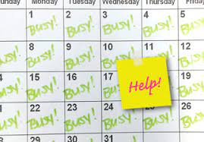
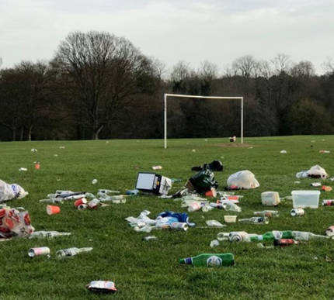
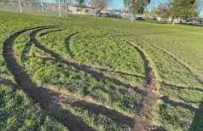

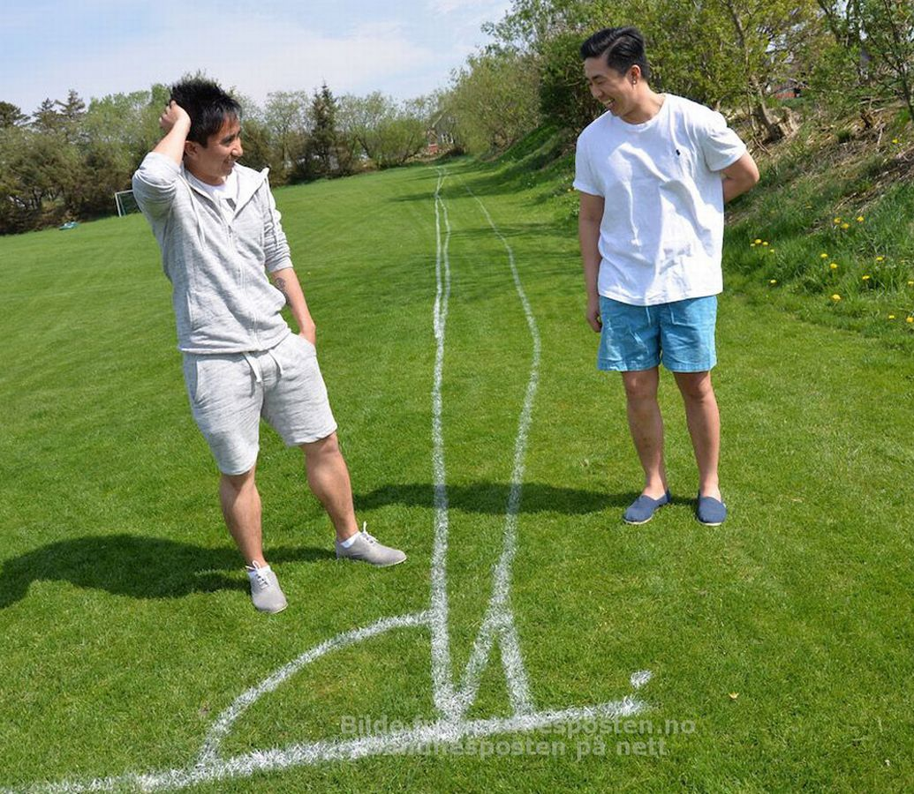
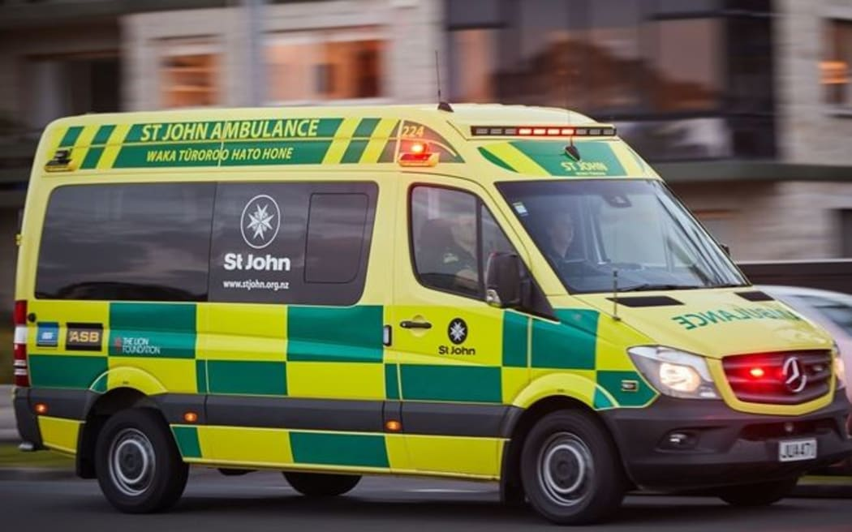
Rationale: Why bother?

Slide 13
Rationale: Why have a strategy
Strategy is a way to set Council and community up for success
Clear and accessible booking process that aligns with competing influences (RMP, maintenance etc)
Sets clear rules and guidelines up front
Give us a backbone and creates consistency and fairness
Identifies our risk appetite
Aligns with our values
Sets a road map and creates accountability and measures for success
Helps to allocate resource
Gives direction for resource (including staff and monetary)
Ensures the long-term protection of our natural resources
Creates clear direction and support for community
        Fifth level
        Fifth level

Slide 14

Council Strategic Vision
Improving Council’s Core Services | Improving Council Responsiveness | Building Community Resilience | Building Relationships | Improving Connectivity | Supporting Sustainable Growth
X | √ | √ | √ | √ | √
Events are not part of council’s core services | Improving communication about events, application processes and council expectations aligns well with this priority. | Opportunity to improve community wellbeing and foster resilience through providing events and building community capacity to deliver them. | Opportunity to partner with community and mana whenua in providing events | Improving communication about and promoting local events is well aligned with this priority | Events can help contribute to this priority by celebrating local heritage and creating a sense of community.

Slide 15
Benefits of Events
Events have a positive impact on the economy, society, and culture, supporting local businesses, strengthening community bonds, and celebrating the richness of diverse cultures.
Social - Events strengthen community wellbeing
Events enhance community wellbeing and social connections, fostering inclusivity and diversity. They provide opportunities for people to connect, have fun, and build meaningful relationships. They promote participation in various activities, benefiting both mental and physical health. Events bring excitement and entertainment, adding vibrancy to the district.
Cultural - Events celebrate who we are
Events celebrate our unique cultural identity. They can tell the stories of our people and places and showcase what is special about a place. They can help to highlight and embrace the diverse cultural heritage of a community, foster a sense of pride in local traditions and encourage the sharing of stories and customs across generations. Events can also serve as platforms for artistic expression and appreciation and foster creativity.
Economic - Events support our economy
Events have a positive impact on the local economy, boosting businesses and creating more opportunities for
growth. They can attract visitors who spend money, helping local businesses thrive and creating employment
opportunities. Events can also showcase the district as an exciting destination, with the potential to
attract more tourists in the future.

Slide 16
Key Principles
Regardless of strategic direction the following principles will be applicable to all events run on WDC land:
Safe
Sustainable
Low impact
Accessible for all
Celebrating local

Slide 17
Considerations
What expectations should be placed on event holders to align with our values or strategic direction?
What is fair and
Equitable?
What capacity is there for us to change/ do things differently?
What is the benefit to the ratepayer?
What does a move to Zero Waste events look like?
What capacity is there for community led projects and collaboration?
What does partnership for events actually look like?
What tools/ resources are we missing?
How do we show economic benefit – is it enough to justify large scale commercial events?
What presence does WDC want to have in the events space for our communities?
What does a WDC branded event look/ feel like?
What is the long term impact to our land?
What does our community actually want?
What does reinvestment look like?

Slide 18
Options: In a snapshot
Status quo
Continue to act only in a processing and compliance capacity
Move towards providing better processes and resources for community run events to be safe and accessible
Community led and empowerment focus.
2. WDC run/hosted events
Opportunity for WDC to deliver events
Aimed at providing low-cost family friendly days to boost engagement and participation
Opportunity to partner with event organizers/ community groups
Partnership and tourism focus.
3. Attract commercial events to the district
Align ourselves with being an event destination
Partnership with Tourism Waikato/ Tourism NZ
Economic and tourism focus.

Slide 19
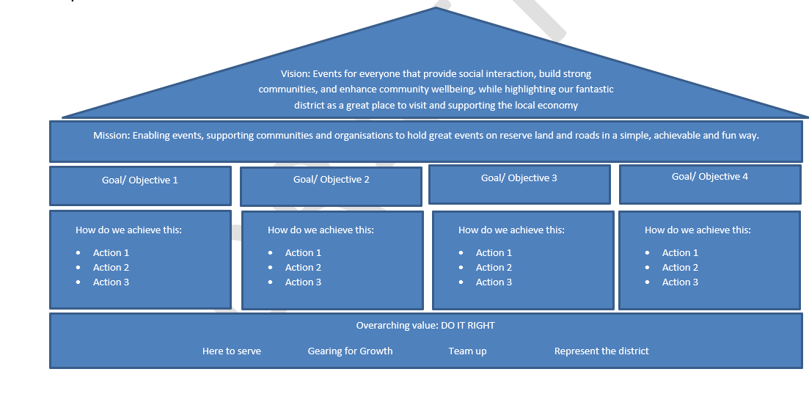
Option one
Considerations:
Toolbox for resources
Education
Empowerment ​
Community Led

Slide 20
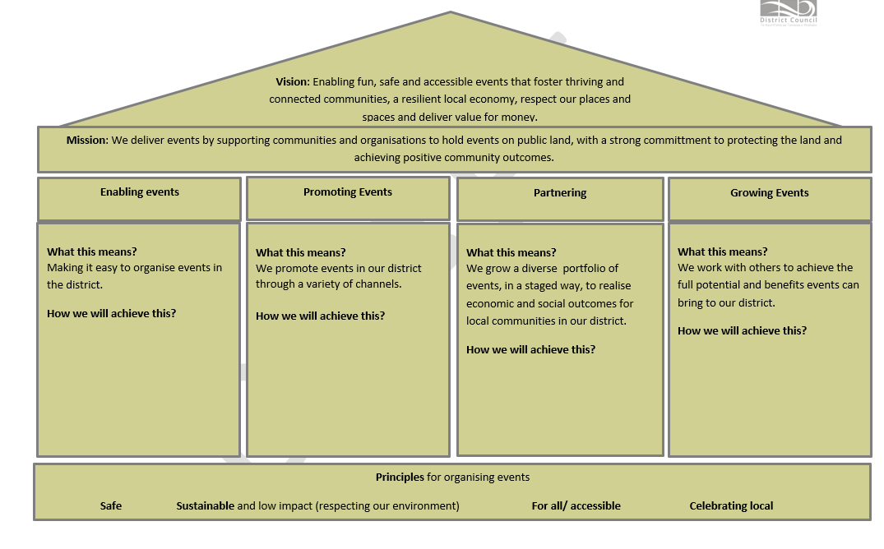
Options two and three
Considerations:
Alignment of values
What type of Commercial?
Resourcing (staff time)
Distribution across district
Reinvestment into spaces
Fund increased LOS/ development
Usability of community/ visitors
Wider economic impact
Community desires

Slide 21
Strategic Direction – Proposal
Short term
Continue status quo
Continual improvement
Event booking system revamp
Medium term
WDC branded events
Sustainable/zero waste focus
Partner with community groups/local business to deliver events
Long term
Attract commercial events
Align major events with strategic vision
Reinvestment of funds into development

Slide 22
Next Steps
Consultation
Community Boards and Committees
Existing users
Sports groups
Community
Mana whenua
Draft Strategy
Event Strategy developed and brought back to Council
Event Strategy adopted
Action plan created from feedback

Slide 23
Questions for Councillors:
Do you see any options we have missed?
Do you have any feedback on the options presented?
Are there any issues you see not identified today?

Slide 24
Thank you for your time
We now welcome any questions

