Slide 1

Transport AMP 2024
How much is it going to cost?

Slide 2
What are we covering?
LTP Process – Nicole Hubbard (Corporate Planning Manager)
- How AMPs fit into it – Trisha Morrison (Community Assets Manager)
Transport Function – Attinder Singh (Transport Operations Team Leader)
Levels of Service – Steve Browning (External Consultant)
Scenarios – Attinder Singh (Transport Operations Team Leader)

Slide 3
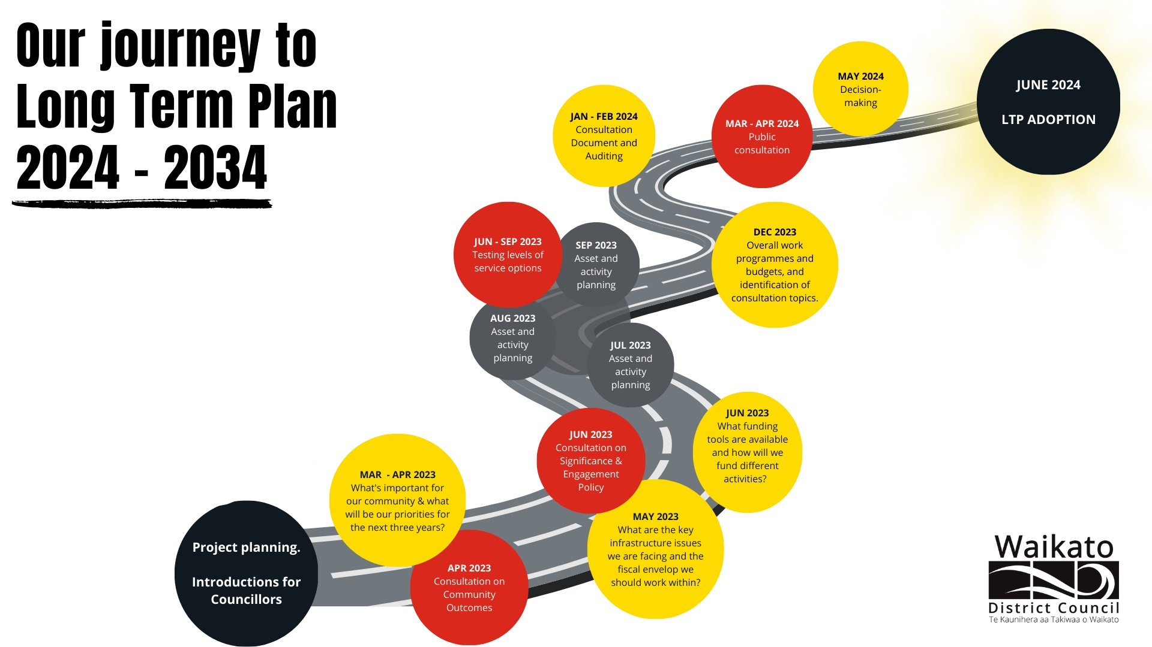

Slide 4
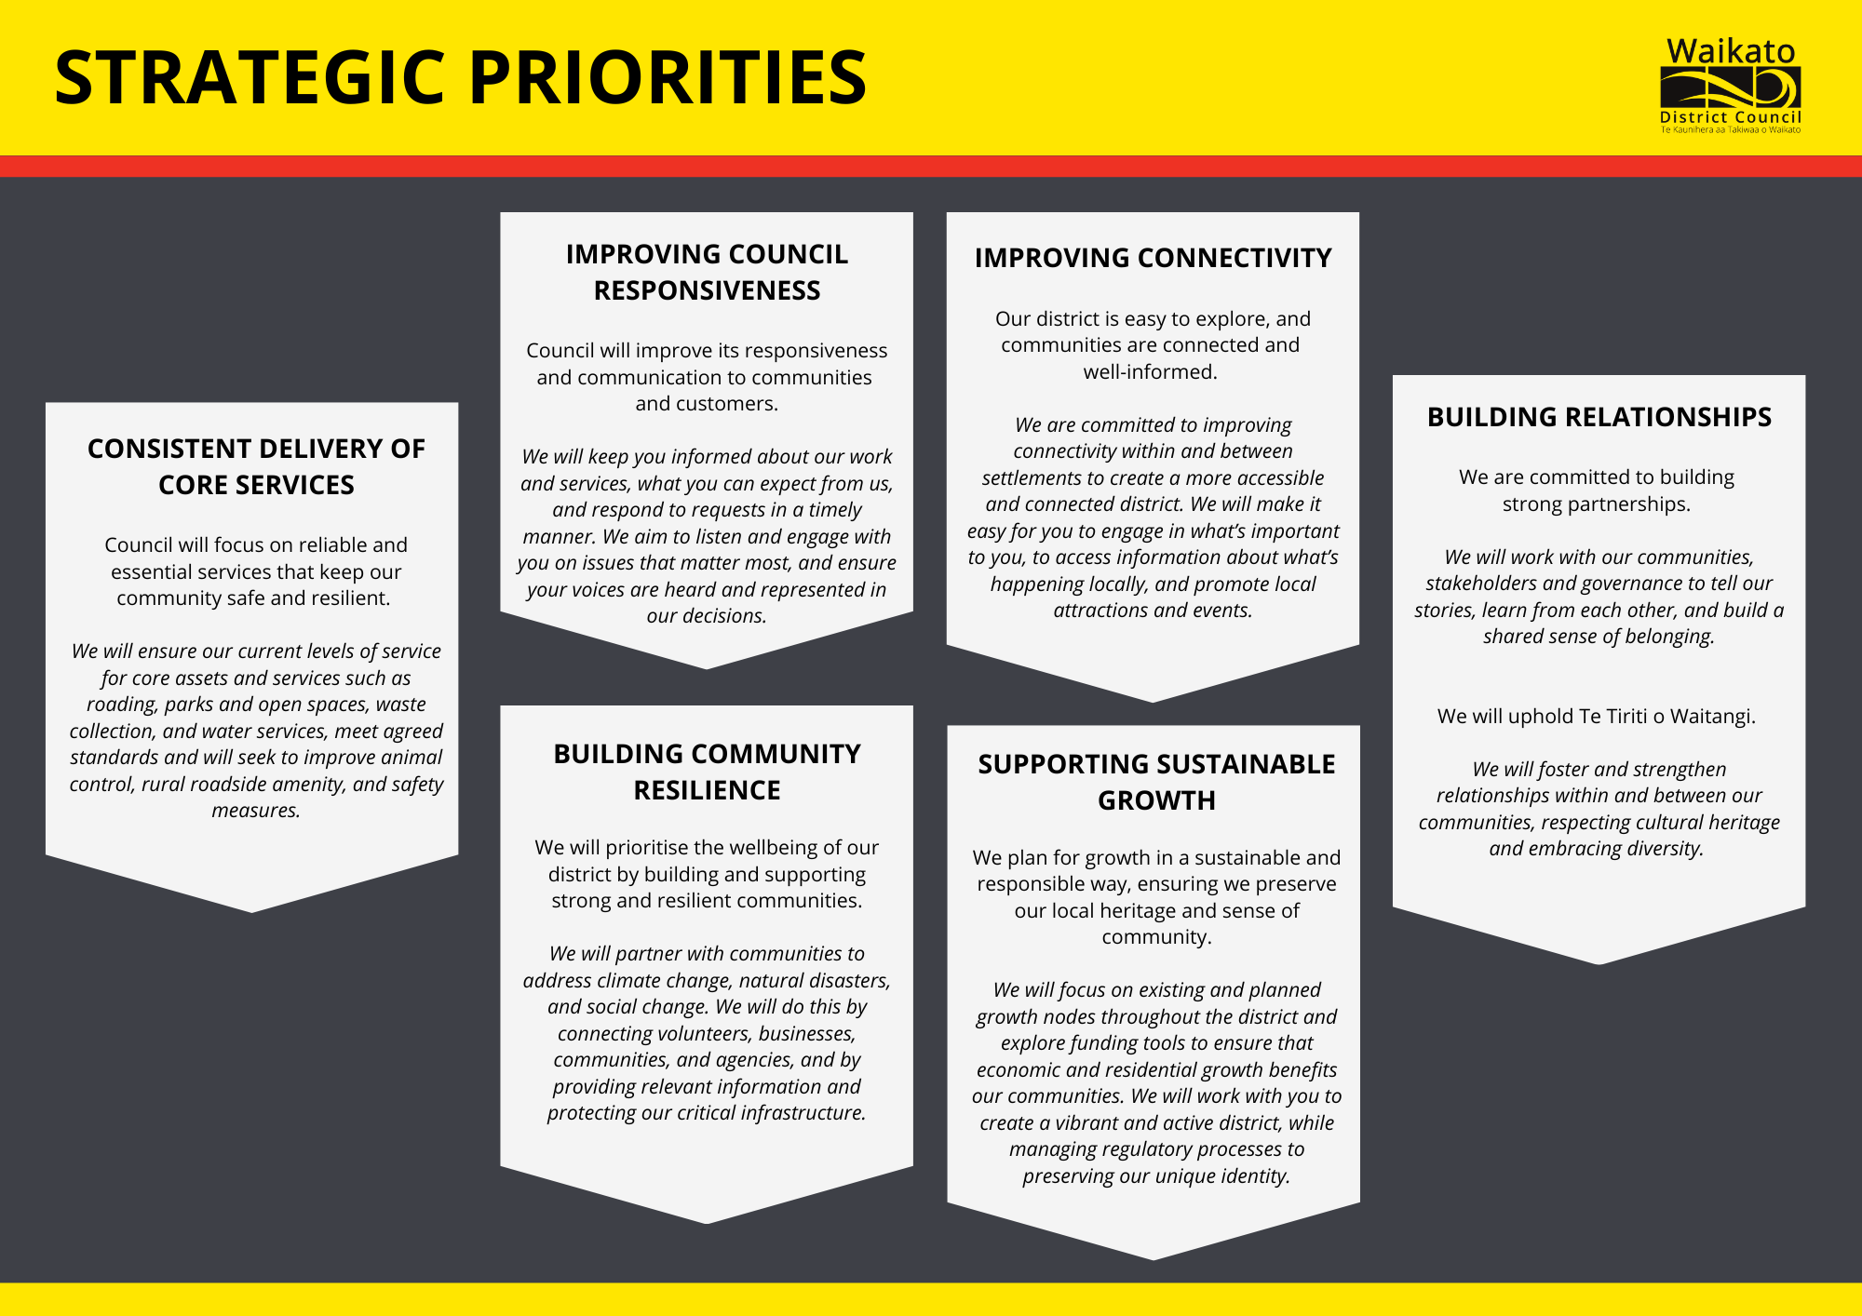

Slide 5
What is an AMP
Is the foundation for our asset management (AM) planning. It is a 10-year Strategic Plan which shows our vision and what steps we will take to get there.
The purpose is to show that active management of the assets we own (and services provided by those assets):
comply with regulatory requirements, and
outlines funding required to provide the Levels of Service over a 10-year planning period.
The goal of asset management is to:
“ Deliver the required levels of service to existing and future customers in the most cost-effective way.”
Notes:
Trish

Slide 6
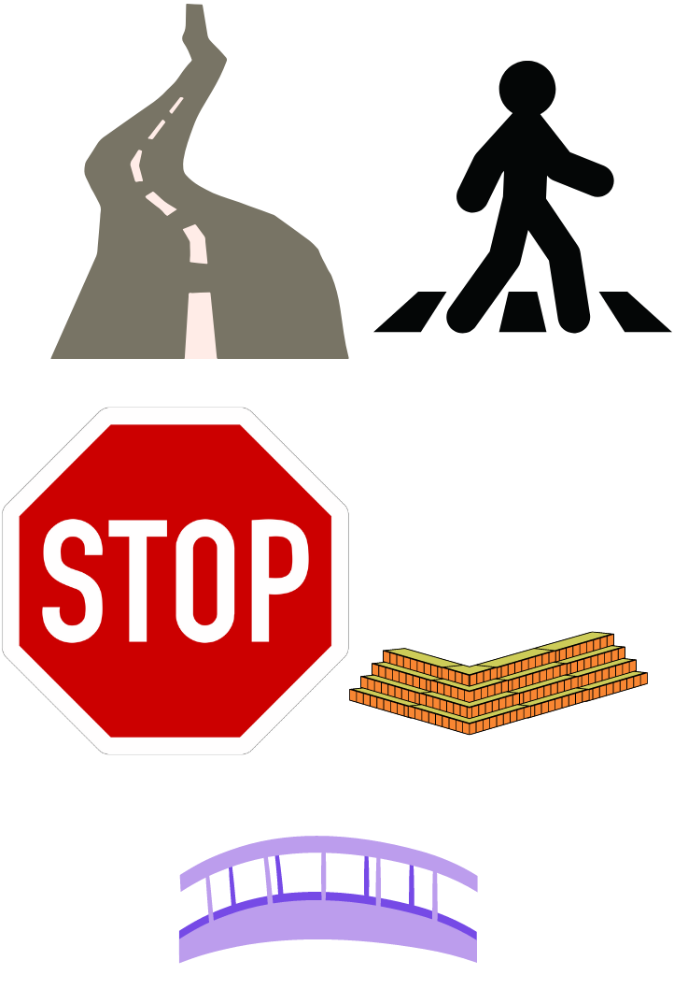
What type of assets are there?
Roads
Kerb and Channel
Footpaths
Guardrail
Retaining Walls
Signage
Bridges
Other Features
Notes:
Rural Roads
Local Streets
Rural Connectors
Urban Connectors
Main Streets
Activity Streets
Peri-Urban Roads
Stopping Places
Interregional Connectors

Slide 7
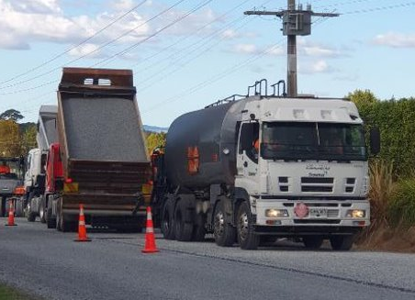
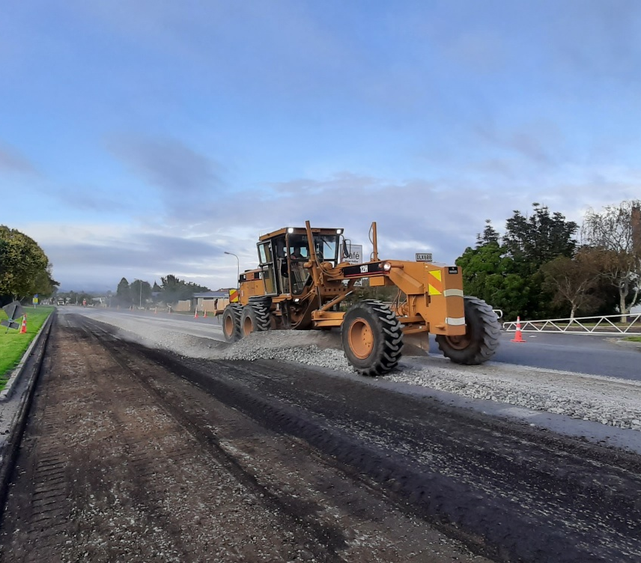
What are we doing now?
The current budget of $30m a year for Maintenance, Operations and Renewals has remained static for 8 years
In 8 years this has meant a
70% reduction of Pavement Rehabilitation
45% reduction of Resurfacing
Notes:
Attinder
But now what you would of spent 8 years ago for 18km is now what you would spend for 9km so costs have approximately doubled
- Pavement Rehabilitation
Basically its an area wide type treatment where we have multiple faults and we reconstruct the road for a continuous length anywhere from 500m to 2km and this….
- Restores the structural integrity of the road
- Contributes to a smooth ride
Provides the pavement strength required for heavy and light vehicles
- 70% reduction in the last 10 years from 20kms a year - At 6kms of rehab a year; which is 0.3% of the network annually, that equates to a renewal cycle of 330 yrs, so that means we need to get an average of 330 yrs out of all our pavements out there, which is obviously not sustainable. Avg pavement age has been increasing year on year and it currently is around 28yrs 28 years may not sound old, but we design roads for 25 yrs and as the pavement gets older, maintenance costs increase
And
Resurfacing, which is predominantly chipsealing for our network, with a small proportion of asphalt, which is mainly in the urban areas
- And resurfacing restores the surface condition of the road – being texture and skid resistance which,
- Provides a safe running surface for vehicles and waterproofs the underlying pavement layers
- 45% reduction in the last 10 years from 150kms a year - At 80kms a year, that equates to 4% of the network renewed annually and that equates to a renewal cycle of 25 yrs.
So that means we need to get an average of 25 yrs out of a reseal, which again isn’t sustainable, as the typical life of a chipseal is around 10-12 years

Slide 8
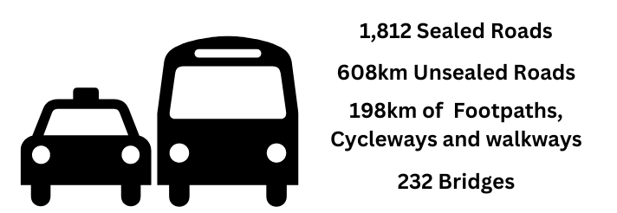
What does it cover???
Notes:
Attinder
Our combined network is longer than SH1 from top to bottom
Unsealed Network covers a distance from Auckland to Wellington

Slide 9
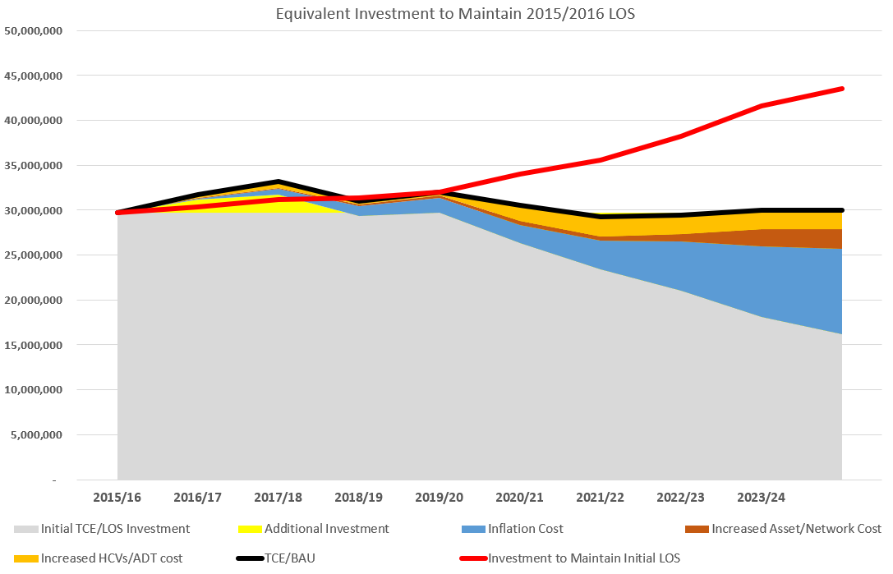
Investment has not been maintaining LoS
Notes:
Attinder
So this chart attempts to illustrate financially the effect that these challenges are having on our budgets.
1) The thick Black line shows the actual funding that we’ve had over the last 8 years. excluding any additional funding for Capital Projects.
The shaded areas below that black line attempt to show the cost of some of those challenges I’ve mentioned
2) The top orange area is the cost associated with traffic growth and the increase of heavy vehicles
3) The brown area is the cost associated with the increased network length
4) And the blue area is the cost associated with inflation
5) Therefore the remaining grey area is the real funding that has been left to maintain the network. This declining Grey area demonstrates the decreasing LOS that can be delivered for the remaining funding available, and indicates the significant asset consumption that has been occurring over the network.
6) The lower black line shows the pavement and surfacing renewal proportion
7) The top red line indicates the GAP in funding for what is required, to deliver the LOS expected from our customers & stakeholders. That gap currently sits at around just over $10M, but by the end of this current funding period, that GAP, based on our modelling, will be around $14M.
This demonstrates that the current level of funding, is just not keeping up with what has been happening to the network, and will only get worse and become more difficult to turn around if we continue as we are.
As a result of the flexibility of the Alliance Contract model, it has allowed the delivery of a relatively good LOS from an aesthetic point of view, taking into account the challenges highlighted here. However this has been at the expense of underlying asset consumption and the undoing of the benefit from some of the strategic investment that has been made in the past, as shown on previous slides.

Slide 10
What has created the funding gaps?
Budget Remaining the same despite:
  Growing Network
  Inflation (15-20%)
  New regulations for higher Traffic Management requirements
Notes:
Attinder
No allowance for:
Growing Network
Inflation (15-20%)
Traffic Control
There is a national trend of sweating

Slide 11
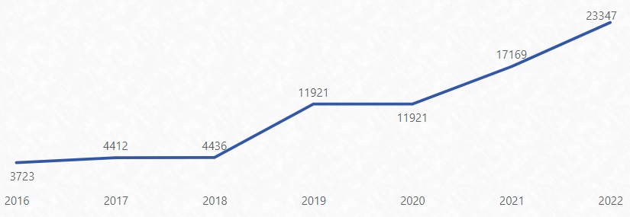
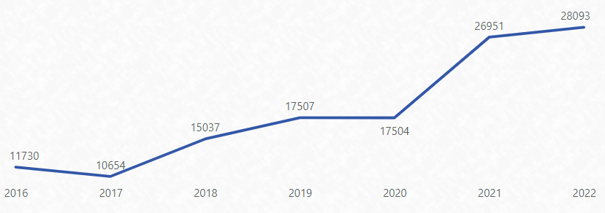
Surface Condition
Sum of Poor and Very Poor Counts (x10 lane.m)
Skid Resistance
Poor and Very Poor length has increased by 100km since 2016
Worse
Better
Sum of Poor and Very Poor Counts (x10 lane.m)
Texture
Poor and Very Poor length has increased by 80 km since 2016
Worse
Better
Notes:
Attinder
Again based on data from our High Speed data surveys, these charts show the evidence of the increased deterioration of our surfacing asset over the last six years as a result of the declining renewal quantities
The top chart shows our counts of poor and v.poor lengths for skid resistance.
You can see that in 2016 that we had around 4,000 poor and v.poor counts but has now increased to 23,000.
That represents an increase of 100km over the last 6 years.
And the lower graph represents texture and that shows that our poor and v.poor lengths has increased by 80km.
Again this increased length is mainly being managed in our lower speed urban environments so to mange the risk
But again the quantities are reflective of the increasing backlog as a result of the reduction of resurfacing quantities over the years.

Slide 12
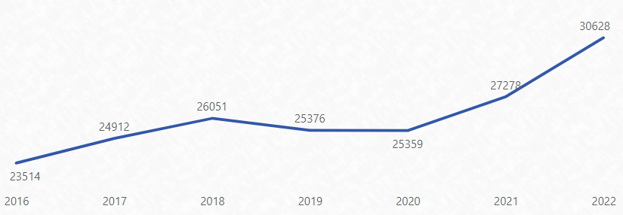
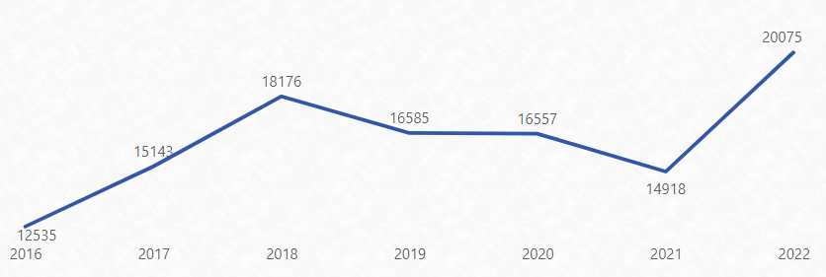
Pavement Condition
Roughness
Poor and Very Poor length has increased by 70 km since 2016
Sum of Poor and Very Poor Counts (x20 lane.m)
Worse
Better
Rutting
Poor and Very Poor length has increased by 75 km since 2016
Sum of Poor and Very Poor Counts (x20 lane.mm)
Worse
Better
Notes:
Attinder
And these charts show the evidence of the increased deterioration of our pavements as a result of those declining renewal quantities
Since 2016 we have been carrying out annual high speed data surveys that measures pavement and surface condition.
The top chart shows our counts of poor and v.poor lengths of Roughness through the network. Each count represents 20m of road lane length.
You can see that in 2016 that we had around 23,000 poor and v.poor counts but has now increased to 30,000.
That represents an increase of 70km over the last 6 years.
And the lower graph represents our poor and v.poor lengths of Rutting and that has increased by 75km over the last 6 years.
These increased lengths are mainly being managed within our low trafficked rural network to assist in managing the risk
But it’s reflective of the increasing backlog that we have on the network

Slide 13
Level of Service Framework
Council Vision and Community Outcomes
Activity Outcomes
Outcomes delivered by each activity
Levels of Service
The defined quality for a particular service area
The level of service received by the customer
Service Level Statements
How Council provides the service
Performance Measures
Notes:
Steve

Slide 14
Level of Service Alignment
Council Vision and Community Outcomes
Activity Outcomes
Levels of Service
Service Level Statements
Performance Measures
Notes:
Steve

Slide 15
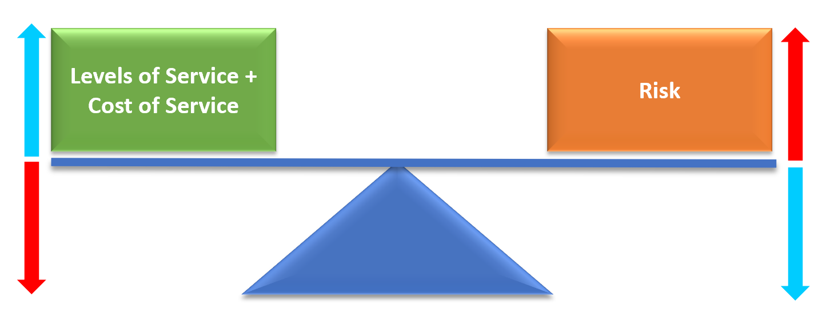
Cost Service Risk
Notes:
Steve

Slide 16
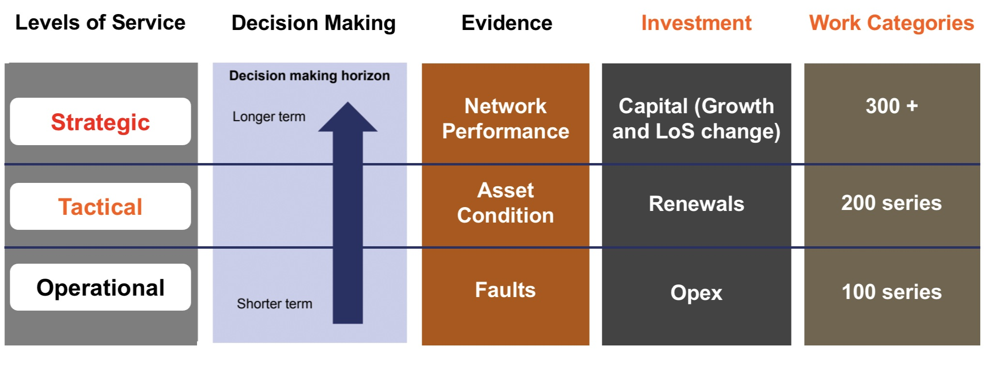
Levels of Service
Notes:
Steve

Slide 17
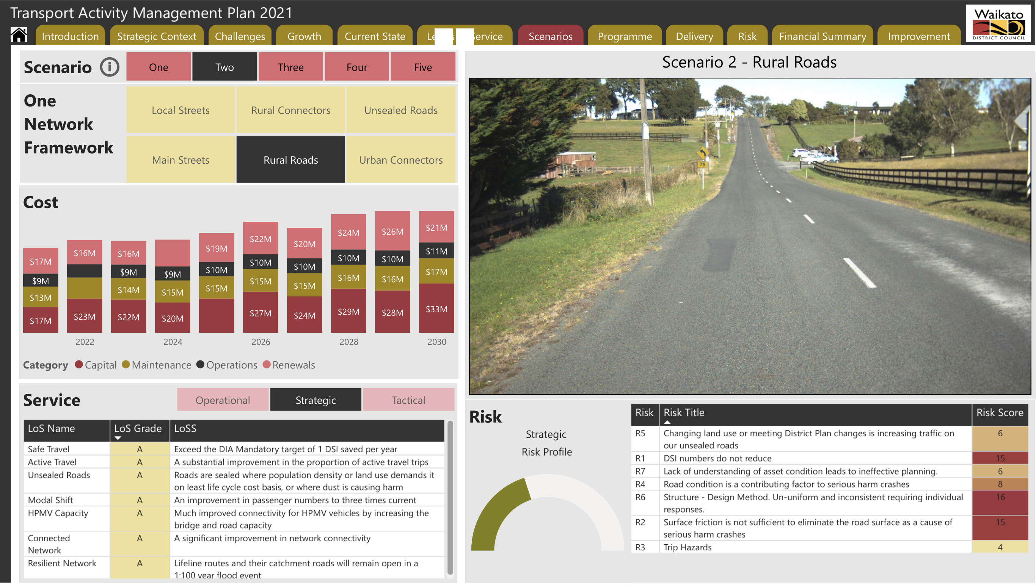
2021 Preferred Programme
Notes:
Steve

Slide 18
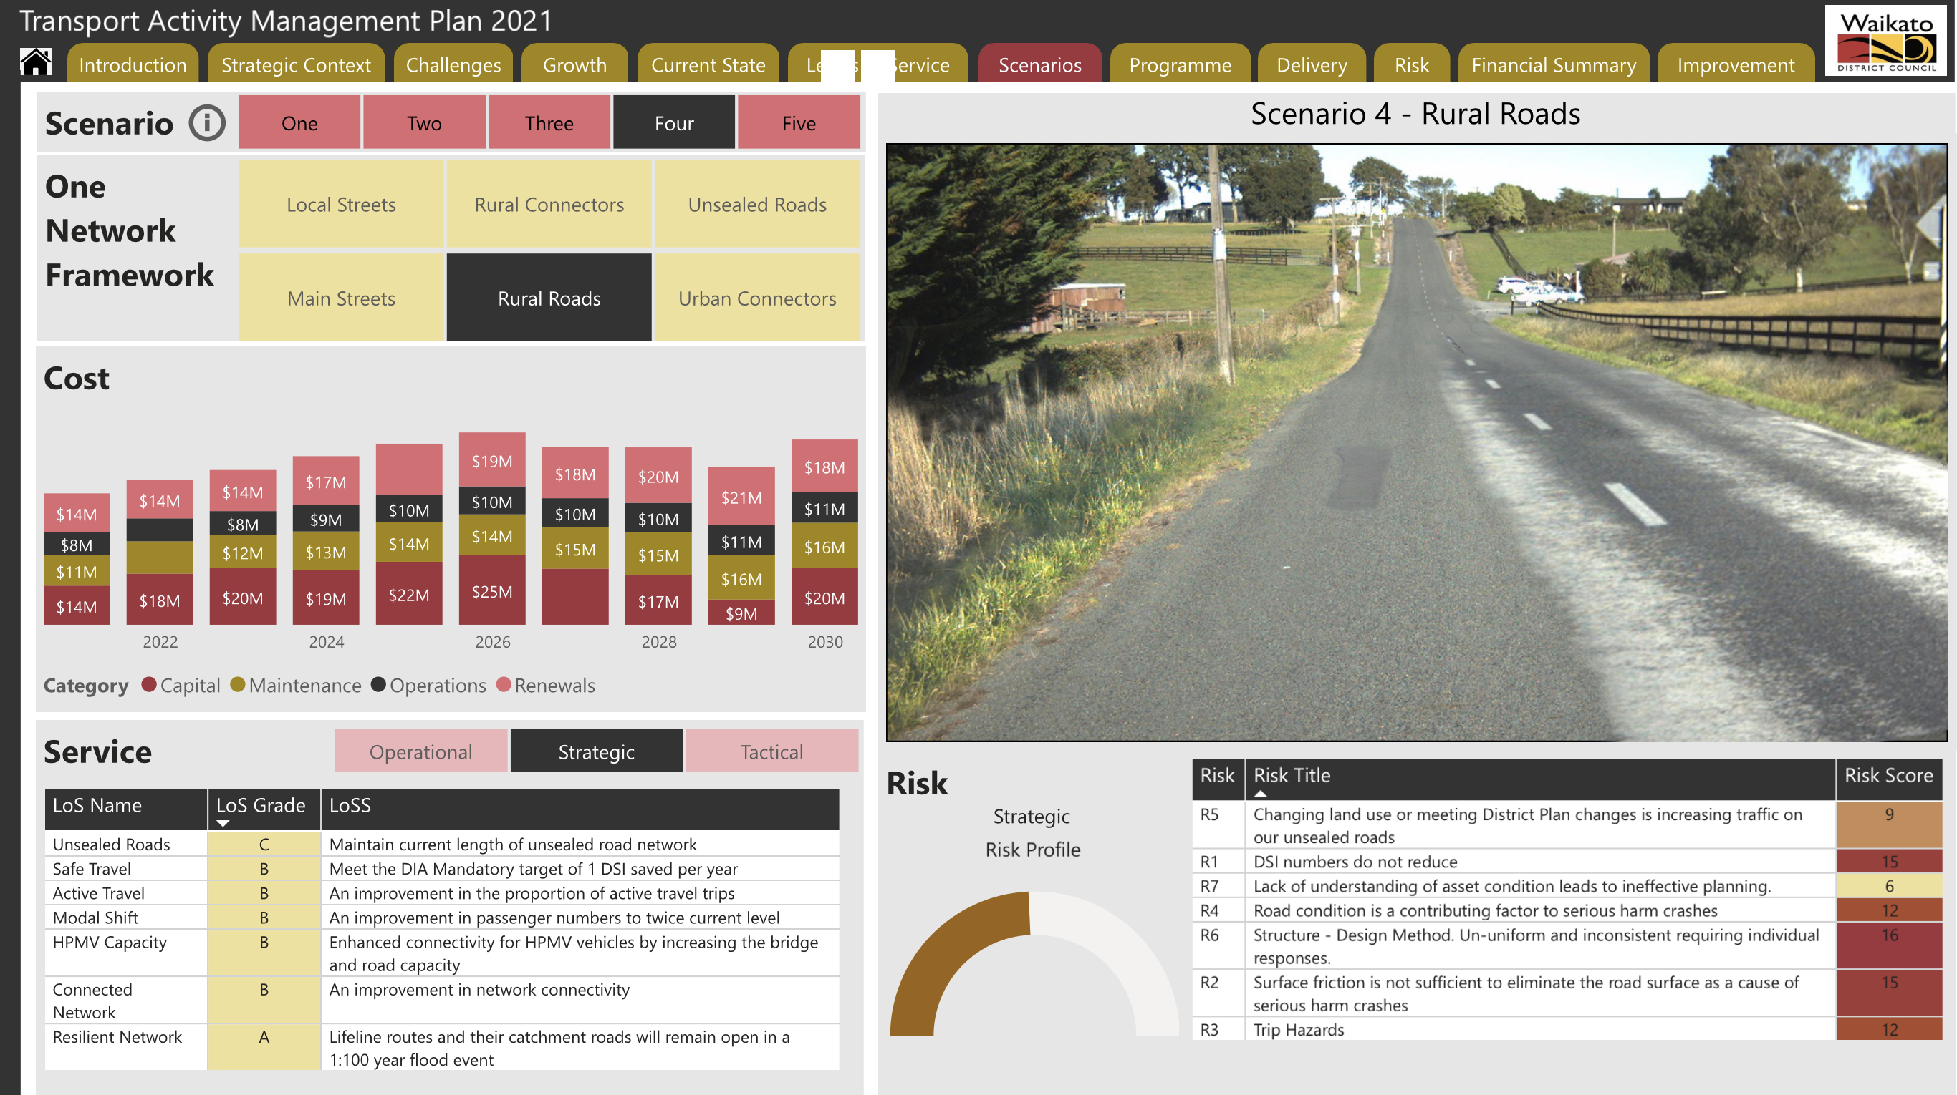
2021 Actual Programme
Notes:
Steve

Slide 19
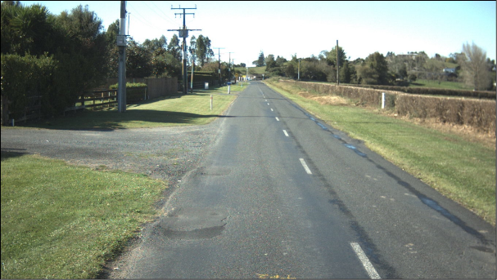
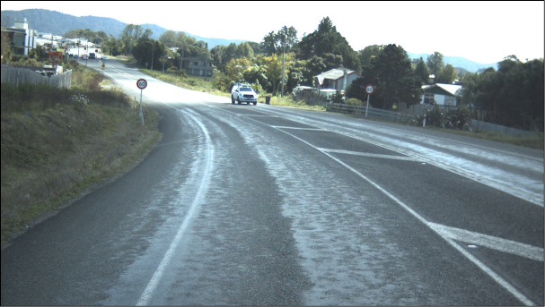
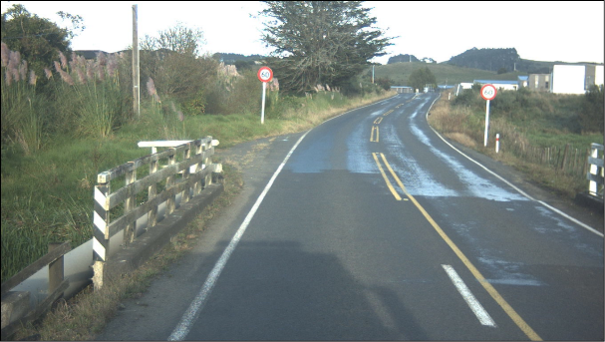
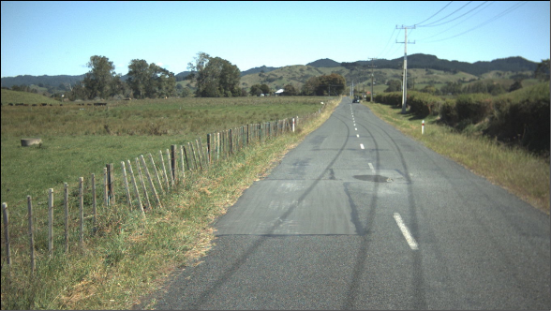
Actual pics now
Notes:
Steve

Slide 20
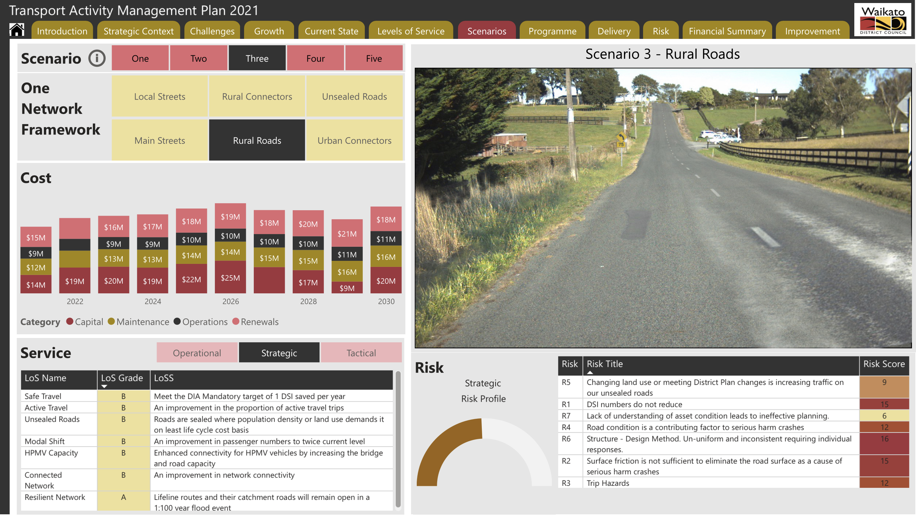
2024 – Network Need
Notes:
Steve

Slide 21
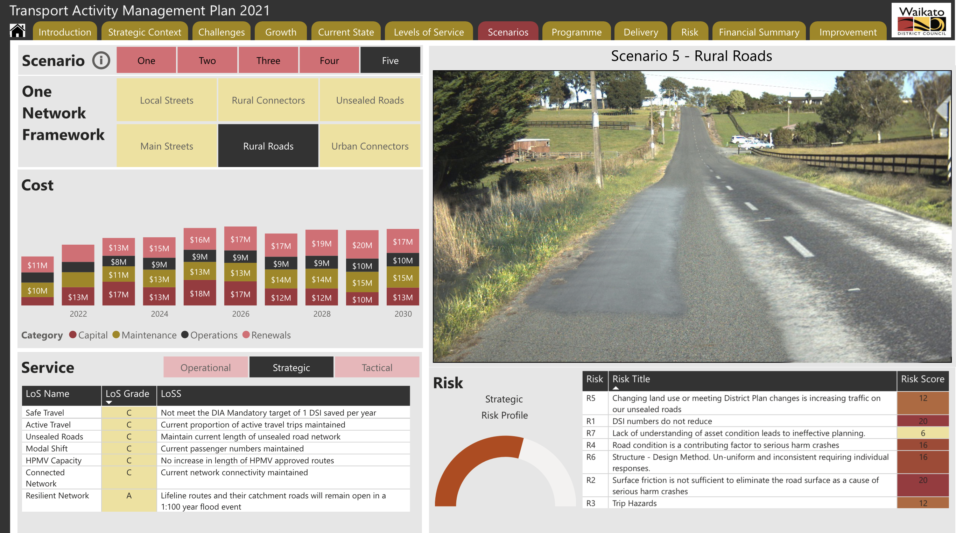
2024 – Status Quo
Notes:
Steve

Slide 22
So what can we do
Re-evaluate the budget and establish scenarios
Two scenarios have been developed
  Current Network Need
  Status Quo
Notes:
Attinder
Some scenarios have been established by the Roading Team to try and address the current budgeting insufficiencies
Which will include the implications of the level of investment or lack of for them.
We need to get the balance between, the cost / levels of service and risk of our network

Slide 23
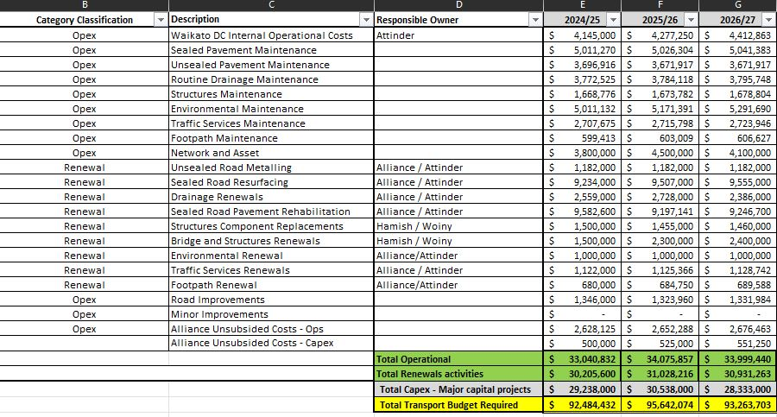
Network Need
Notes:
Attinder
Averages over the first three years
Operational: $33.7m
Renewals : $30.7m
Capex: $29.3m
Total: $92.4m

Slide 24

What will the extra money provide?
Reduce the gap in the shortfall in Maintenance, Operations and Renewals that has been occurring over recent years
Enable us to maintain an acceptable level of service for the community
Improve community perception that we are looking after our roads (less potholes)
Reduced DSI’s on the network
Notes:
Attinder

Slide 25
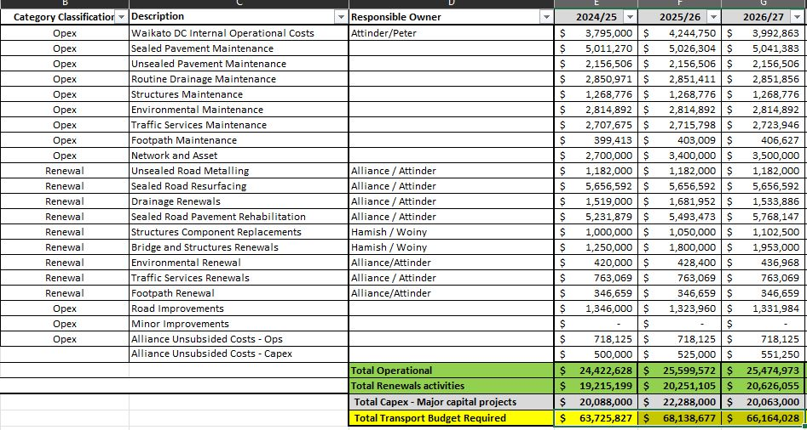
Status Quo
Notes:
Attinder
Averages over the first three years
Operational: $25.1m
Renewals: $20.0m
Capex: $20.8m
Total: $63.7m

Slide 26
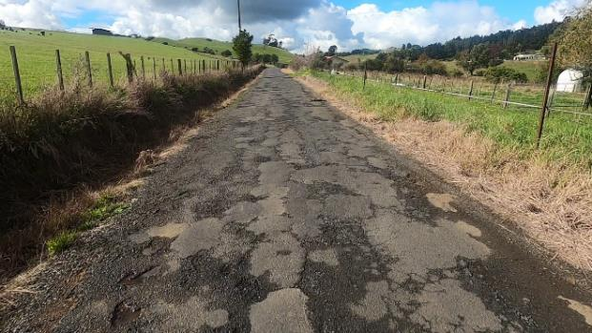
What are the implications of lower spend?
Strategic priorities not being met
Reduced levels of service
Increased DSI’s
Increased number of potholes visible on the roads
Reputational impact with our community that we are not investing in our roads
Associated risk level for road users could increase
Notes:
Attinder
Removal of non-essential services
Mowing of rural berms

Slide 27

Questions

