Slide 1
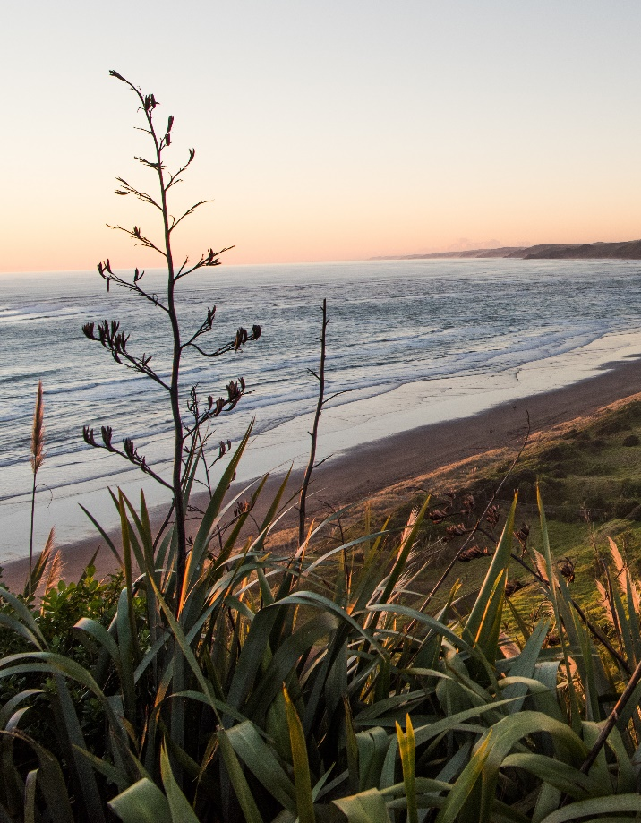

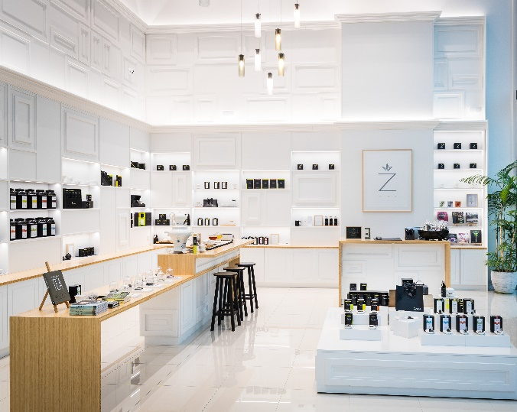
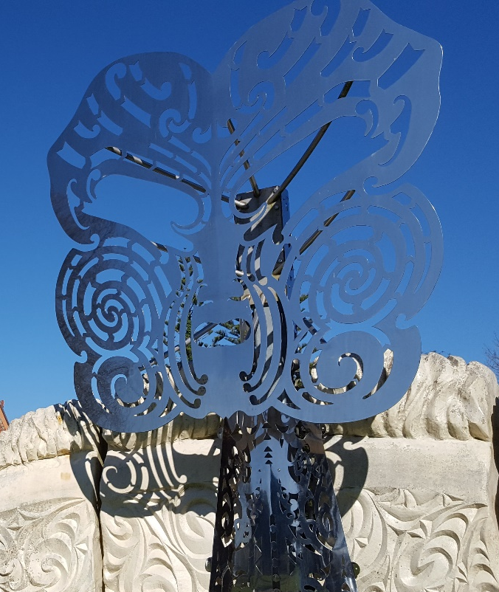
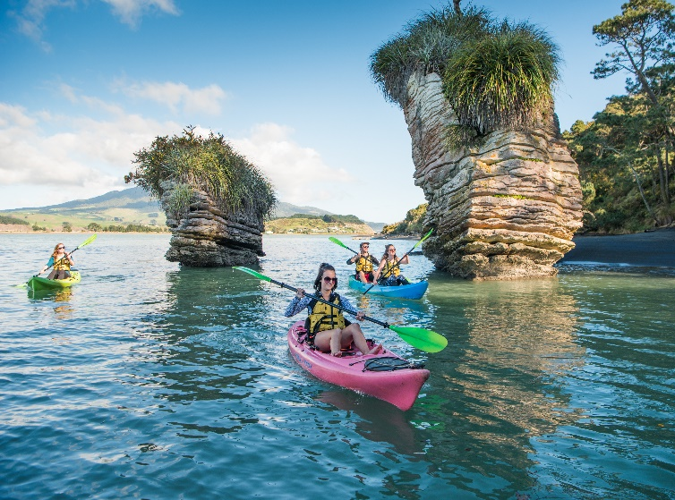
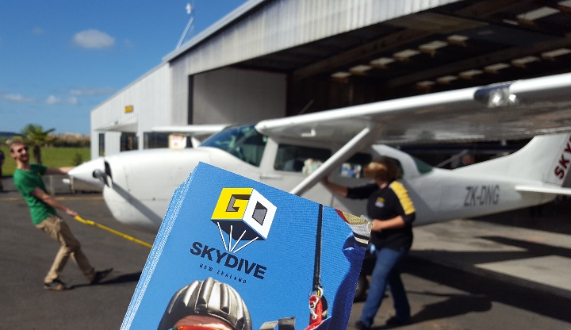



Slide 2


$35.9 billion
Visitor expenditure
399,150
employees
14.5%
NZ workforce
employed in tourism*
$3.3b GST
10.5% contribution to GDP
No.1
export earner
($2b ahead of dairy)
*230,793
direct employment
(168,357 indirect)
Statistics NZ: Tourism Satellite Account (YE March 2017)

Slide 3



International visitor arrivals 3.71m
for New Zealand
$1.478b
Visitor expenditure
5th highest in NZ
1.42m
commercial guest nights
7.344m
total estimated
guest nights
International Visitor Arrivals (Y/E Nov 2017)
Commercial Accommodation Monitor (Y/E Dec 2017)
4.0% increase in domestic guest nights
Domestic visitors
$1.13b
International visitors
$345m
Regional Tourism Estimates (Y/E Dec 2017)
QRIOUS (Y/E Sept 2017)
Commercial Accommodation Monitor
(Y/E Nov 2017)

Slide 4








Visitor nights
5% increase of total visitor guest nights vs national

Result: 3.1%
NZ growth 2.4%;
(Commercial Accommodation Monitor Y/E Nov 2017)
Result: 5%
Annual $1.478 billion
(Monthly Regional Tourism Estimates MBIE, Y/E Dec 17)
Visitor spend
5% increase in visitor spend across the region
➔
Conventions & business events
Grow market share of business events from 9% to 10%

Result: 10.6%
(Convention Activity Survey Y/E December 2017)
Visitor awareness & perceptions
Improve by 3 points, including Waikato residents
➔
Result: TBC
Research conducted in June 2018
(Fresh Info & AA Traveller)
Website & social media: HamiltonWaikato
5% digital engagement on previous year

Result: 9.29%
engagement rate (10.4% 16/17)
Industry investment
$400,000 of industry contributions towards activities
➔
Result: $265,141
Return on investment
Total visitor spend per dollar of HWT spend

Result: $1,198
per dollar of council funding

Slide 5






Visitors % Increase Market Share
Australia 1,475,472 +4.3% 40%
China 401,056 -5% 11%
USA 333,968 +12.6% 9%
UK 251,072 +13.5% 7%
Japan 102,256 +1.2% 3%
Germany 104,784 +5.3% 3%






International Visitor Arrivals : year ending January 2018 (Statistics NZ)
Notes:
December: Hainan Airlines & Tianjin (CHINA)

Slide 6





Visitors % Increase Market Share
Korea 92,592 +12.6% 2%
Canada 68,512 +13.8% 2%
India 62,560 +20.1% 2%
Singapore 58,208 +1.1% 2%
Malaysia 52,880 +-0.2% 1%





International Visitor Arrivals : year ending January 2018 (Statistics NZ)
Notes:
December: Hainan Airlines & Tianjin (CHINA)

Slide 7




Visitor nos % Increase
Holiday 1,953,152 +6.1%
Visiting friends/relatives 1,074,384 +4.5%
Business 302,592 +4.2%
Education 65,616 -1.2%
Conference/convention 72,096 +9.1%
Other 129,360 +3%
Not Stated 125,360 +12.4%







International Visitor Arrivals : year ending January 2018 (Statistics NZ)
Notes:
December: Hainan Airlines & Tianjin (CHINA)

Slide 8


Result: $84m domestic
14% $28m international
Visitor spend
Year end December 2017
Monthly Regional Tourism Estimates: year ending January 2018 (MBIE)

Slide 9


Result: 5% decrease
from previous year
[2.8% regional increase]
Guest arrivals
Year end December 2017
Commercial Accommodation Monitor : year ending December 2017 (Statistics NZ)

Slide 10
Guest nights
Year end December 2017

Result:
164,605
Commercial Accommodation Monitor : year ending December 2017 (Statistics NZ)

Slide 11



Slide 12

Target market | Campaign activity
Auckland, Wellington, Christchurch, BOP & Taranaki | Short Escapes (Oct – Nov 17)
Waikato region (locals) | Explore Your Own Backyard (Dec 17 - Jan 18)
Chinese New Zealanders | Short Breaks (Nov 17 – Jan 18)
Other domestic & international activity | Website & social media channels Official Regional Visitor Guide Major Events – Lions Series & Rugby League World Cup Go Travel magazine Kia Ora magazine Arrivals magazine Stuff Weekend Getaway NZ Surfing magazine

Slide 13

Target market | Campaign activity
Australia | Tour the North Island Campaign (JV with Tourism NZ) Social influencer hosting
Canada & the United States | ECNI - Thermal Explorer Highway @ KiwiLink events ECNI North America Roadshow (travel agent training)
China, Philippines, Indonesia & Malaysia | Kiwilink China & South East Asia (with Tourism NZ) Explore Central North Island
All international markets | International media hosting & famil programmes International trade trade programme Explore Central North Island (ECNI) Collective (product manual, e-newsletters, website, trade show)

Slide 14

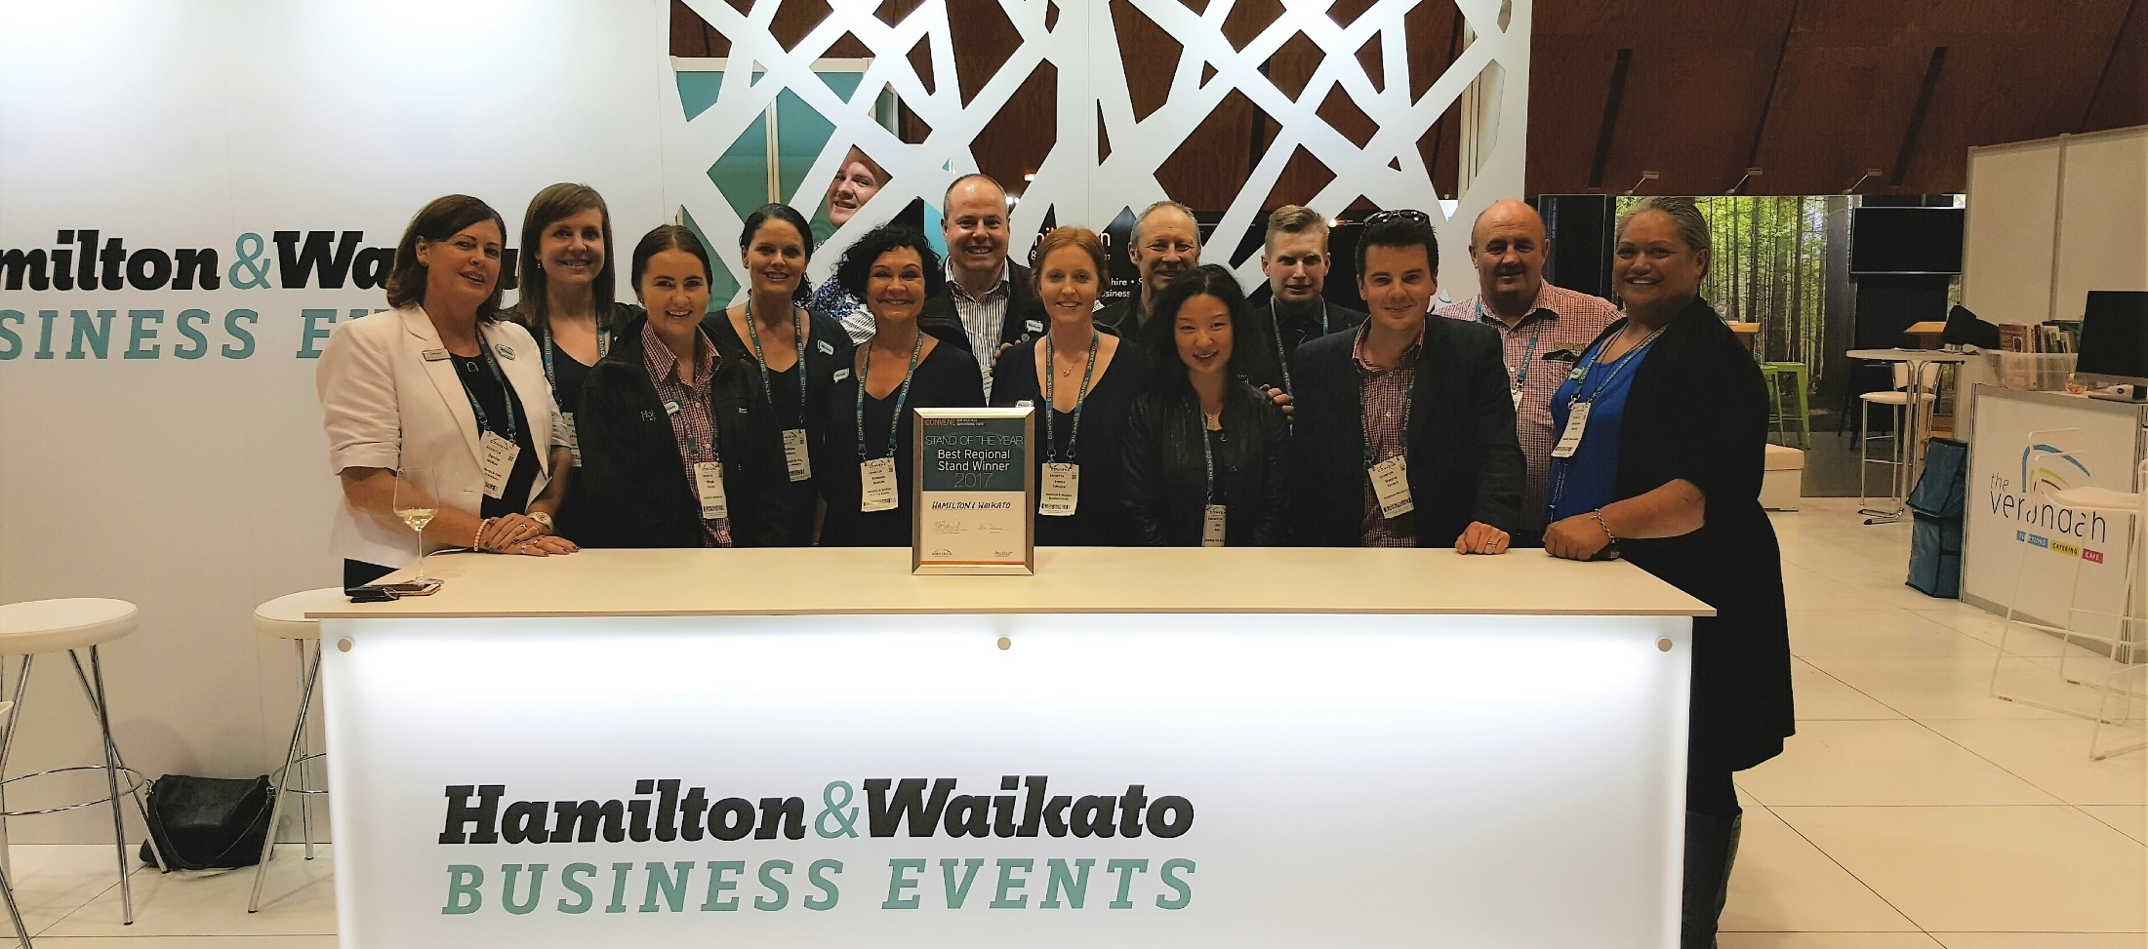

Slide 15


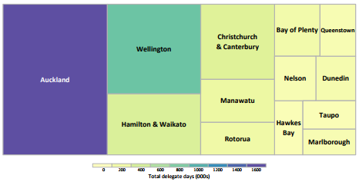
Overview of business events by region
Year ended December 2017
 10.7% market share of events
 8.9% market share of delegates
Convention Activity Survey : year ending December 2017 (MBIE)
Notes:
Business events are a huge growth area for all our regions
Business events delegates spend an average $350 per day and they also visit throughout the year, plus are potential repeat visitors

Slide 16



Slide 17

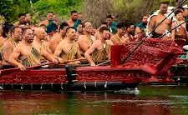
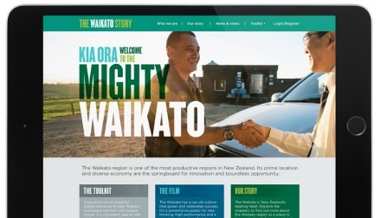
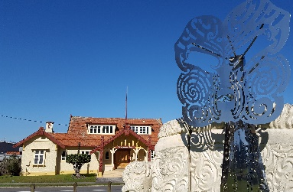
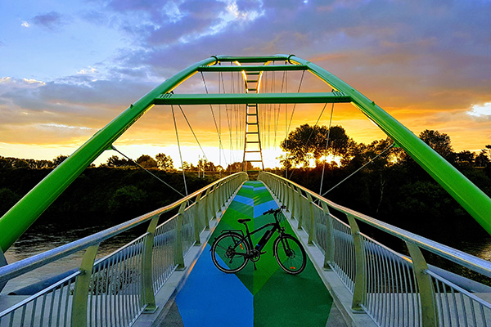
Regional Major Events Strategy
Audit complete, discovery phase underway, draft strategy development
Regional Brand Proposition & Strategy
Regional audit completed, industry workshops held, draft story developed, creative development begins
Home of Kiingitanga
Tourism symposium held, products piloted, Waikato Region Maori Economic Action Plan released, Hakarimata app, Taniwha Ventures, Waikato-Tainui College campus
Product development
Te Awa Lakes water adventure park, Open Up Ngāruawāhia, Soft Leaf Glamping, River Riders NZ, Raglan destination management, Hampton Downs development

Slide 18

$8 million over four years from 2014/15
50% co-funding available – maximum $300,000
Waikato River Trail
$150,000 of funding for enhancements on the Lake Karapiro section of the trail, including retaining wall upgrades and trail widening.
$52,500 of funding for extreme event recovery works to repair damage to the trail caused by heavy rainfall.

Slide 19

Provides up to $25million per year
development of tourism-related infrastructure such as carparks, freedom camping facilities, sewerage & water, and transport projects.
Matamata-Piako District Council:
$221,000 for Wairere Falls carpark
Waikato District Council:
$868,000 for new toilet & rubbish facilities, Raglan

Slide 20
Round two opens in April 2018
Letter sent to all council Mayor & CEOs
Priorities for round two include:
Supporting communities most in need of immediate infrastructure to support visitor growth
Demonstrate thinking around the longer-term sustainability of the infrastructure through innovation technological solutions

Slide 21

Three investment tiers to target investment to lift productivity, create jobs & provide economic benefits:
Regional projects and capability:
Support of economic development projects, feasibility studies & capability building identified by the regions.
Sector investment (including 1b Trees):
Investment in initiatives targeted at priority and/or high value economic opportunities.
Enabling infrastructure projects:
Investment in regional infrastructure projects that will lift productivity and grow jobs.

Slide 22



