Slide 1
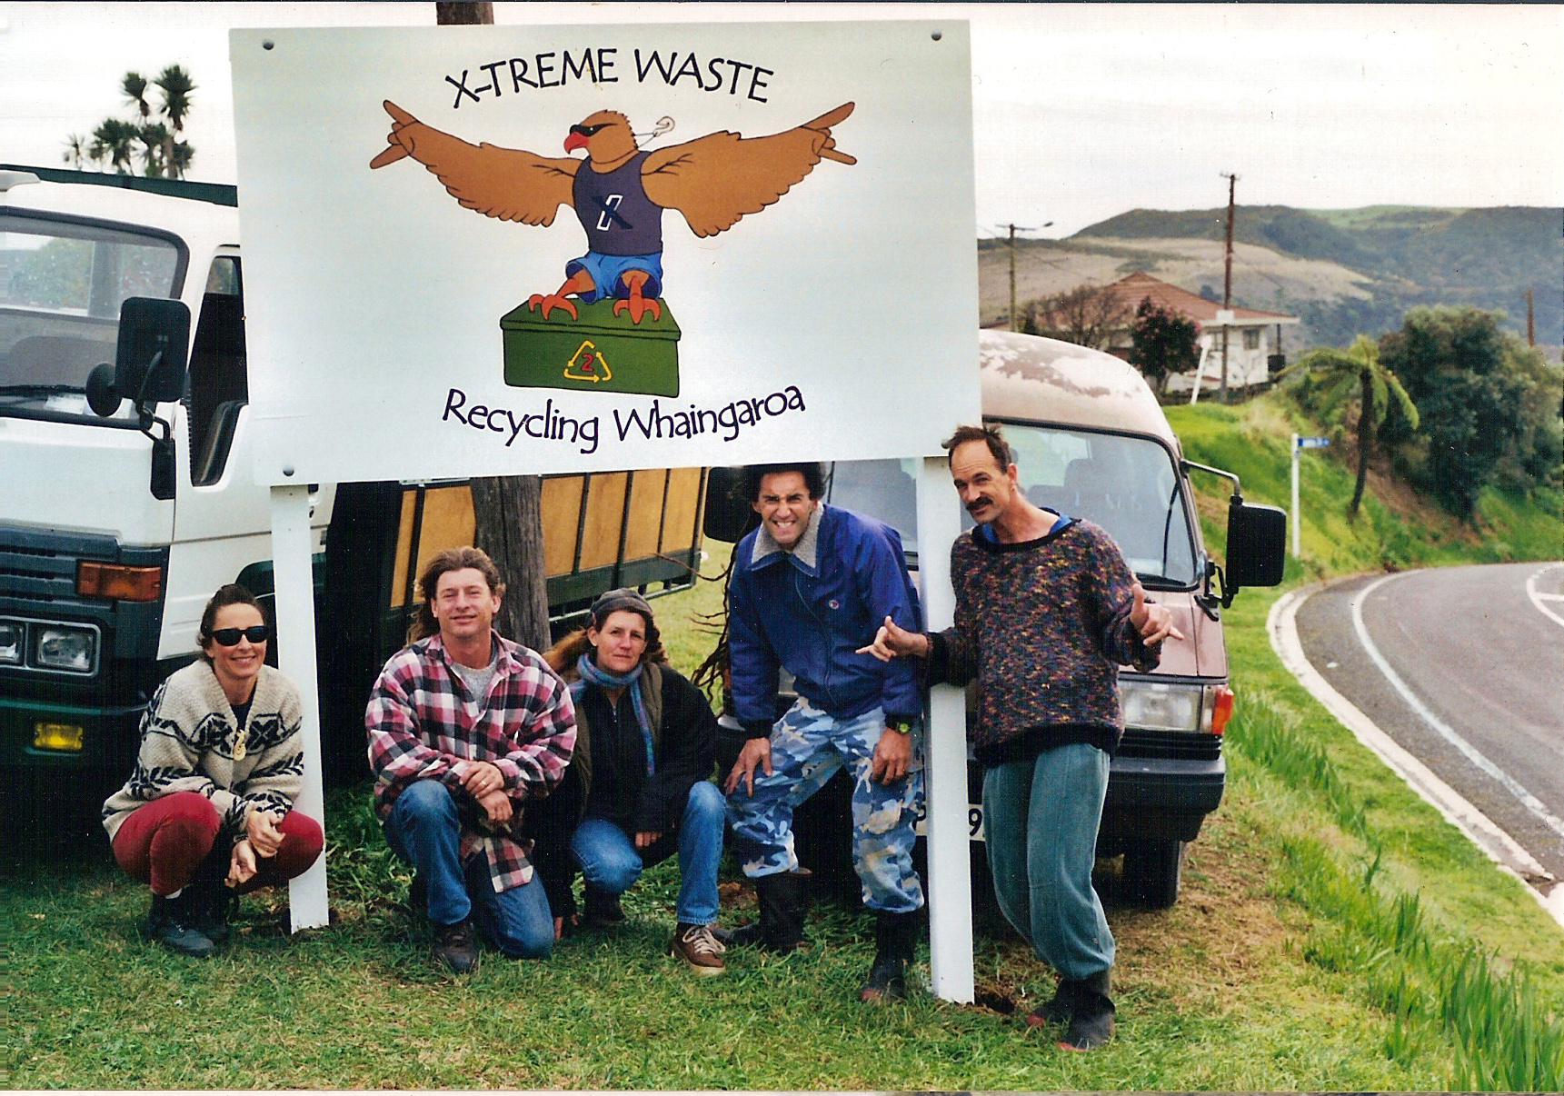

Slide 2
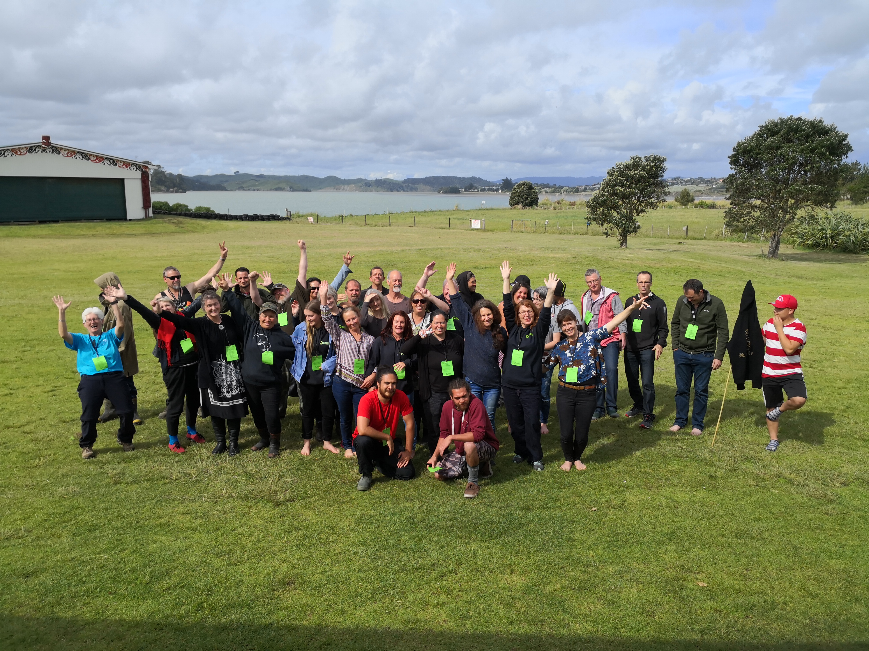

Slide 3
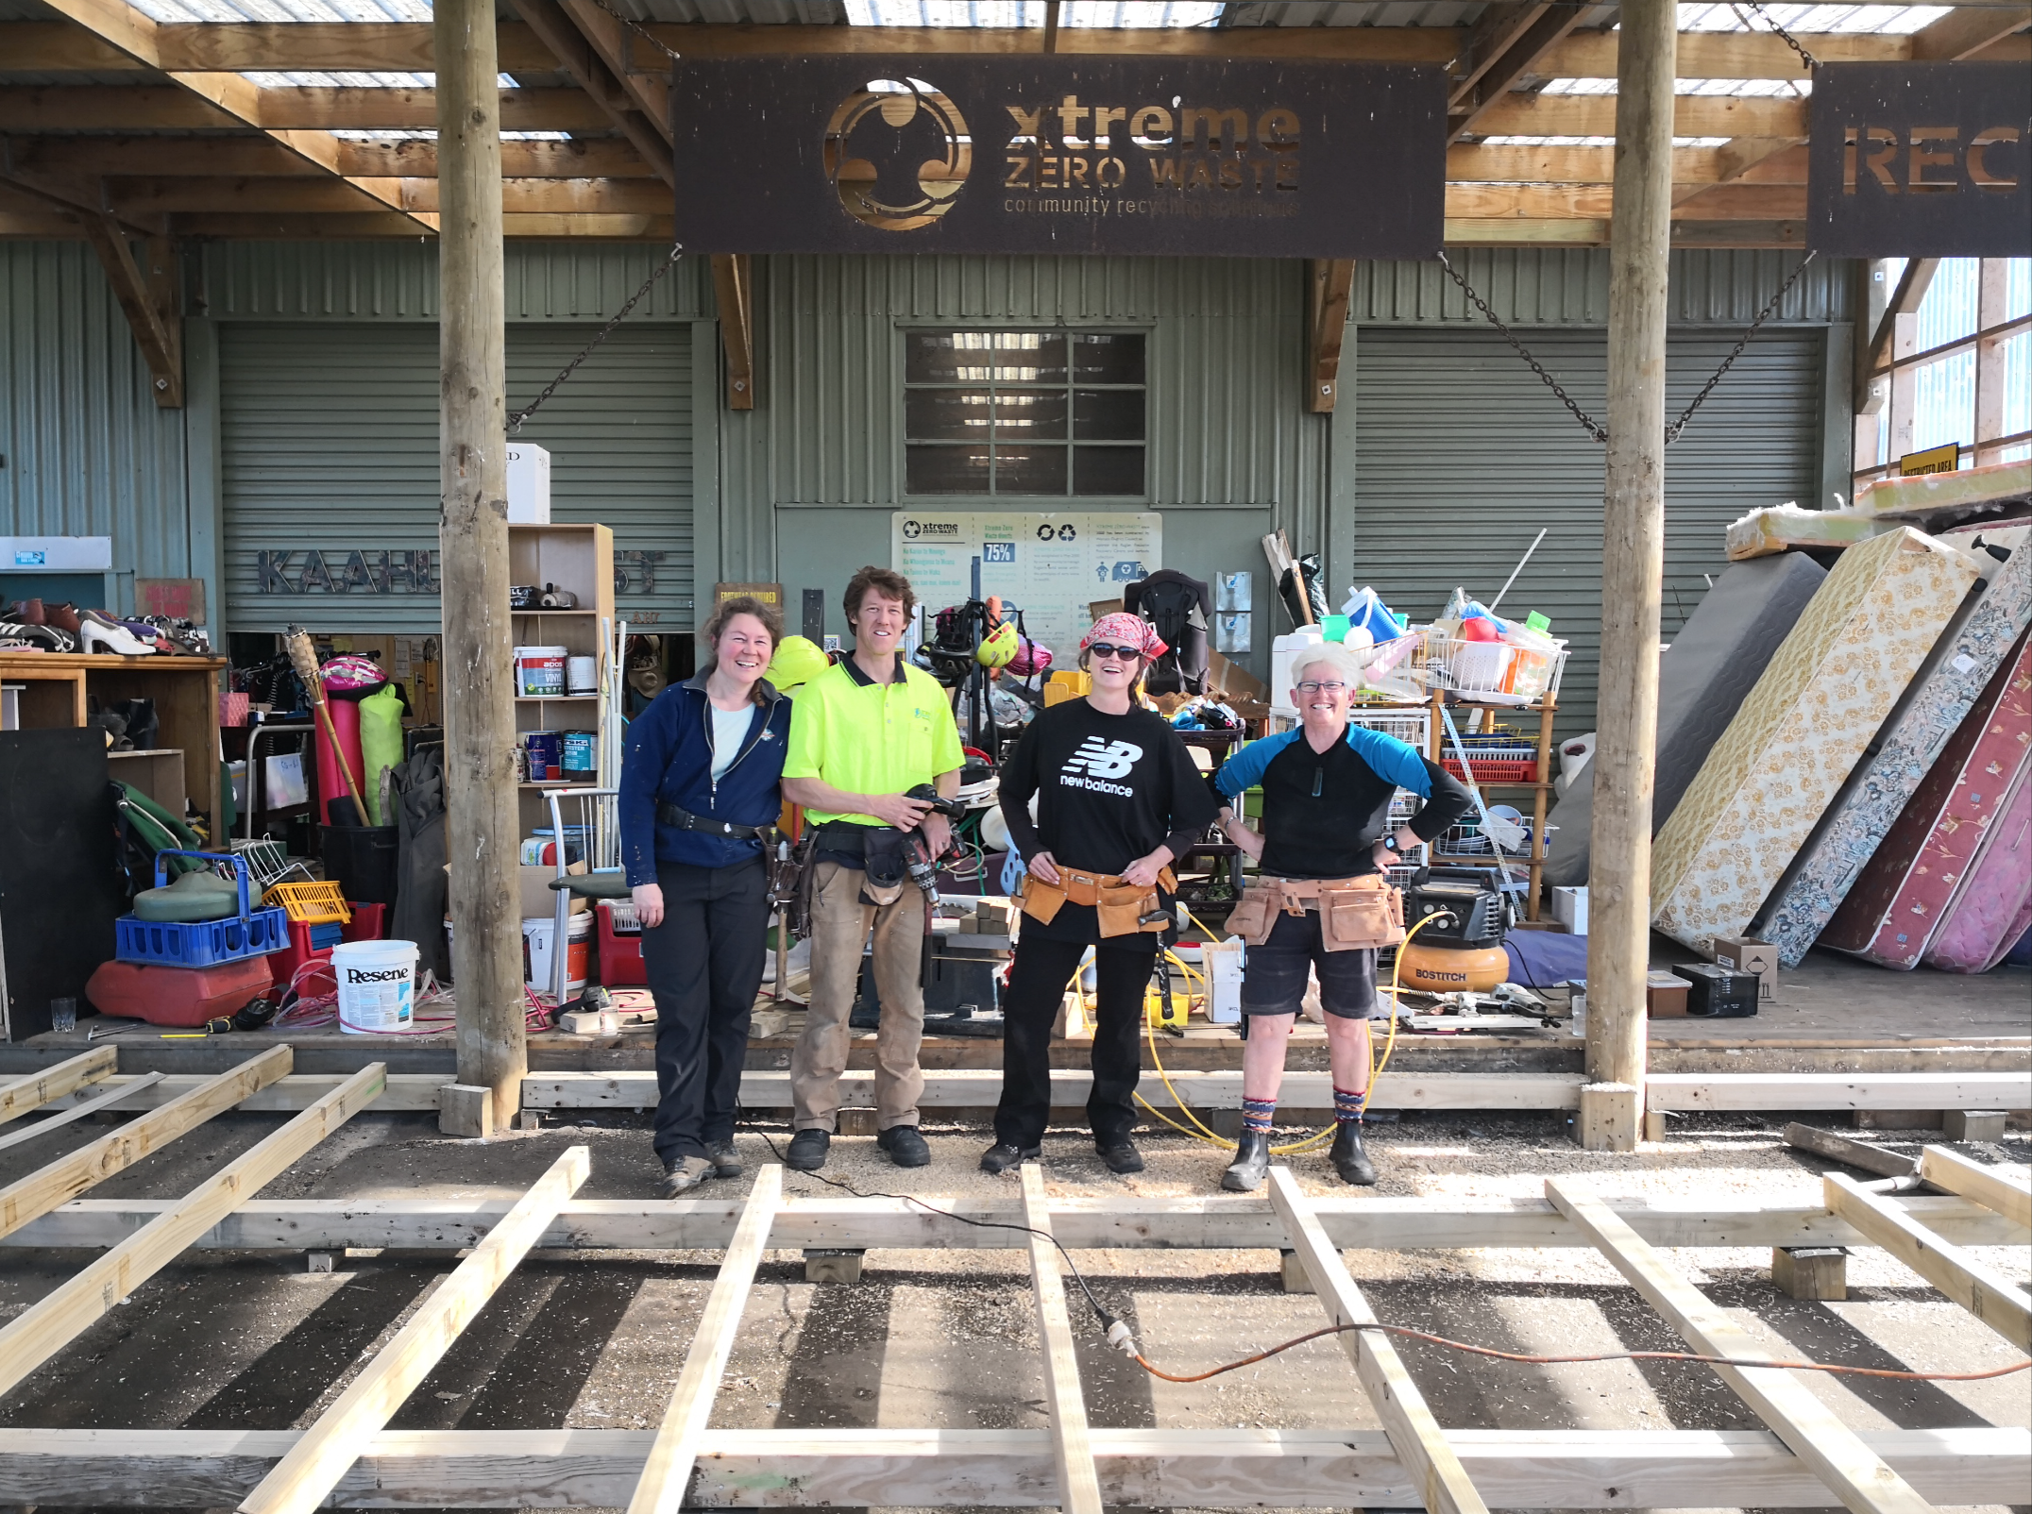

Slide 4
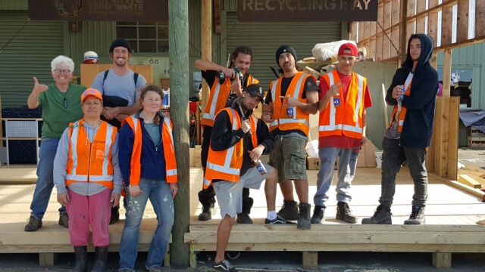

Slide 5
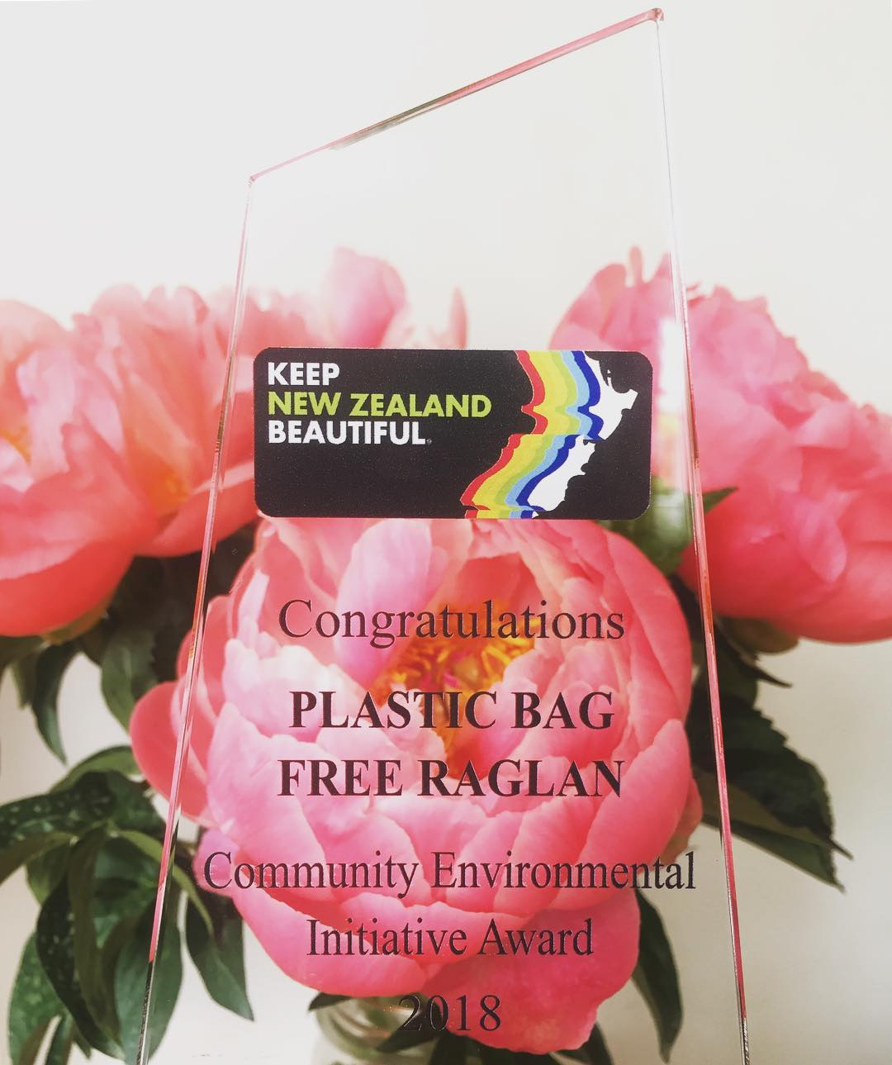

Slide 6
10 Years

Slide 7
Presentation to Raglan Community Board
Getting ready for this summer:
- change of collection days & Centre open hours
Contract review process:
- growth of Raglan
- servicing litter and litter bins
- Te Uku & Te Mata
- loss of plastic markets
- foodwaste collections targeted rate
Support needed from the Board

Slide 8
Change of collection days & Centre open hours - starting Saturday 10 November
 | Mon | Tue | Wed | Thu | Fri | Sat | Sun
6am | Bus. Collection Street bins Te Uku/Te Mata | Street bins | Bus. Collection Street bins Te Uku | Street bins | Bus. Collection Street bins Te Uku/Te Mata | Street bins | Street bins
8.30 |  | Kerbside Pre-paid bag foodwaste | Kerbside Pre-paid bag foodwaste | Kerbside Pre-paid bag foodwaste | Kerbside Pre-paid bag foodwaste | 10.00 Centre open | 10.00 Centre open
12.30 | Centre open | Centre open | Centre open | Centre open | Centre open
1.30 |  | Collections complete | Collections complete | Collections complete | Collections complete
 | processing | processing | processing | processing | processing | processing | processing
 | Street litter |  |  |  | Street litter | Street bins/litter | Street bins/litter
5.00 | Centre closed | Centre closed | Centre closed | Centre closed | Centre closed | Centre closed | Centre closed

Slide 9
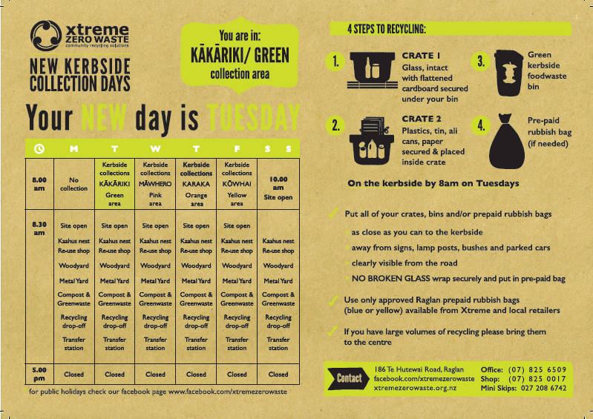
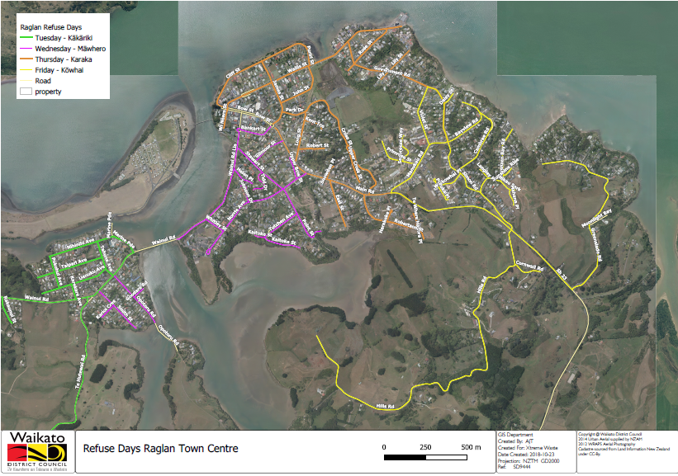
Changes in kerbside collection days – starts 13 Nov
 | Recycle | Pre-paid bags | Food waste
Tuesday | ü | ü | ü
Wednesday | ü | ü | ü
Thursday | ü | ü | ü
Friday | ü | ü | ü

Slide 10
Contract review process:
- Growth of Raglan
Discussions with WDC staff around the growth of Raglan and the infrastructure and services required to manage waste issues.
  We are building a case to WDC around the increased visitor population in Raglan. We still don’t have great information on the peak numbers and trends for Raglan. This information is critical for long term infrastructure planning.
  Our statistics show:
    The total refuse tonnes through the Raglan Resource Recovery Centre has increased by 377 tonnes (27%) in the last 3 years/
    Recovered and recycled materials has increased by 477 tonnes (42%) in the last 3 years.
    Xtreme conducted 120 street bin collections above the contracted collections.
    Xtreme conducted 230 hrs more litter collection time above the contracted service.

Slide 11
Contract review process:
- Growth of Raglan
Currently Xtreme is conducting more collections and bin services than they are being contracted for. The service we provide reflects the need due to high visitor numbers.
WDC, Xtreme, Te Uku School and Te Uku Farmers Market are upgrading the Te Uku recycle drop off centre. The same is happening at Te Mata School.

Slide 12
Contract review process:
-Food waste collections
In July 2019 Raglan Community will decide whether or not to support a targeted rate fund for the continuation of the kerbside food waste collection.
  The collection diverted over 150 tonnes of food waste between Aug 2017 – Aug 2018.
  Food waste was added to greenwaste to produce approx. 300 tonnes of compost.
  Pre-paid bag sales decreased by approx. $18,700 which equates to over 6,500 less bags sent to landfill.

Slide 13
Contract review process:
-Loss of plastic markets
Due to the closure of plastic markets in China there are no markets for:
  Coloured PET, categories 3-7 and coloured film.
Xtreme are working with Hamilton and Raglan based plastic engineers to use the plastics to make products in Raglan.
An ideal location in Aotearoa for a plastic processing and manufacturing plant is northern Waikato.
  There is a large volume of plastic either created or transported through the Waikato from the Rotorua, Hauraki, Waikato, Auckland areas. This volume would be sufficient to establish a hub of activity to ensure departure from fickle overseas markets.

Slide 14
Contract review process:
-Support required from Raglan Community Board
Advocate for more precise information on visitor numbers and trends
Increase Xtreme’s current contract – especially the summer season
Support for the continuation of the kerbside food waste collection
Support Xtreme to develop plastic processing and manufacturing in Raglan
Support a plastic processing and manufacturing plant/hub in the northern Waikato

