Slide 1
HIGHLIGHTS OF
OUR YEAR 2018

Slide 2
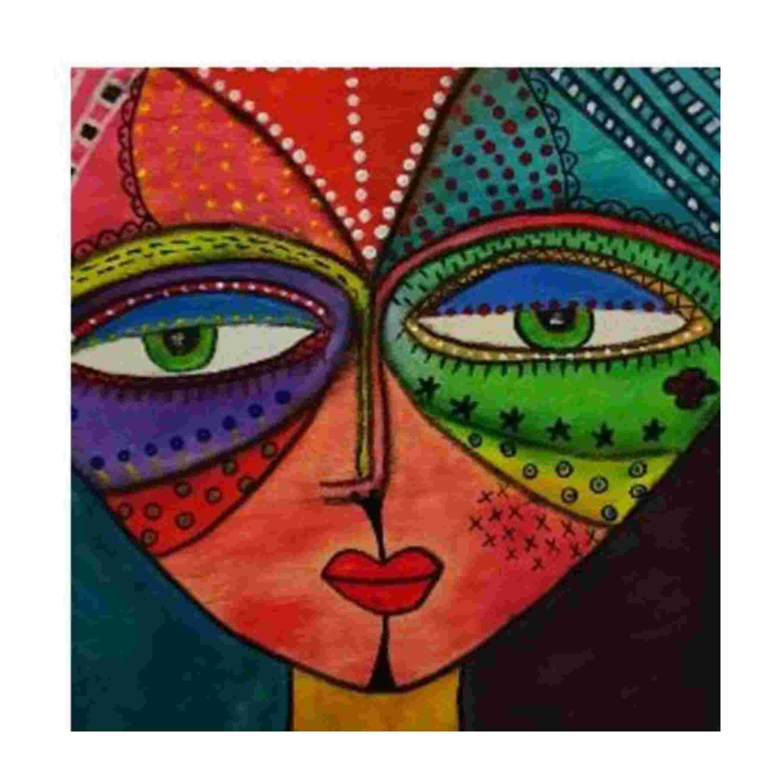
Funky Faces
Master Class with Julie Whyman

Slide 3
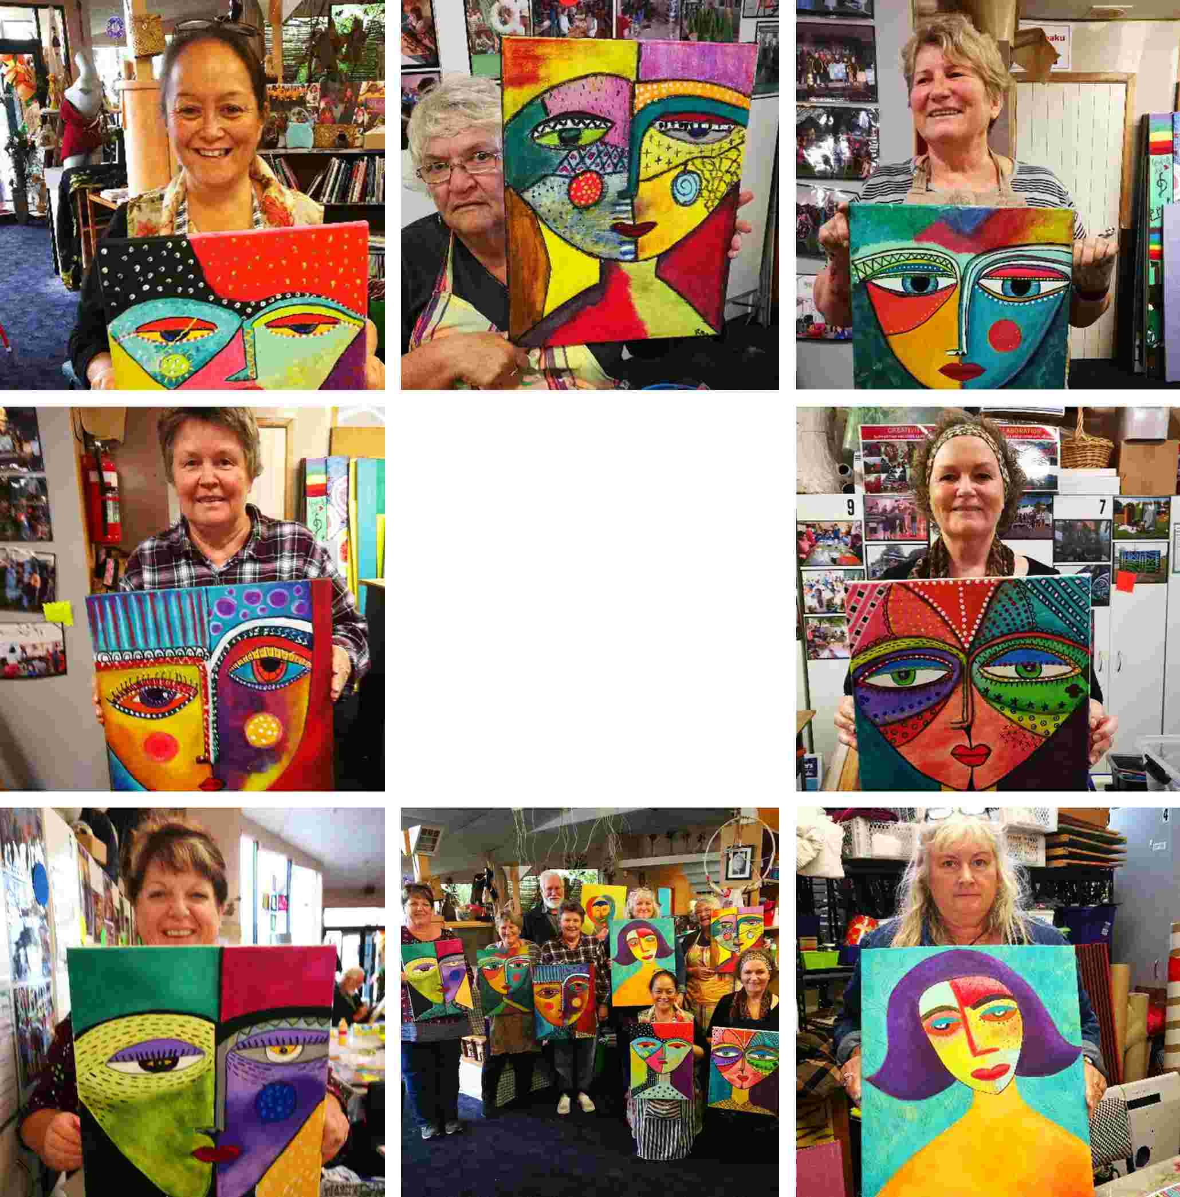


Slide 4
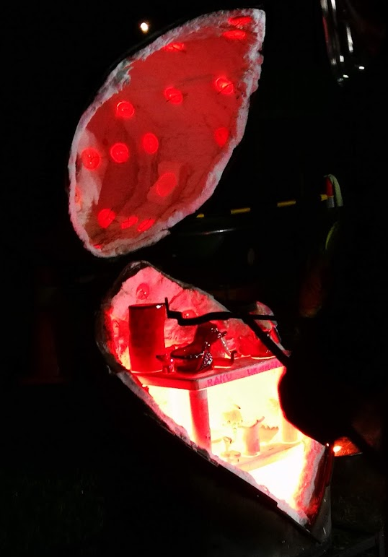
Raku Pottery
Weekly Evening Class with David Kenny

Slide 5
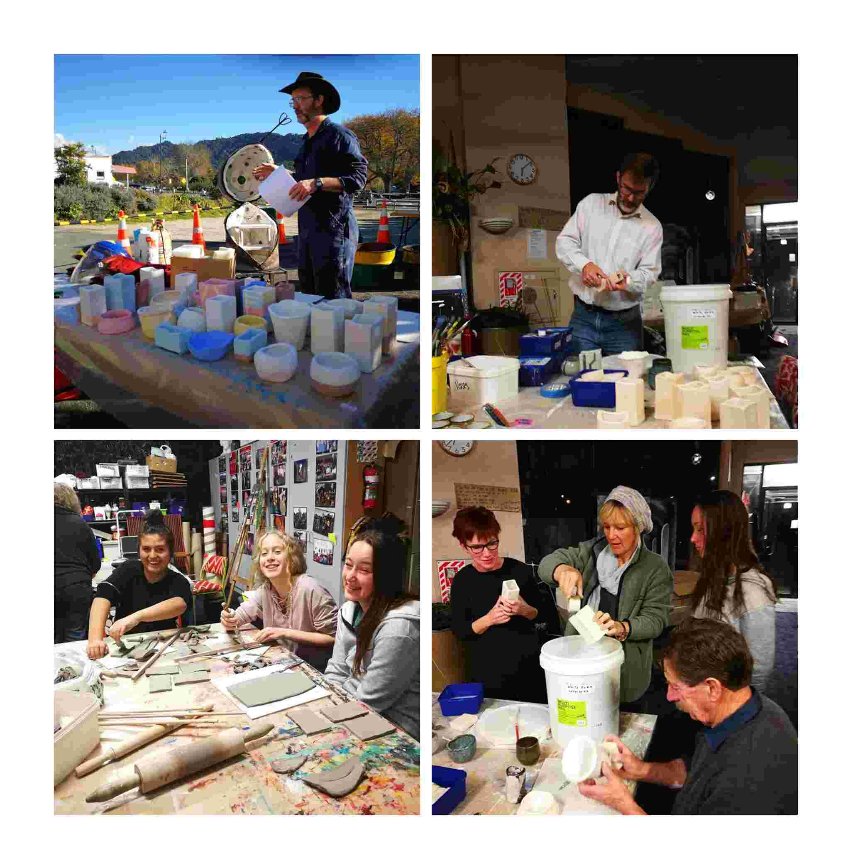

Slide 6
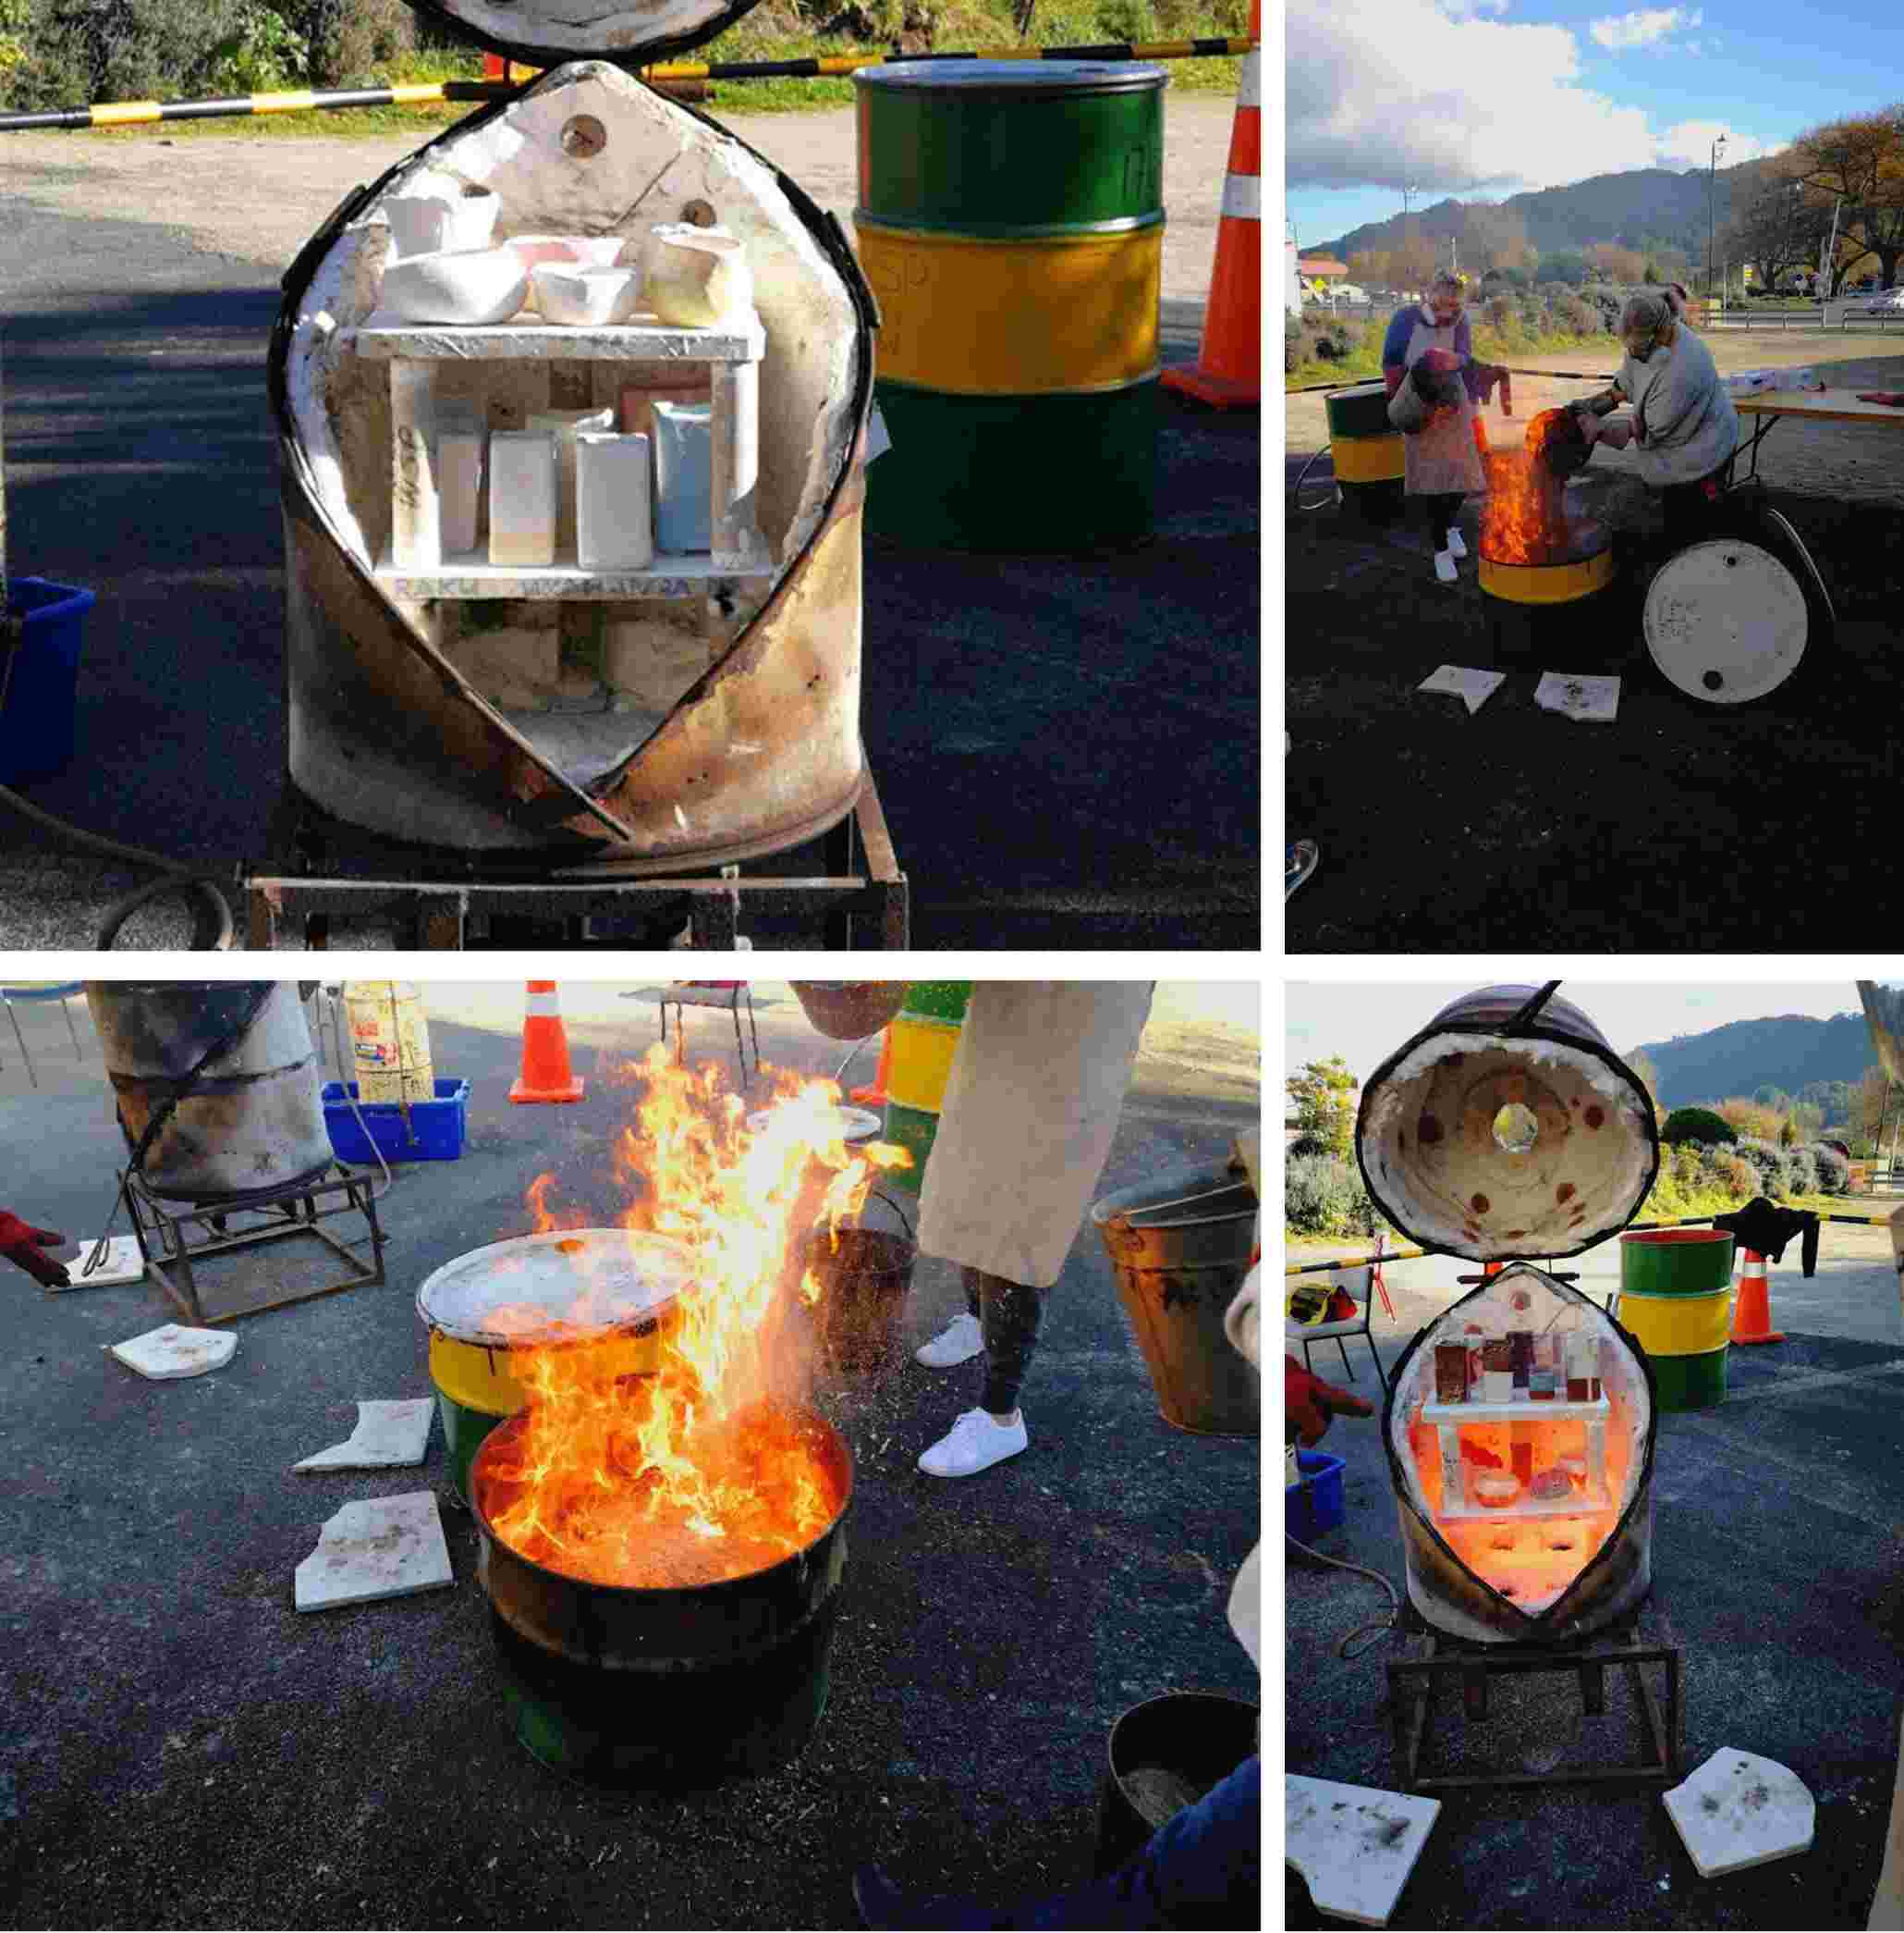

Slide 7
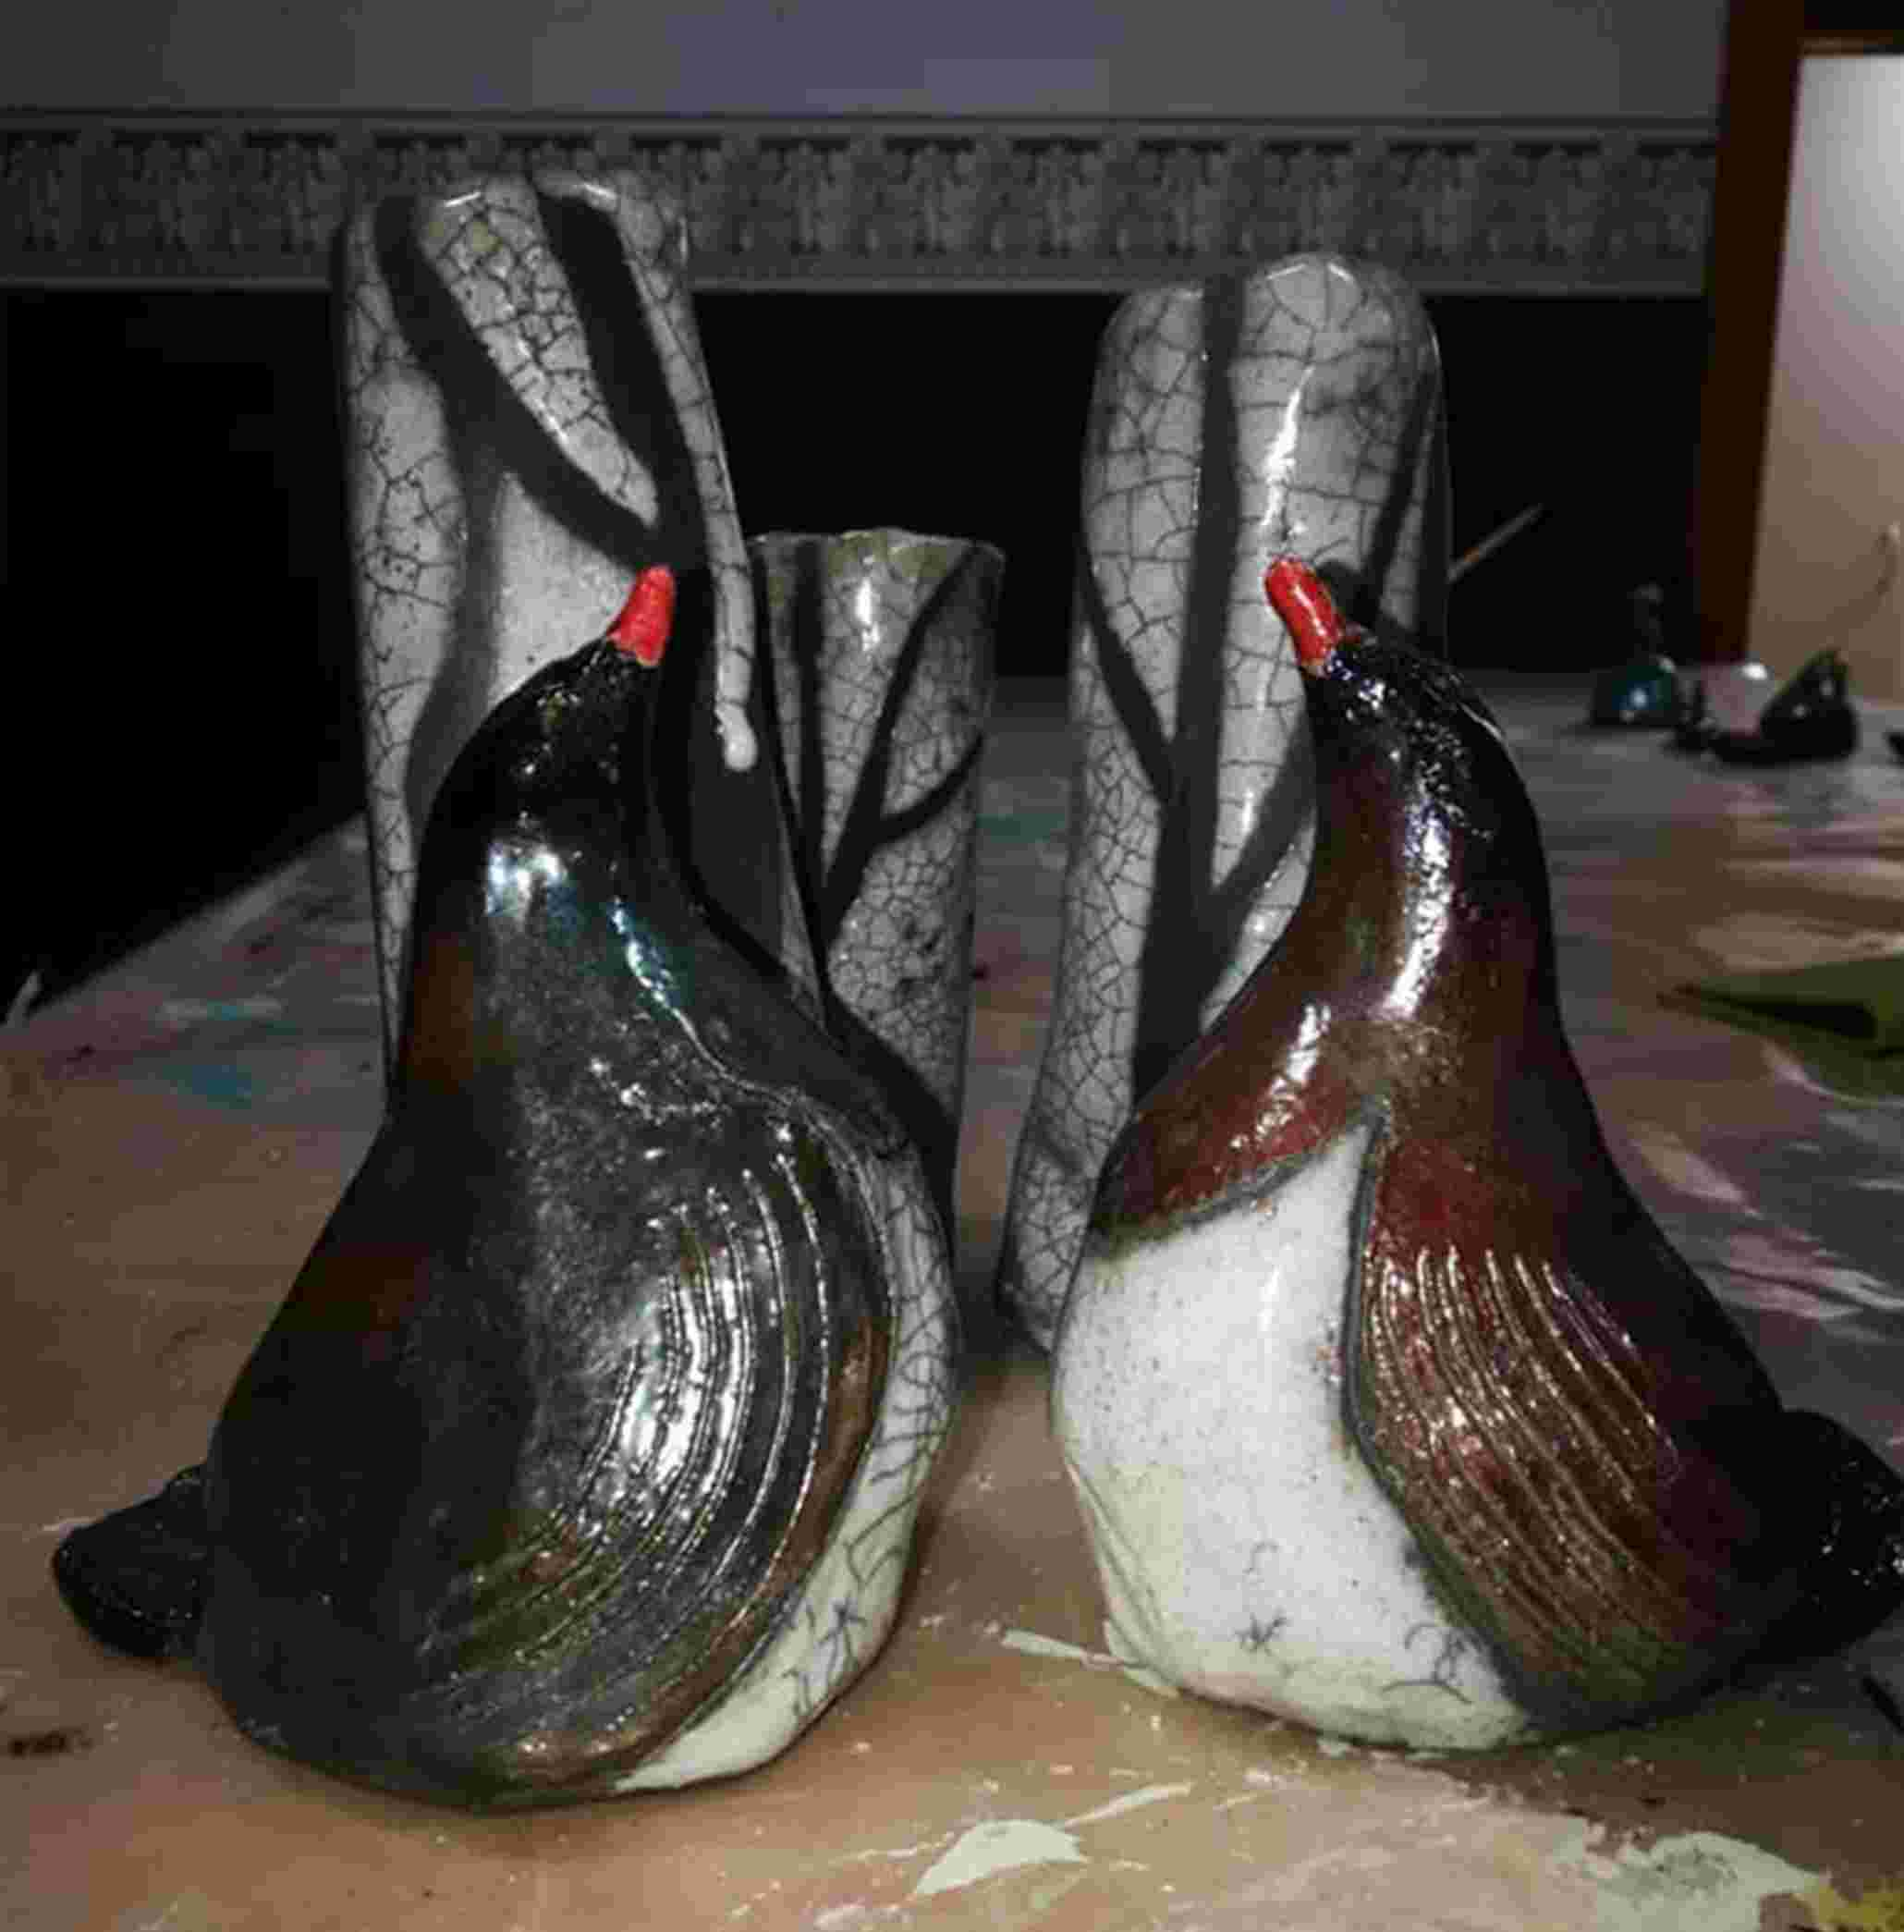

Slide 8
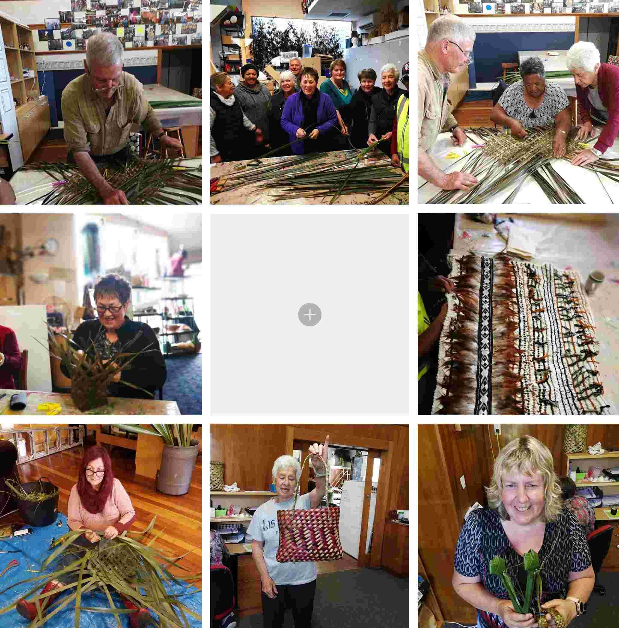
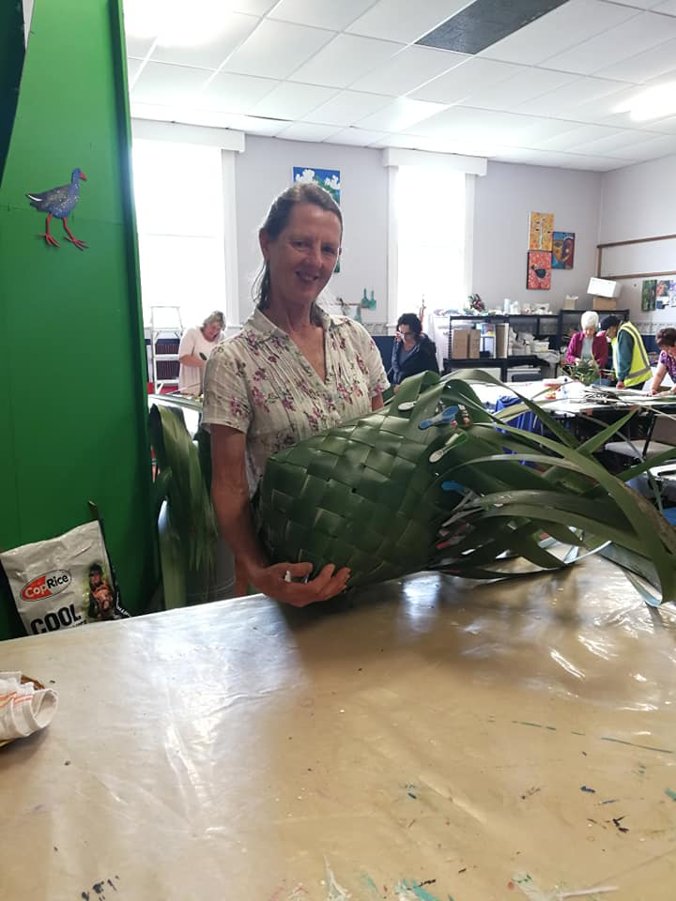
Raranga
Weekly daytime class with tutor Virginia Knowles

Slide 9
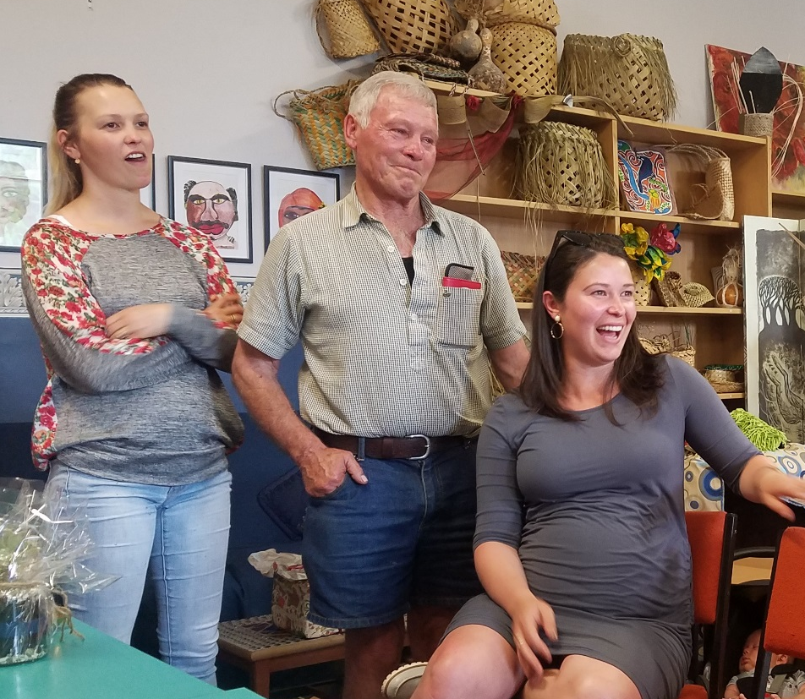
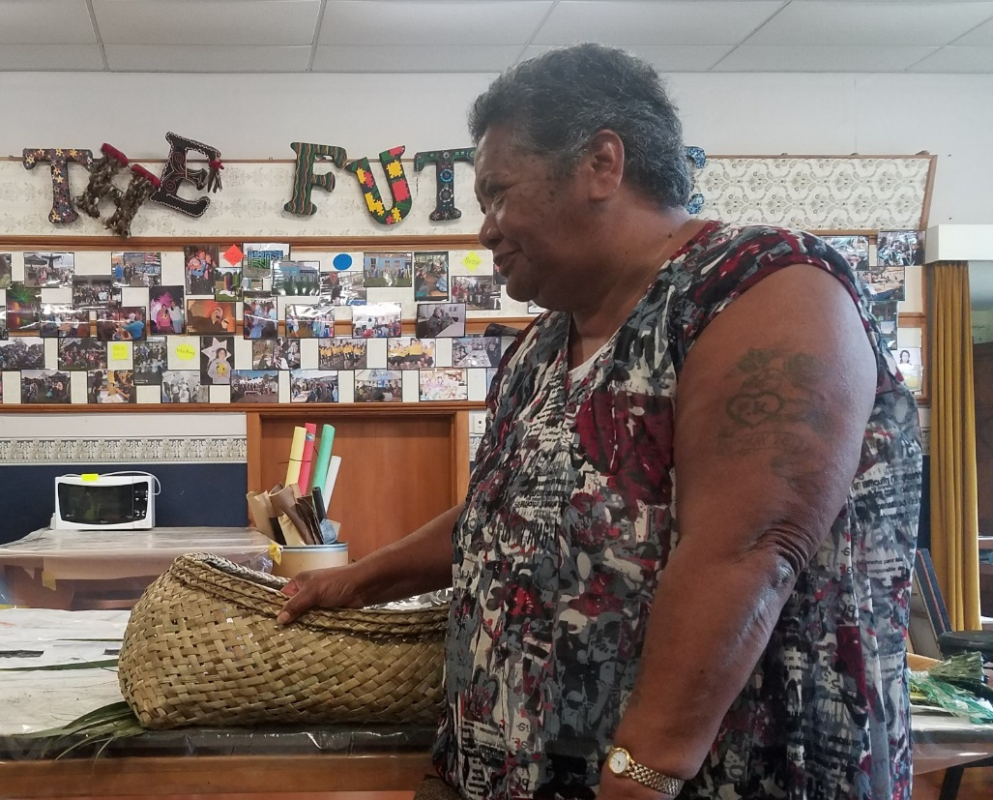
Te tuku o te wahakura ki te whanau

Slide 10
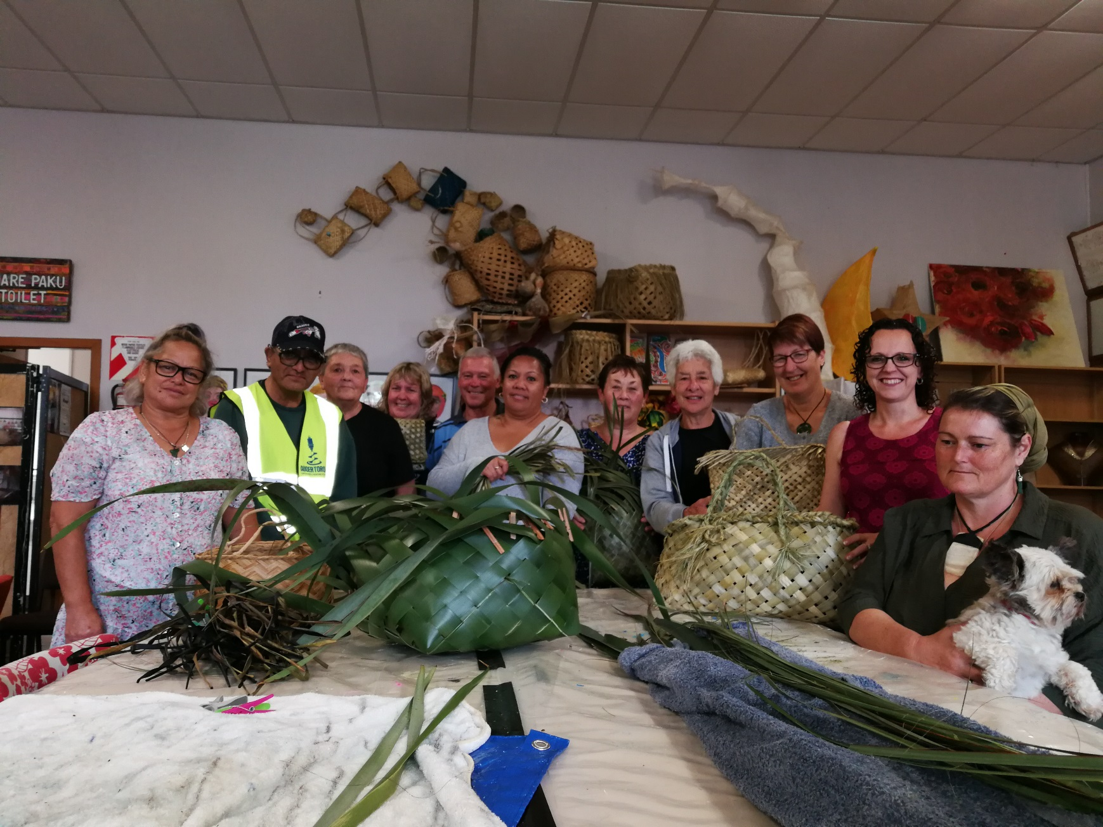

Slide 11
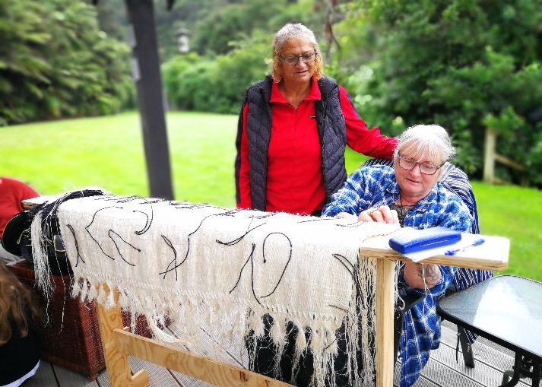
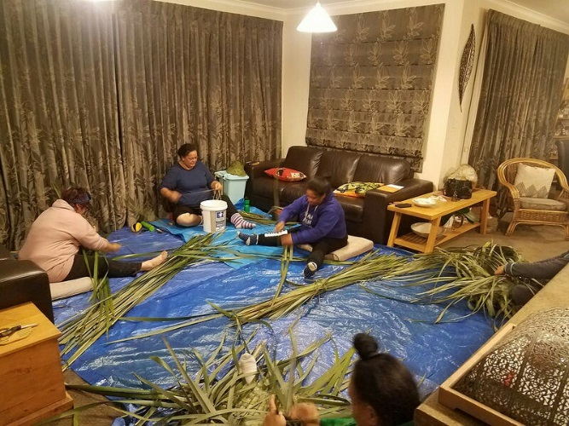
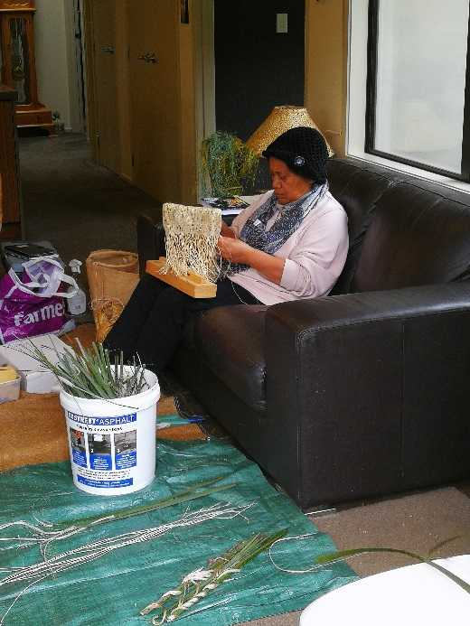
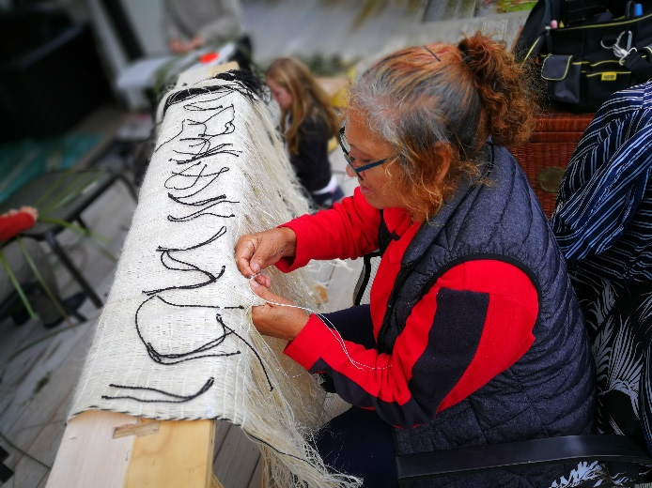
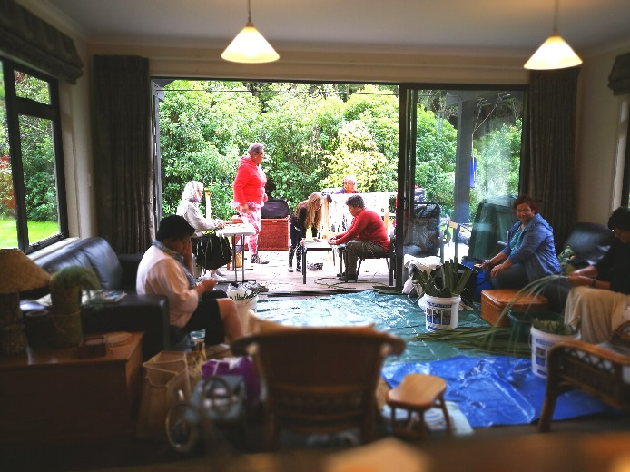
Rarakatia
2 day noho per Term with tutor
Irene Brady

Slide 12
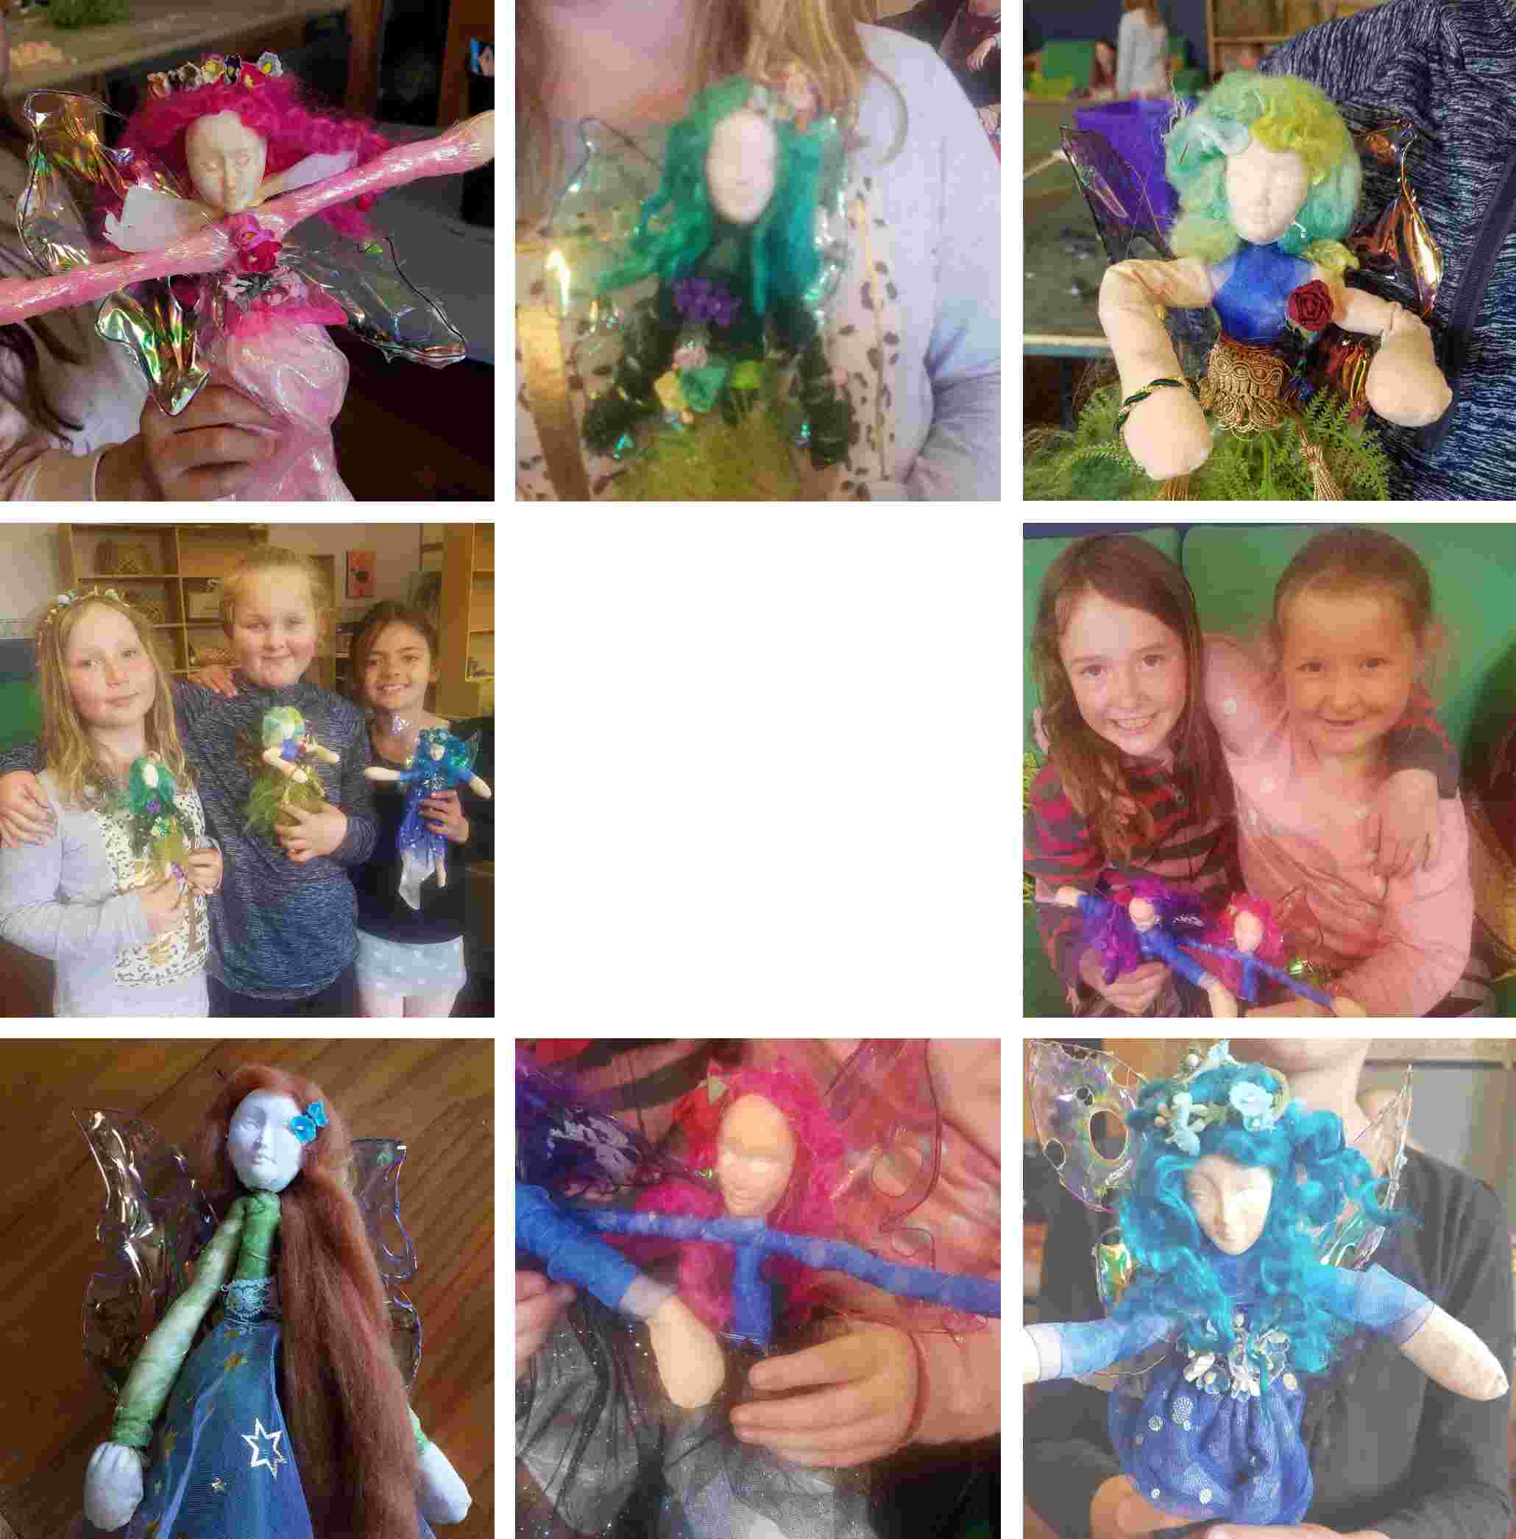
School Holiday Class
Term 3
Magical Fairies

Slide 13
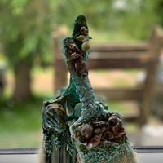
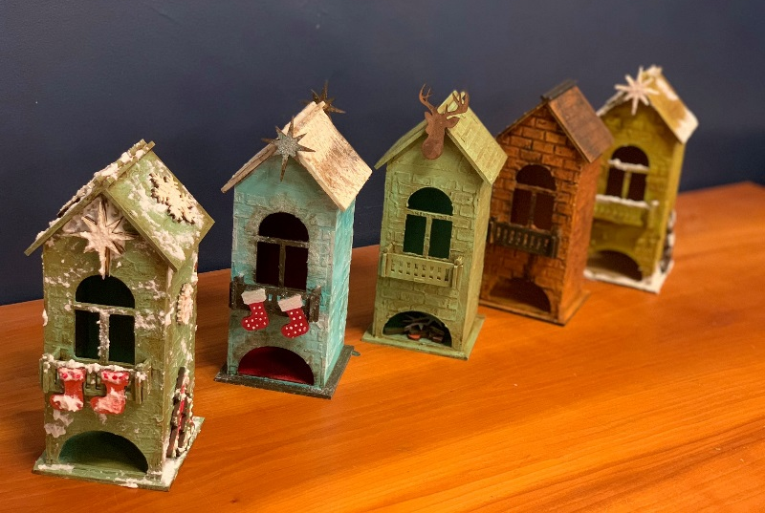
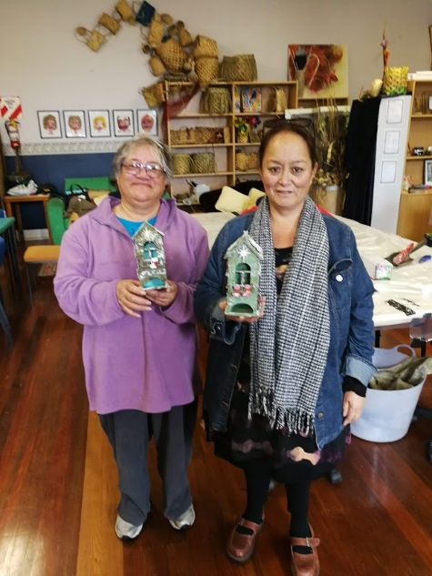
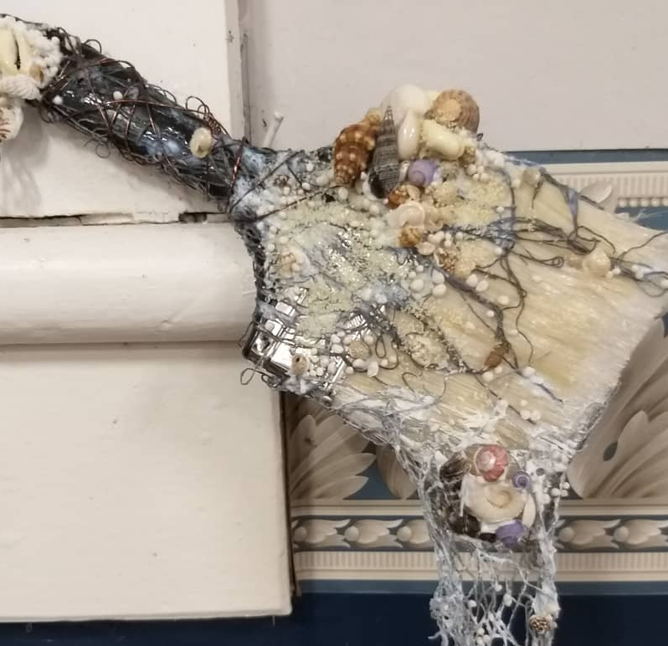
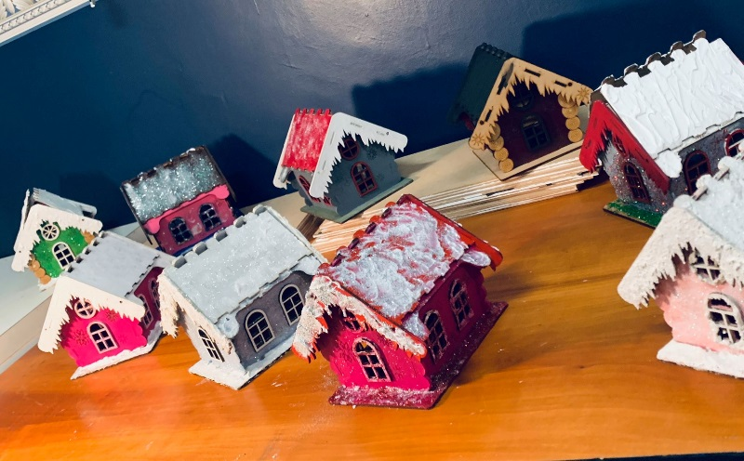
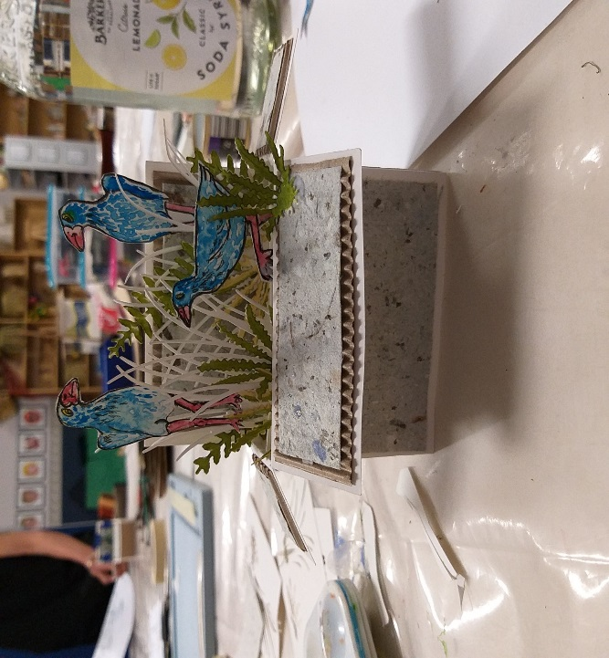
Annual Xmas Craft Class
4 weeks of Xmas Fun with Tutor Faith Pocock

Slide 14
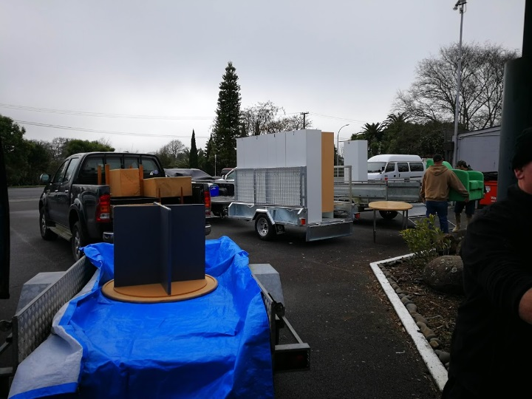
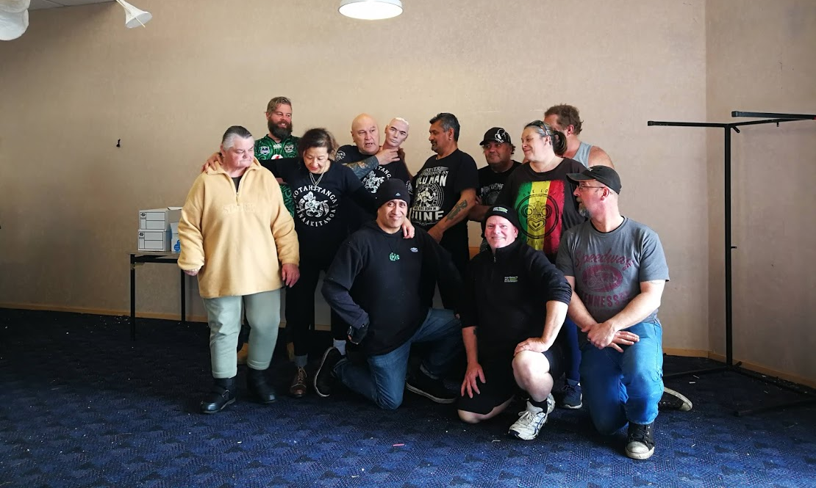
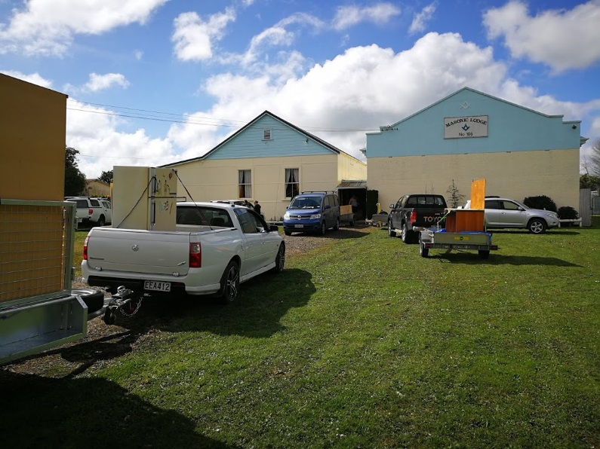
Moving Day – September 2018 with the help of many volunteers including
Tribal Nations

Slide 15
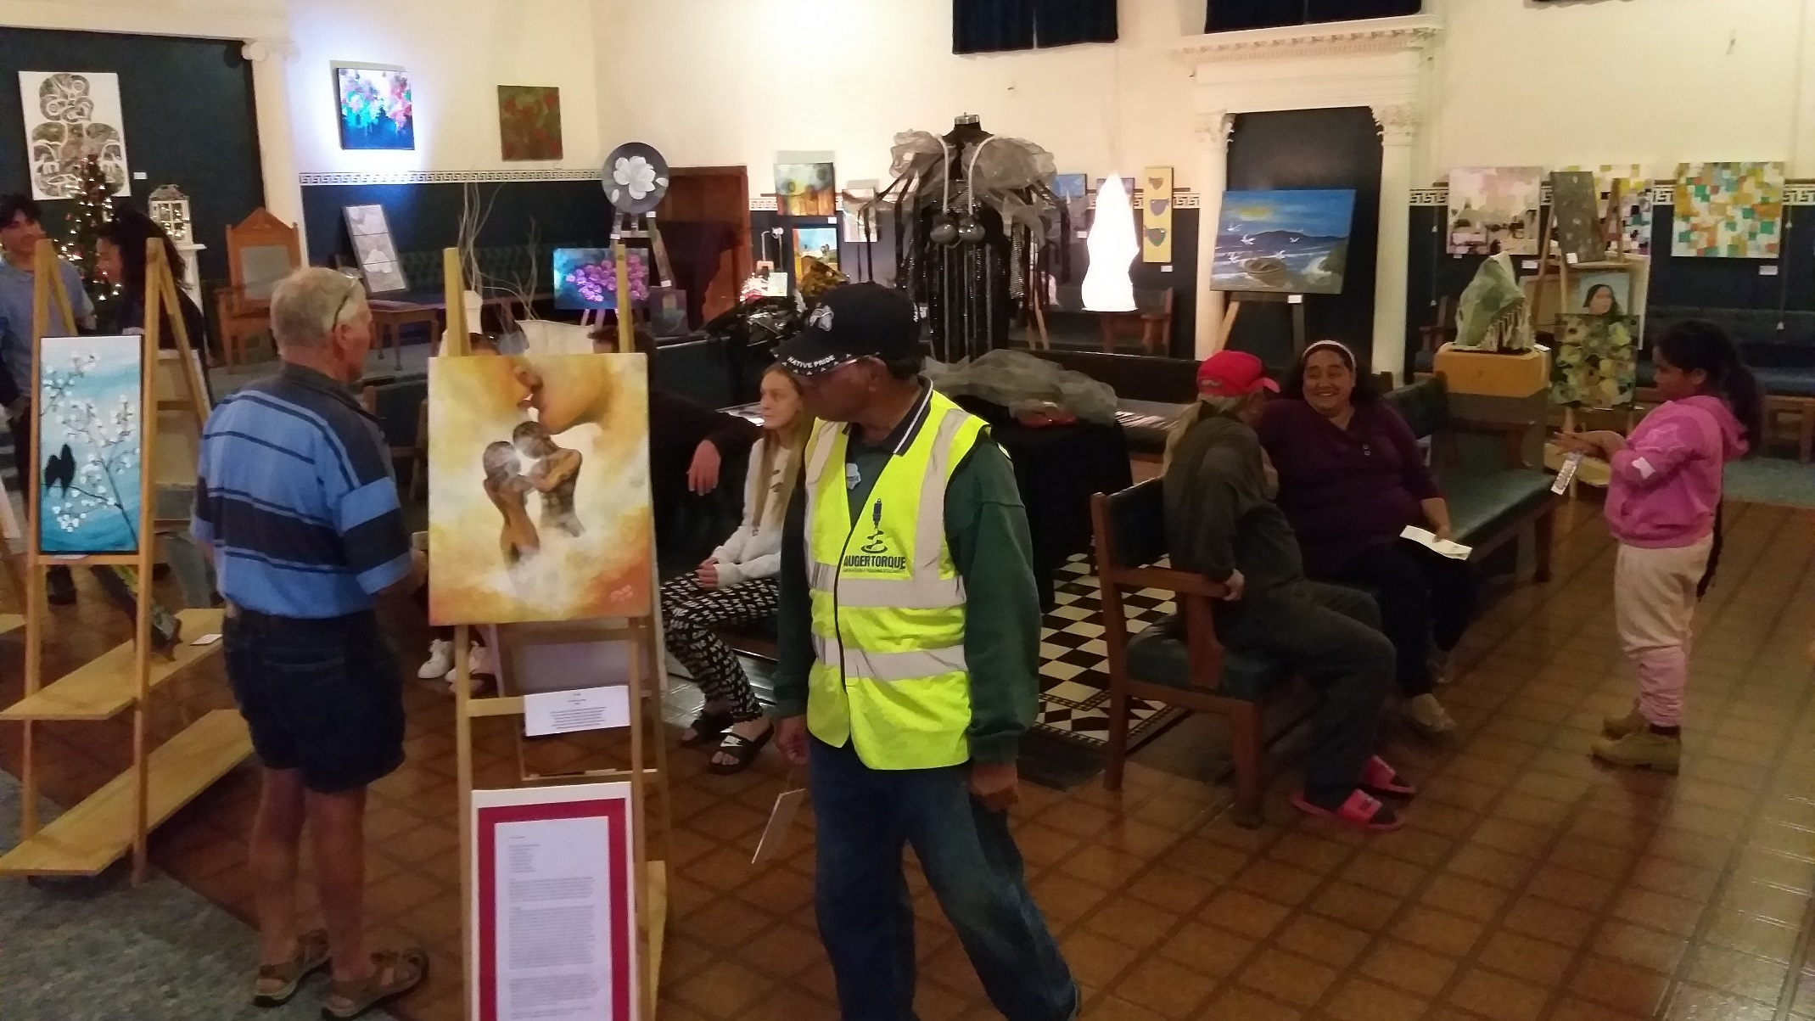
Opening Exhibition

Slide 16
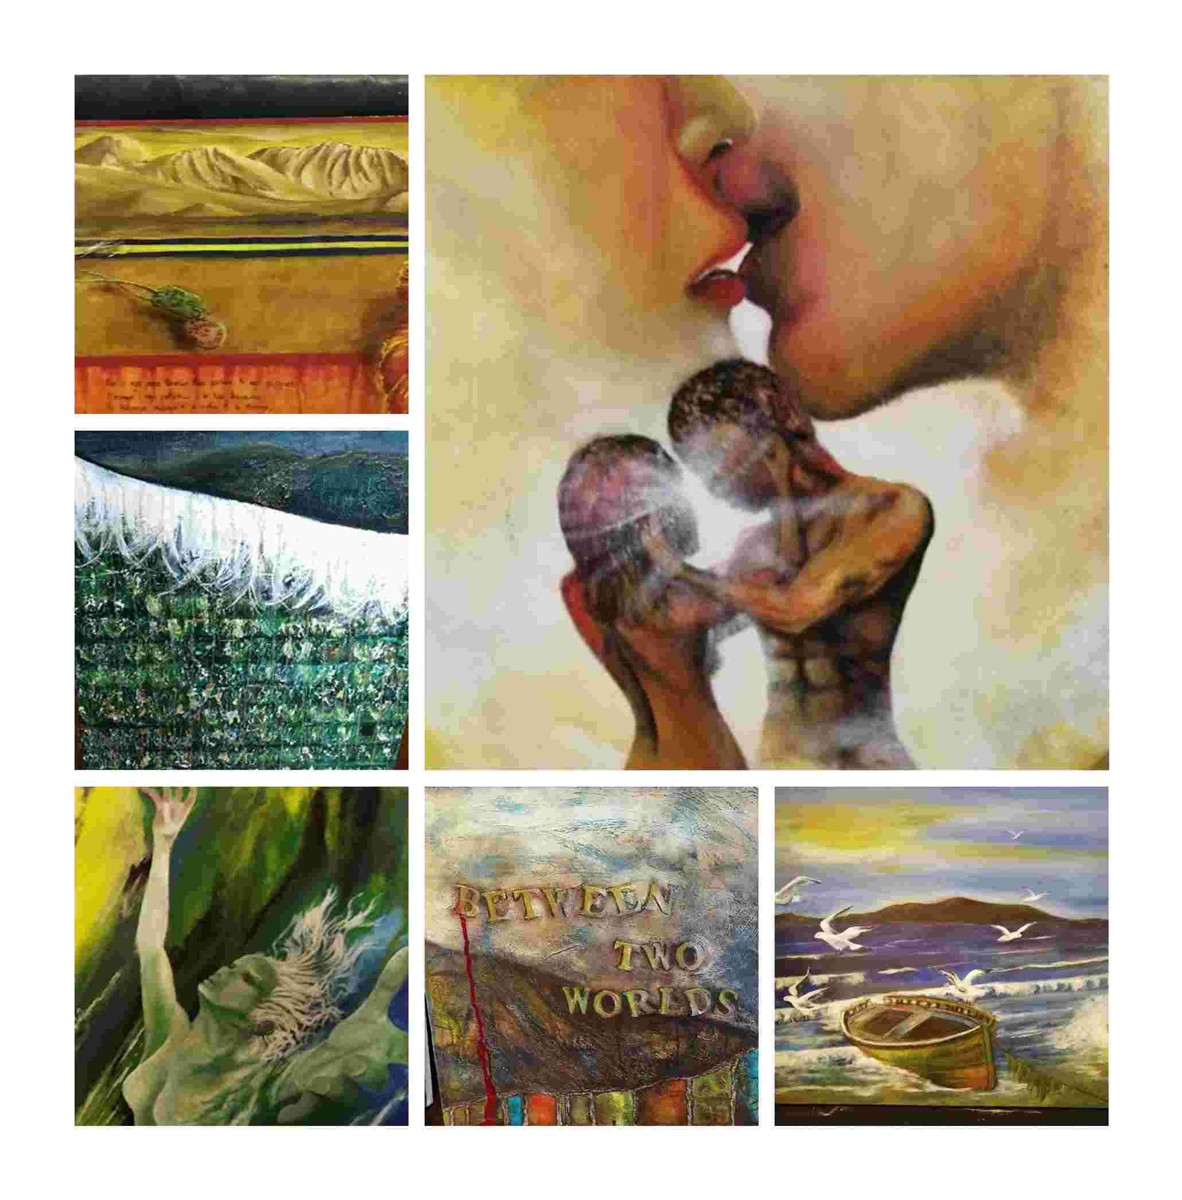
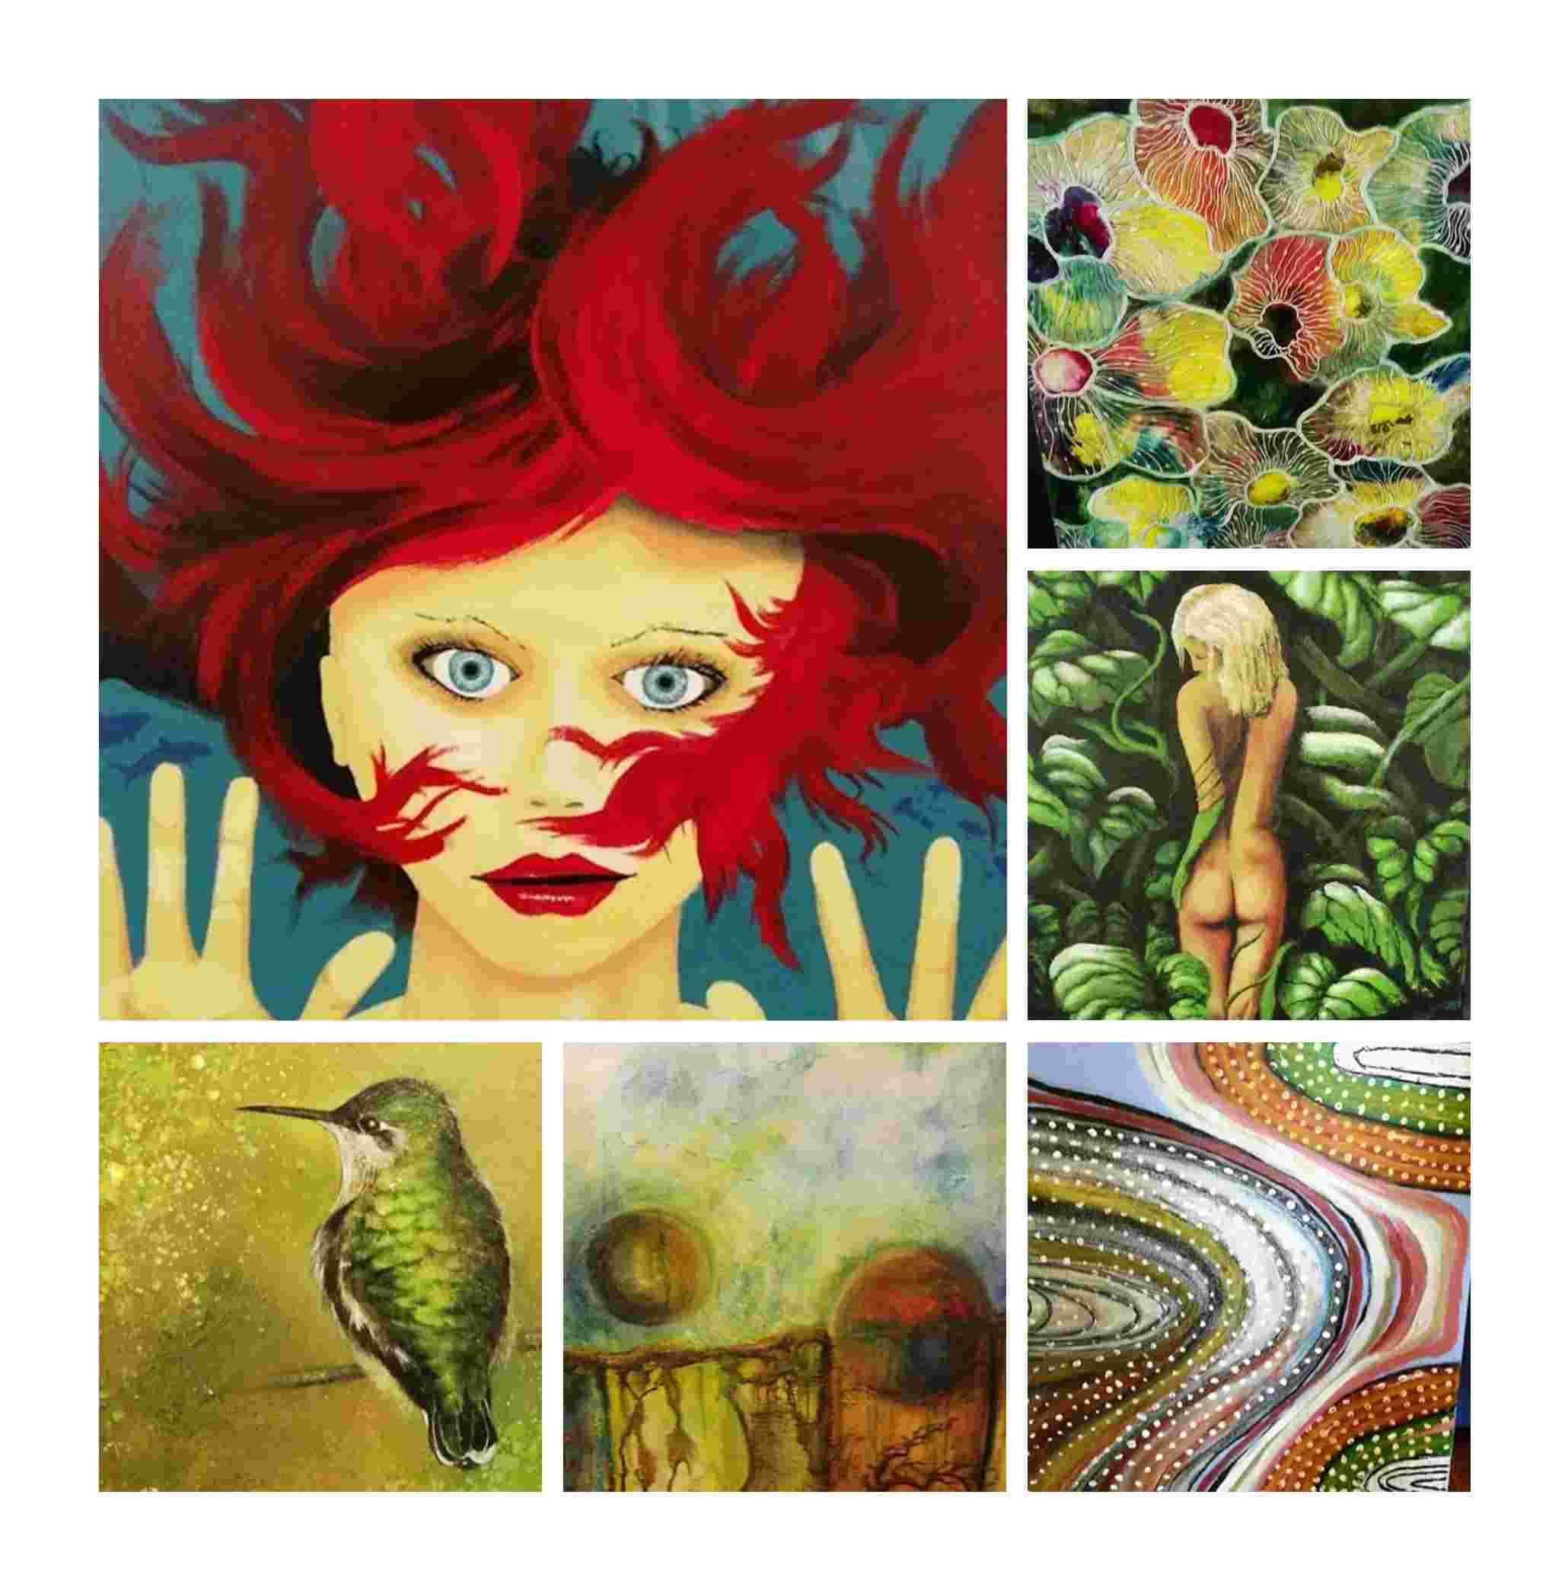
Art
Works from
our Opening Exhibition

Slide 18

KEEPING OUR KAURI
STANDING
Here in the North Waikato we have the southern most habitat for the mighty Kauri tree and in the Hakarimata Ranges we have the largest tree left standing in the Waikato who is over a thousand years old.
Kauri die back disease is threatening our Kauri and the plants and animals that are part of its eco system. So we have teamed up with the Kauri Dieback Trust to focus on how we all can play a part in protecting our Kauri for the future.

Slide 19
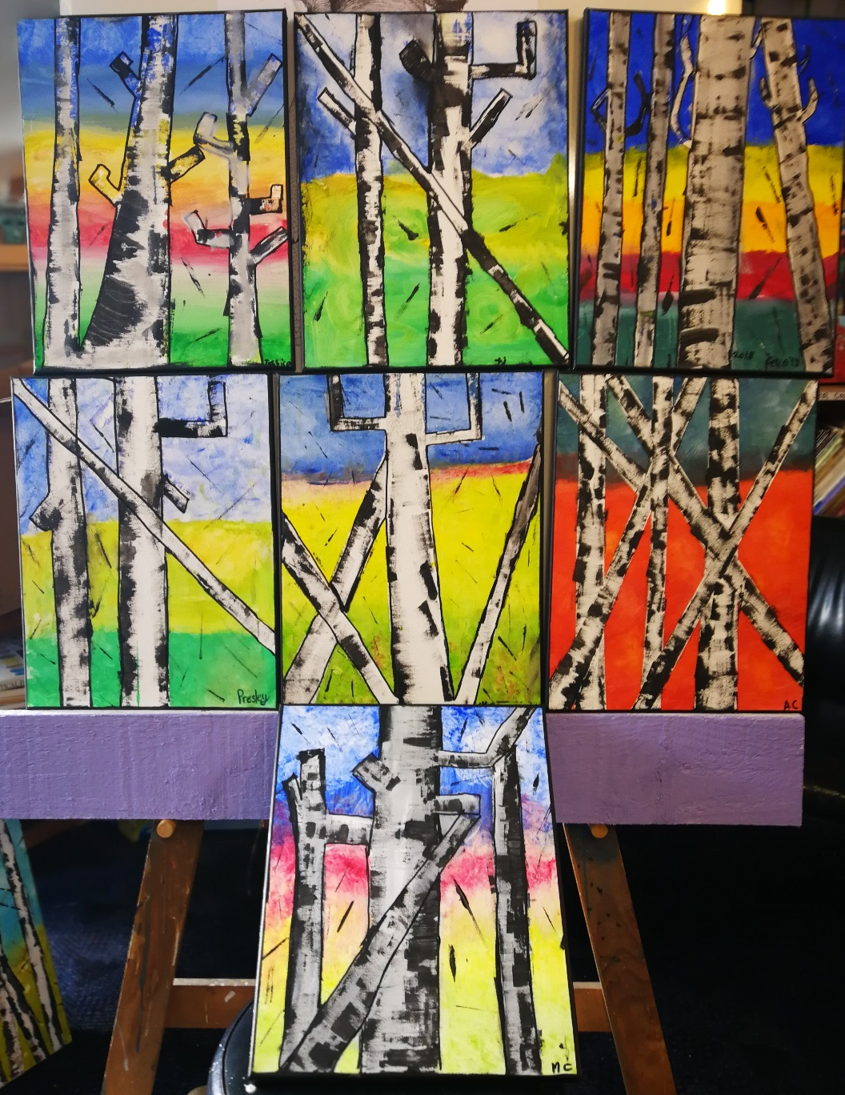

We were all standing tall
just like a Kauri
by the end of
the day.
Proud of what we had learnt and achieved.

Slide 20
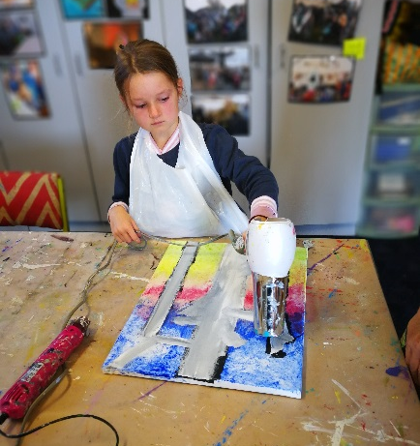
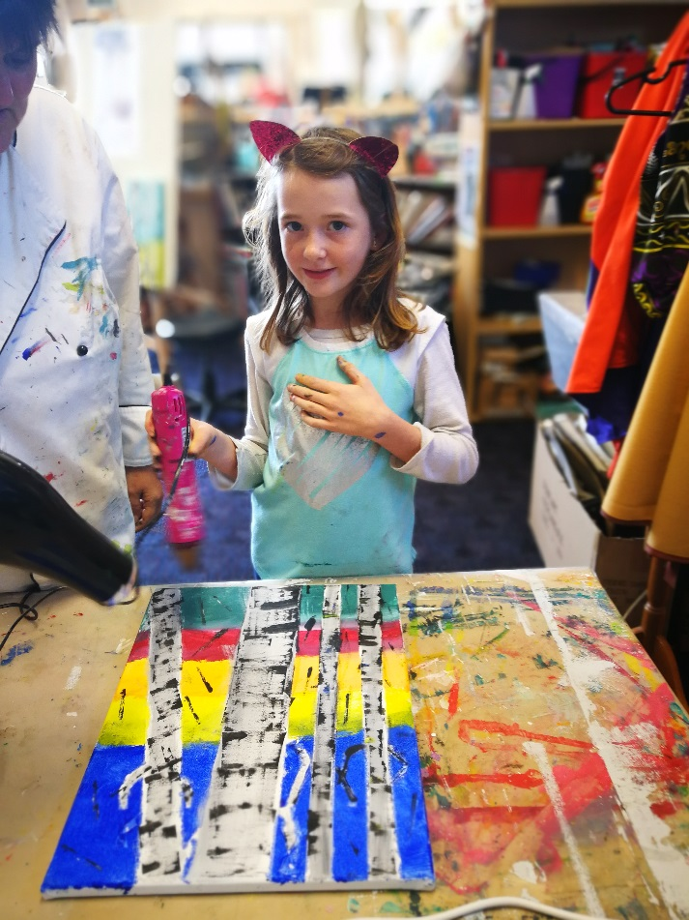
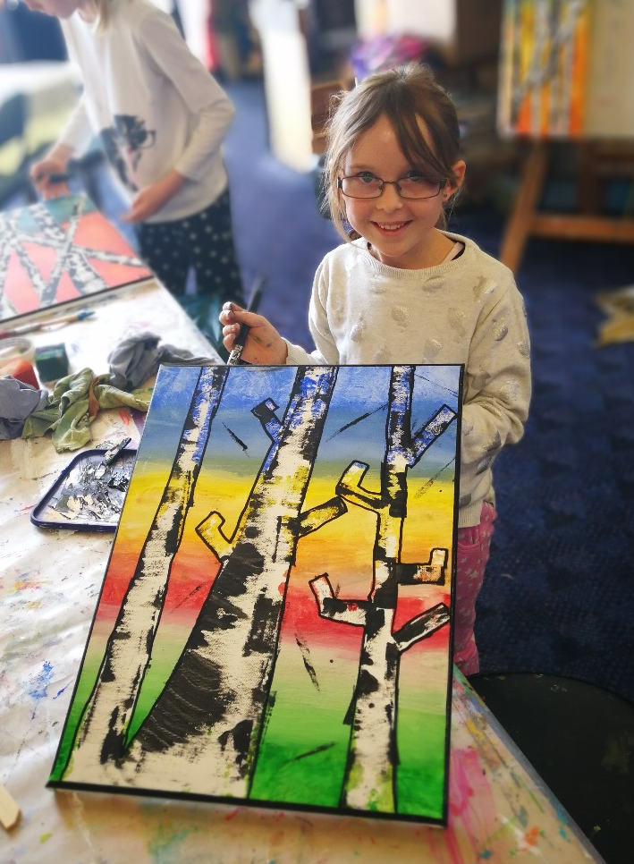
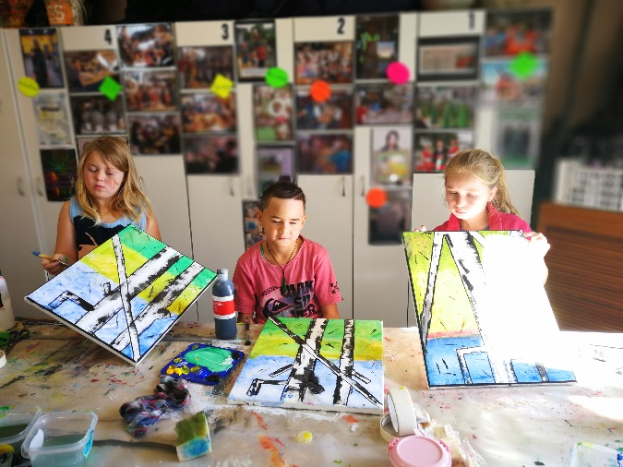
Then we gave the trees their bark

Slide 21
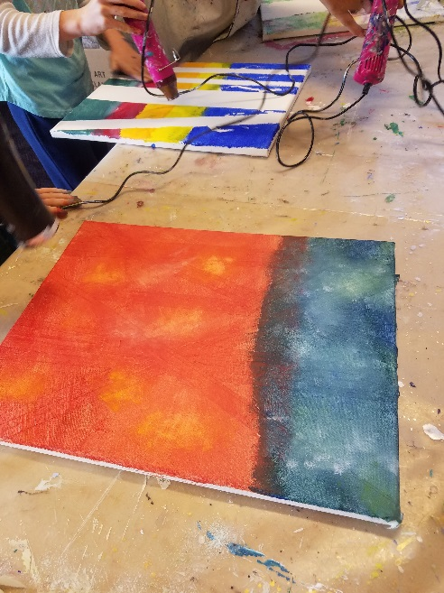
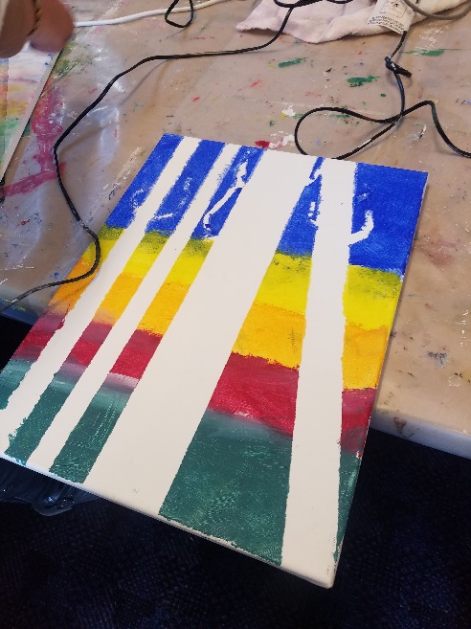
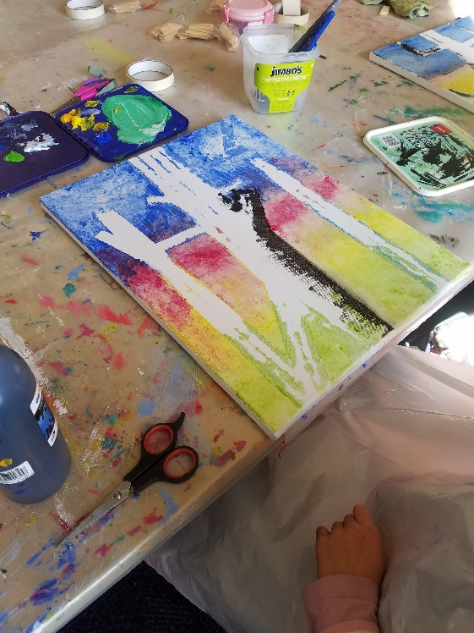
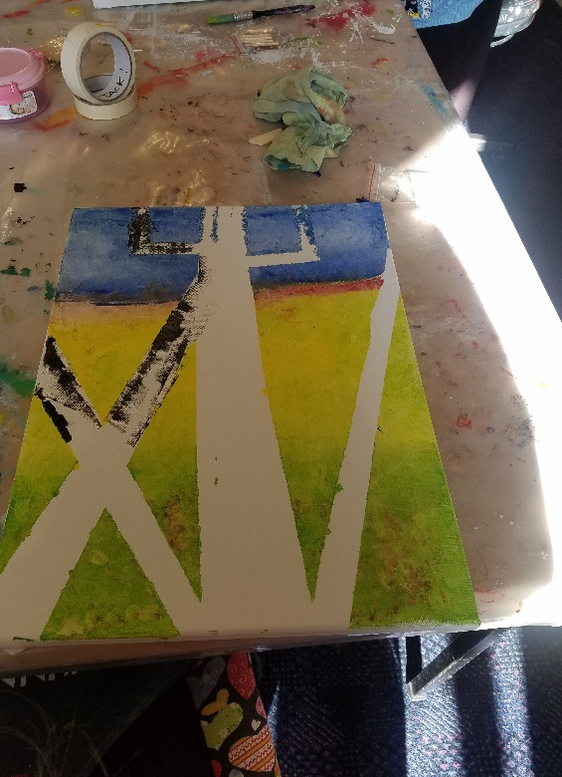
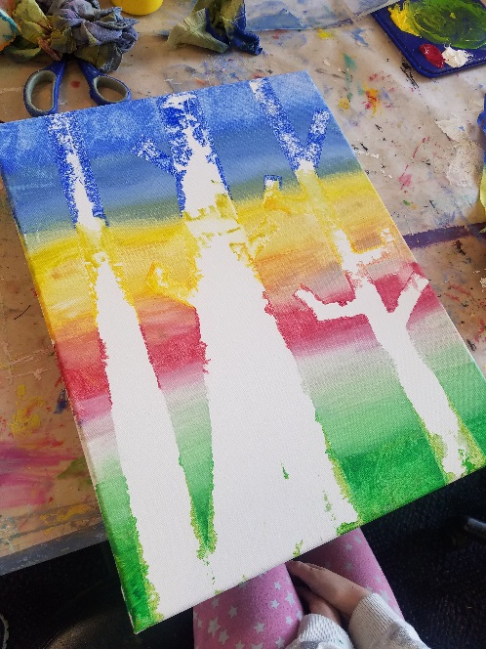
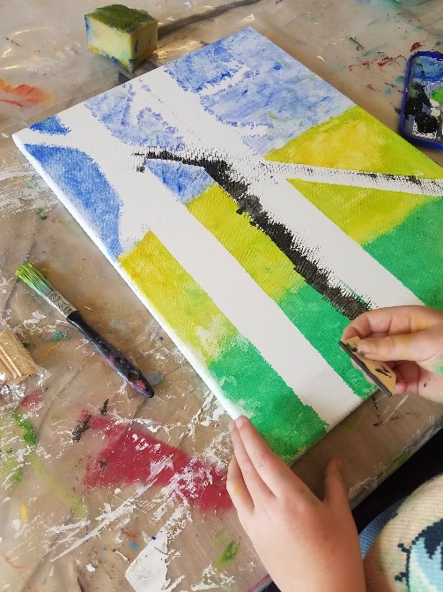
Then we painted the background

Slide 22
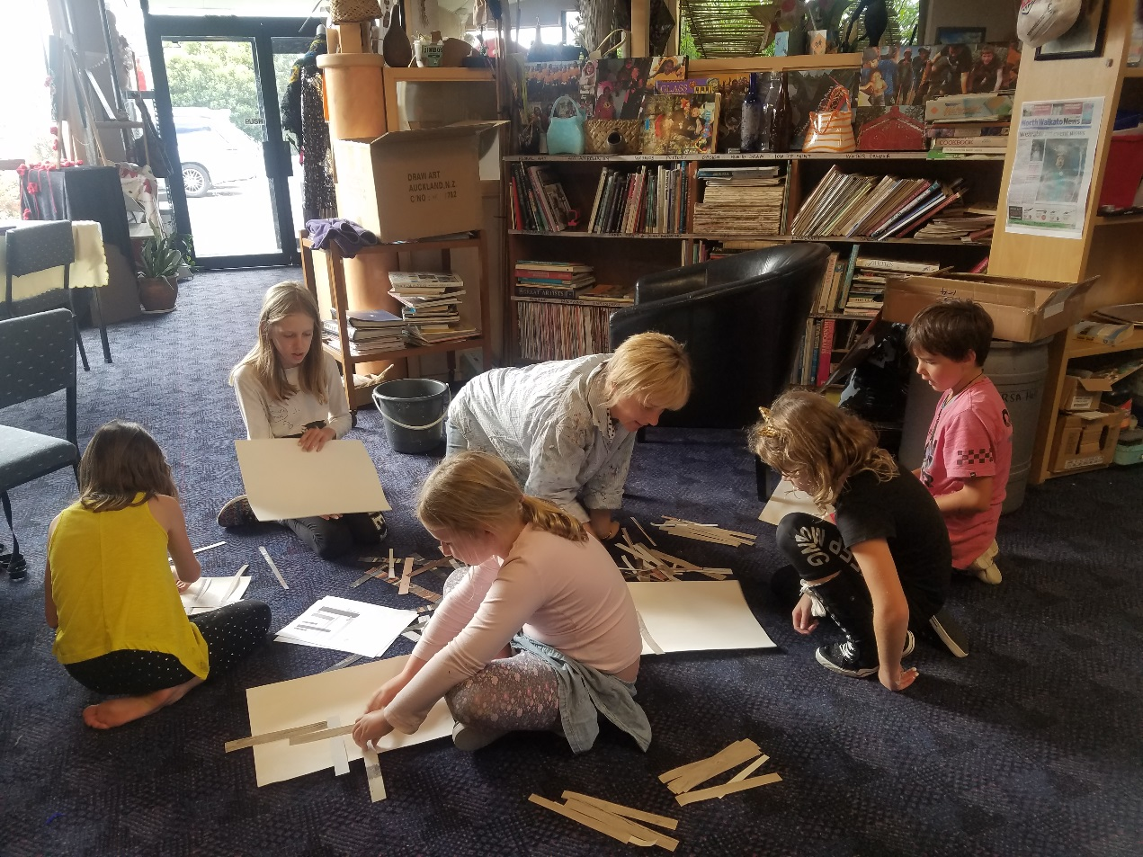
Our third artwork project explores the trunks of the Kauri. We started by masking the trunk outline on the canvas

Slide 23
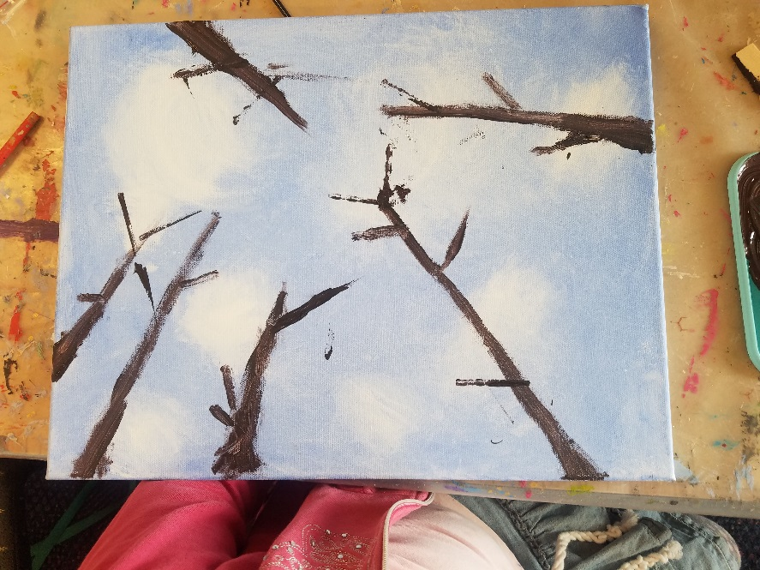
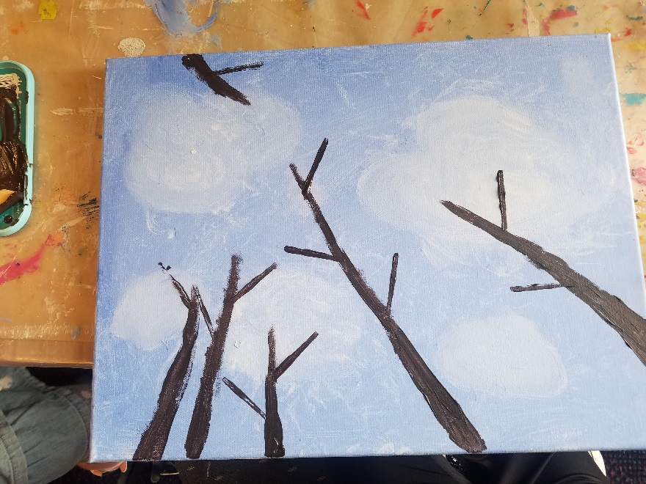
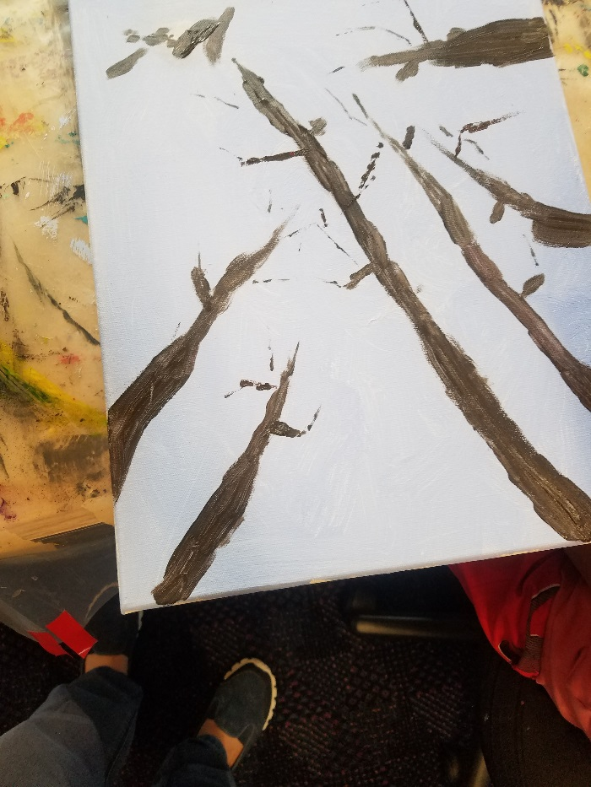
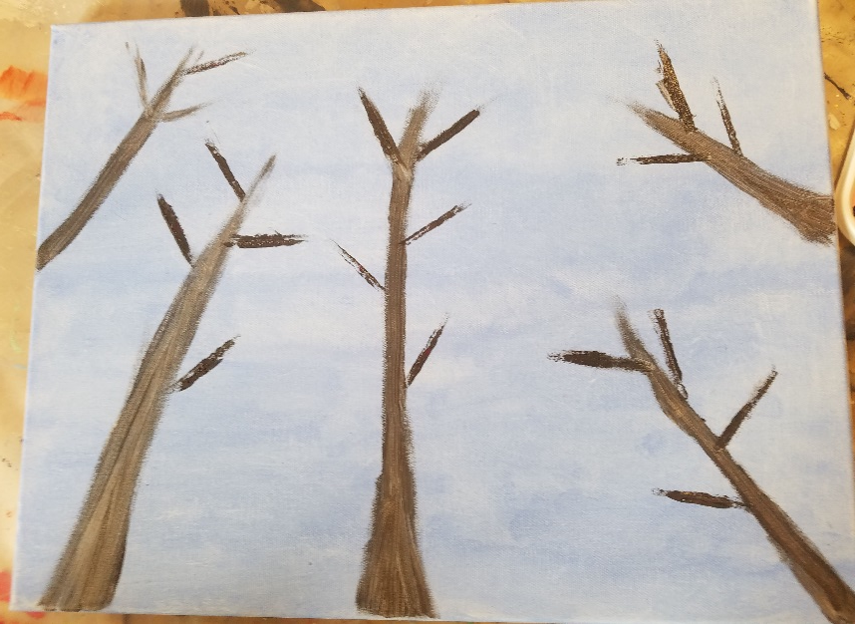
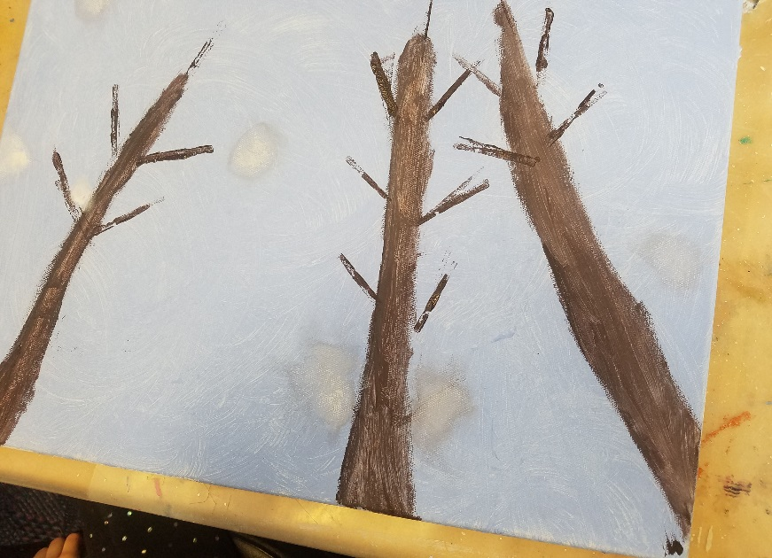
Our school holiday programme at the art centre focused on the forest and how we can play a part in keeping its ecosystem healthy.

Slide 24
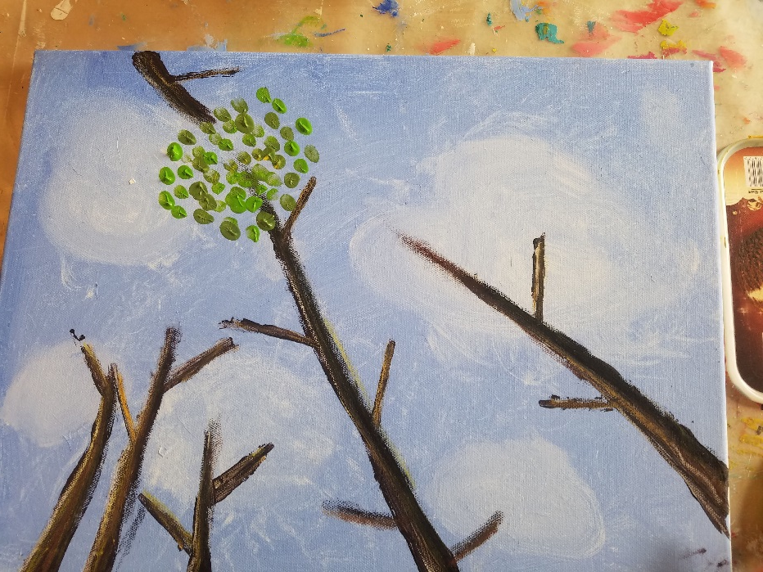

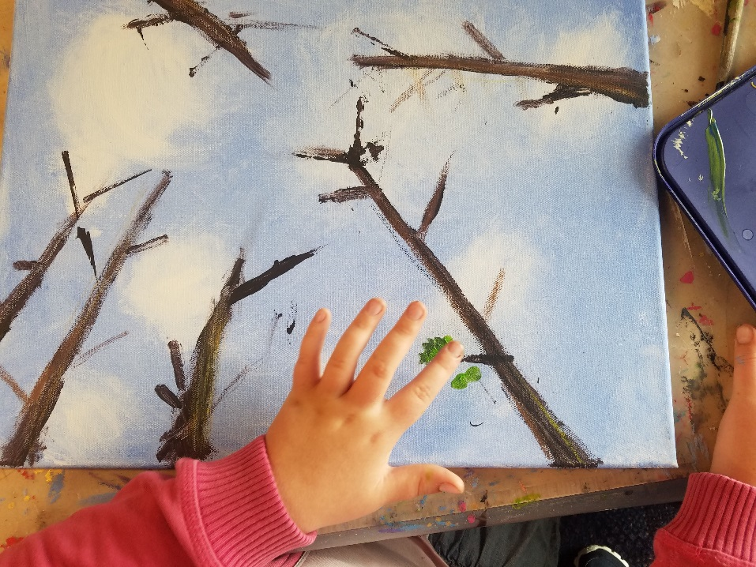
We focused our art work on our mighty Kauri trees and how they are being threatened by Kauri dieback.
Here we are showing how they stand tall in the ngahere, and how they provide shelter and food for all sorts of creatures that live there

Slide 25
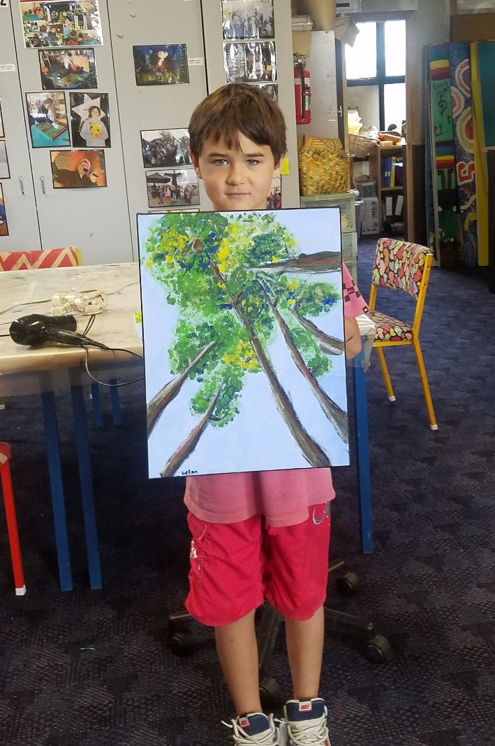
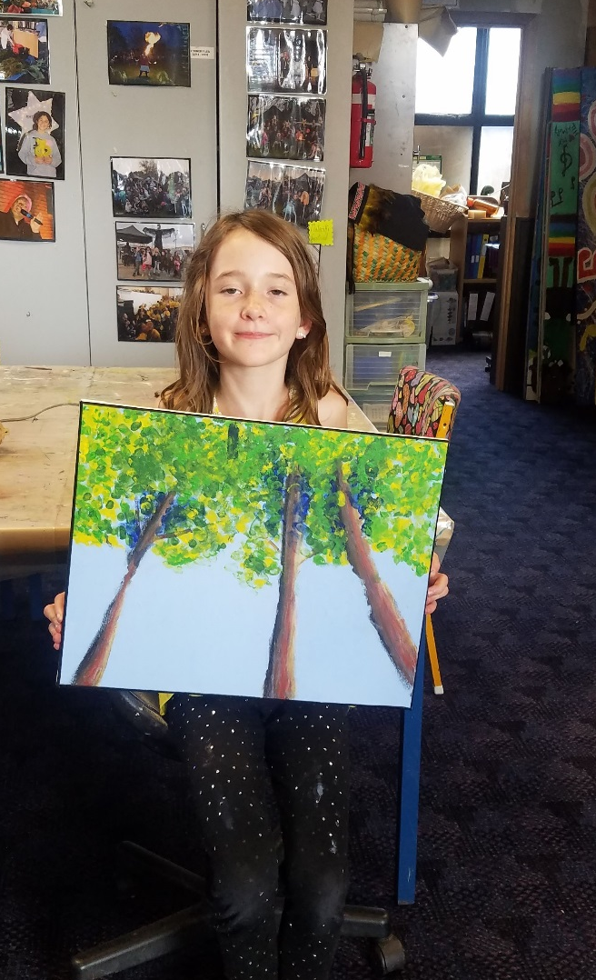

Slide 26



Here are our first paintings showing us looking up from the forest floor at the canopy of the kauri trees

Slide 27



Slide 28

TE WHARE TOI O NGARUAWAHIA
TWIN RIVERS COMMUNITY ART CENTRE
ART EXHIBITION

Slide 29

Tanya Brewer

Slide 30

Tanya Brewer

Slide 31

Jenni Vernon

Slide 32

Jenni Vernon

Slide 33

Jenni Vernon

Slide 34

Marama Olsen

Slide 35

Marama Olsen

Slide 36

June Rowland

Slide 37

June Rowland

Slide 38

Shirley Fox

Slide 39

Rhoda Johnson

Slide 40

Rhoda Johnson

Slide 41

Jane Stevens

Slide 42

Jane Stevens

Slide 43

I-Jay Huirama

Slide 44

I-Jay Huirama

Slide 45

Helen Hagan

Slide 46

Helen Hagan

Slide 47

Gail Wharakura

Slide 48

Gail Wharakura

Slide 49

Gail Wharakura

Slide 50

Emily Gilchrist

Slide 51

Bernie Wood

Slide 52

Bernie Wood

Slide 53


Slide 54


Slide 55


Slide 56


Slide 57


Slide 58


Slide 59


Slide 60


Slide 61


Slide 62


Slide 63


