Slide 1
Waikato District Council Bylaw Submission
Leigh Taylor
February 2021

Slide 2
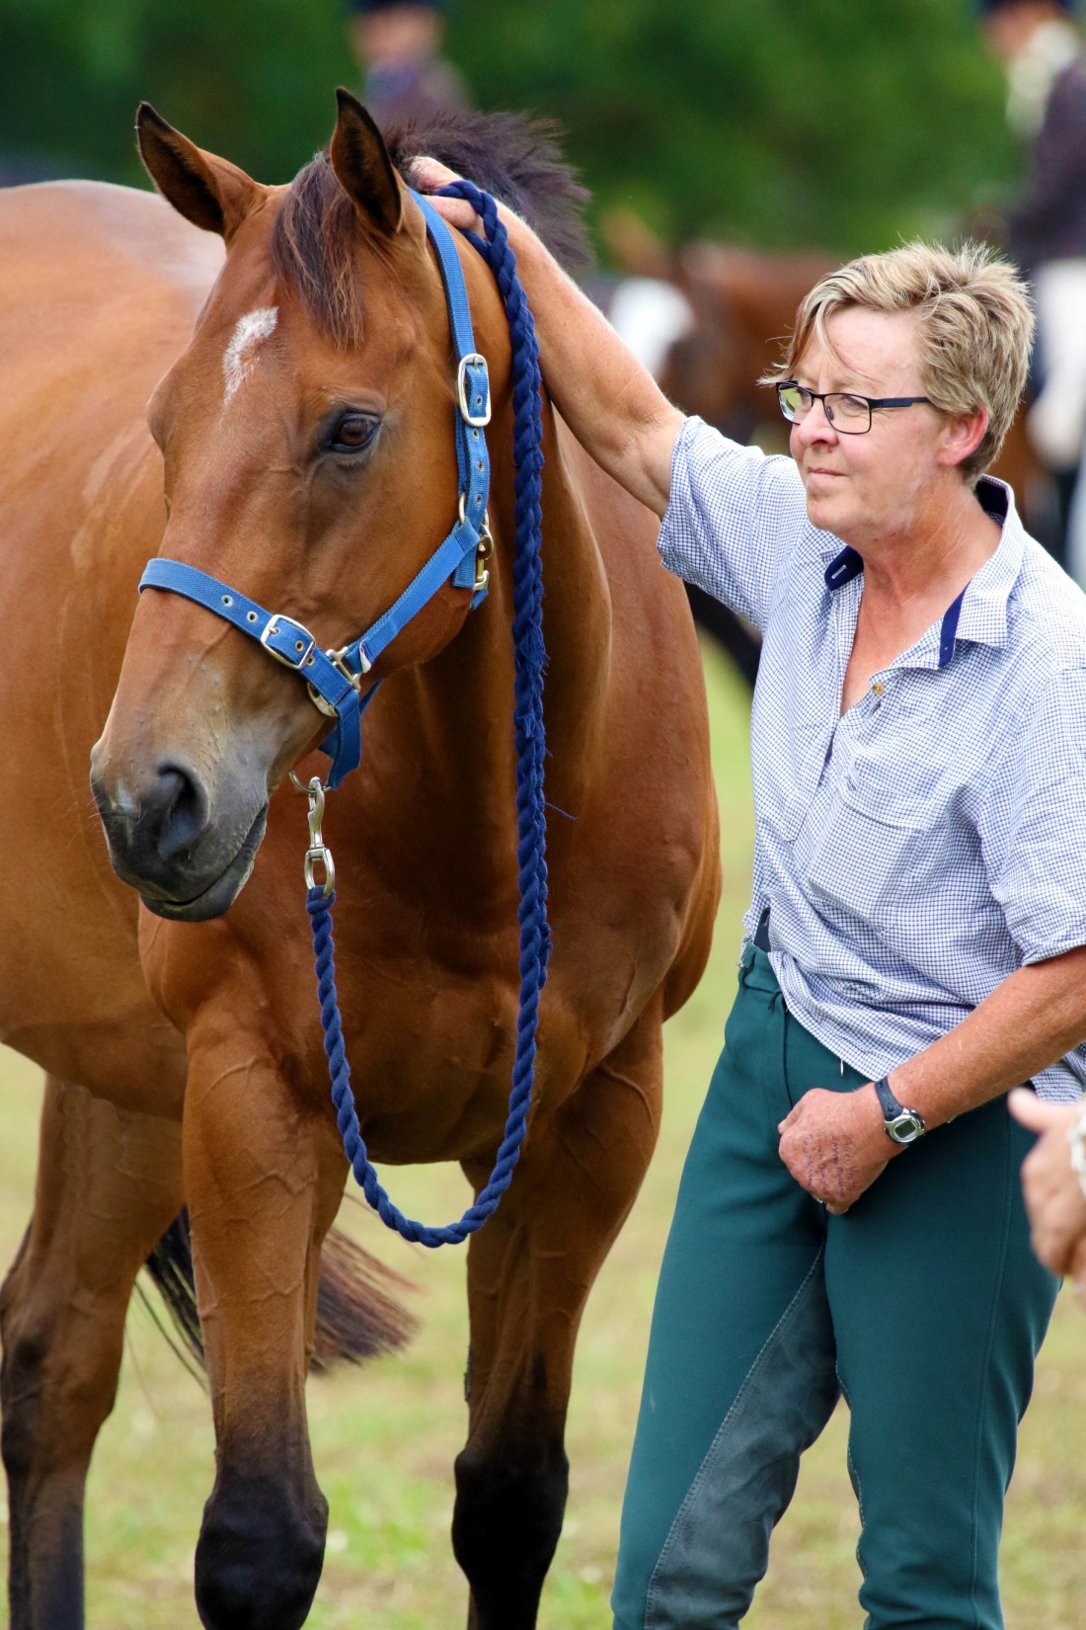
Whateverwillbe (Will)

Slide 3
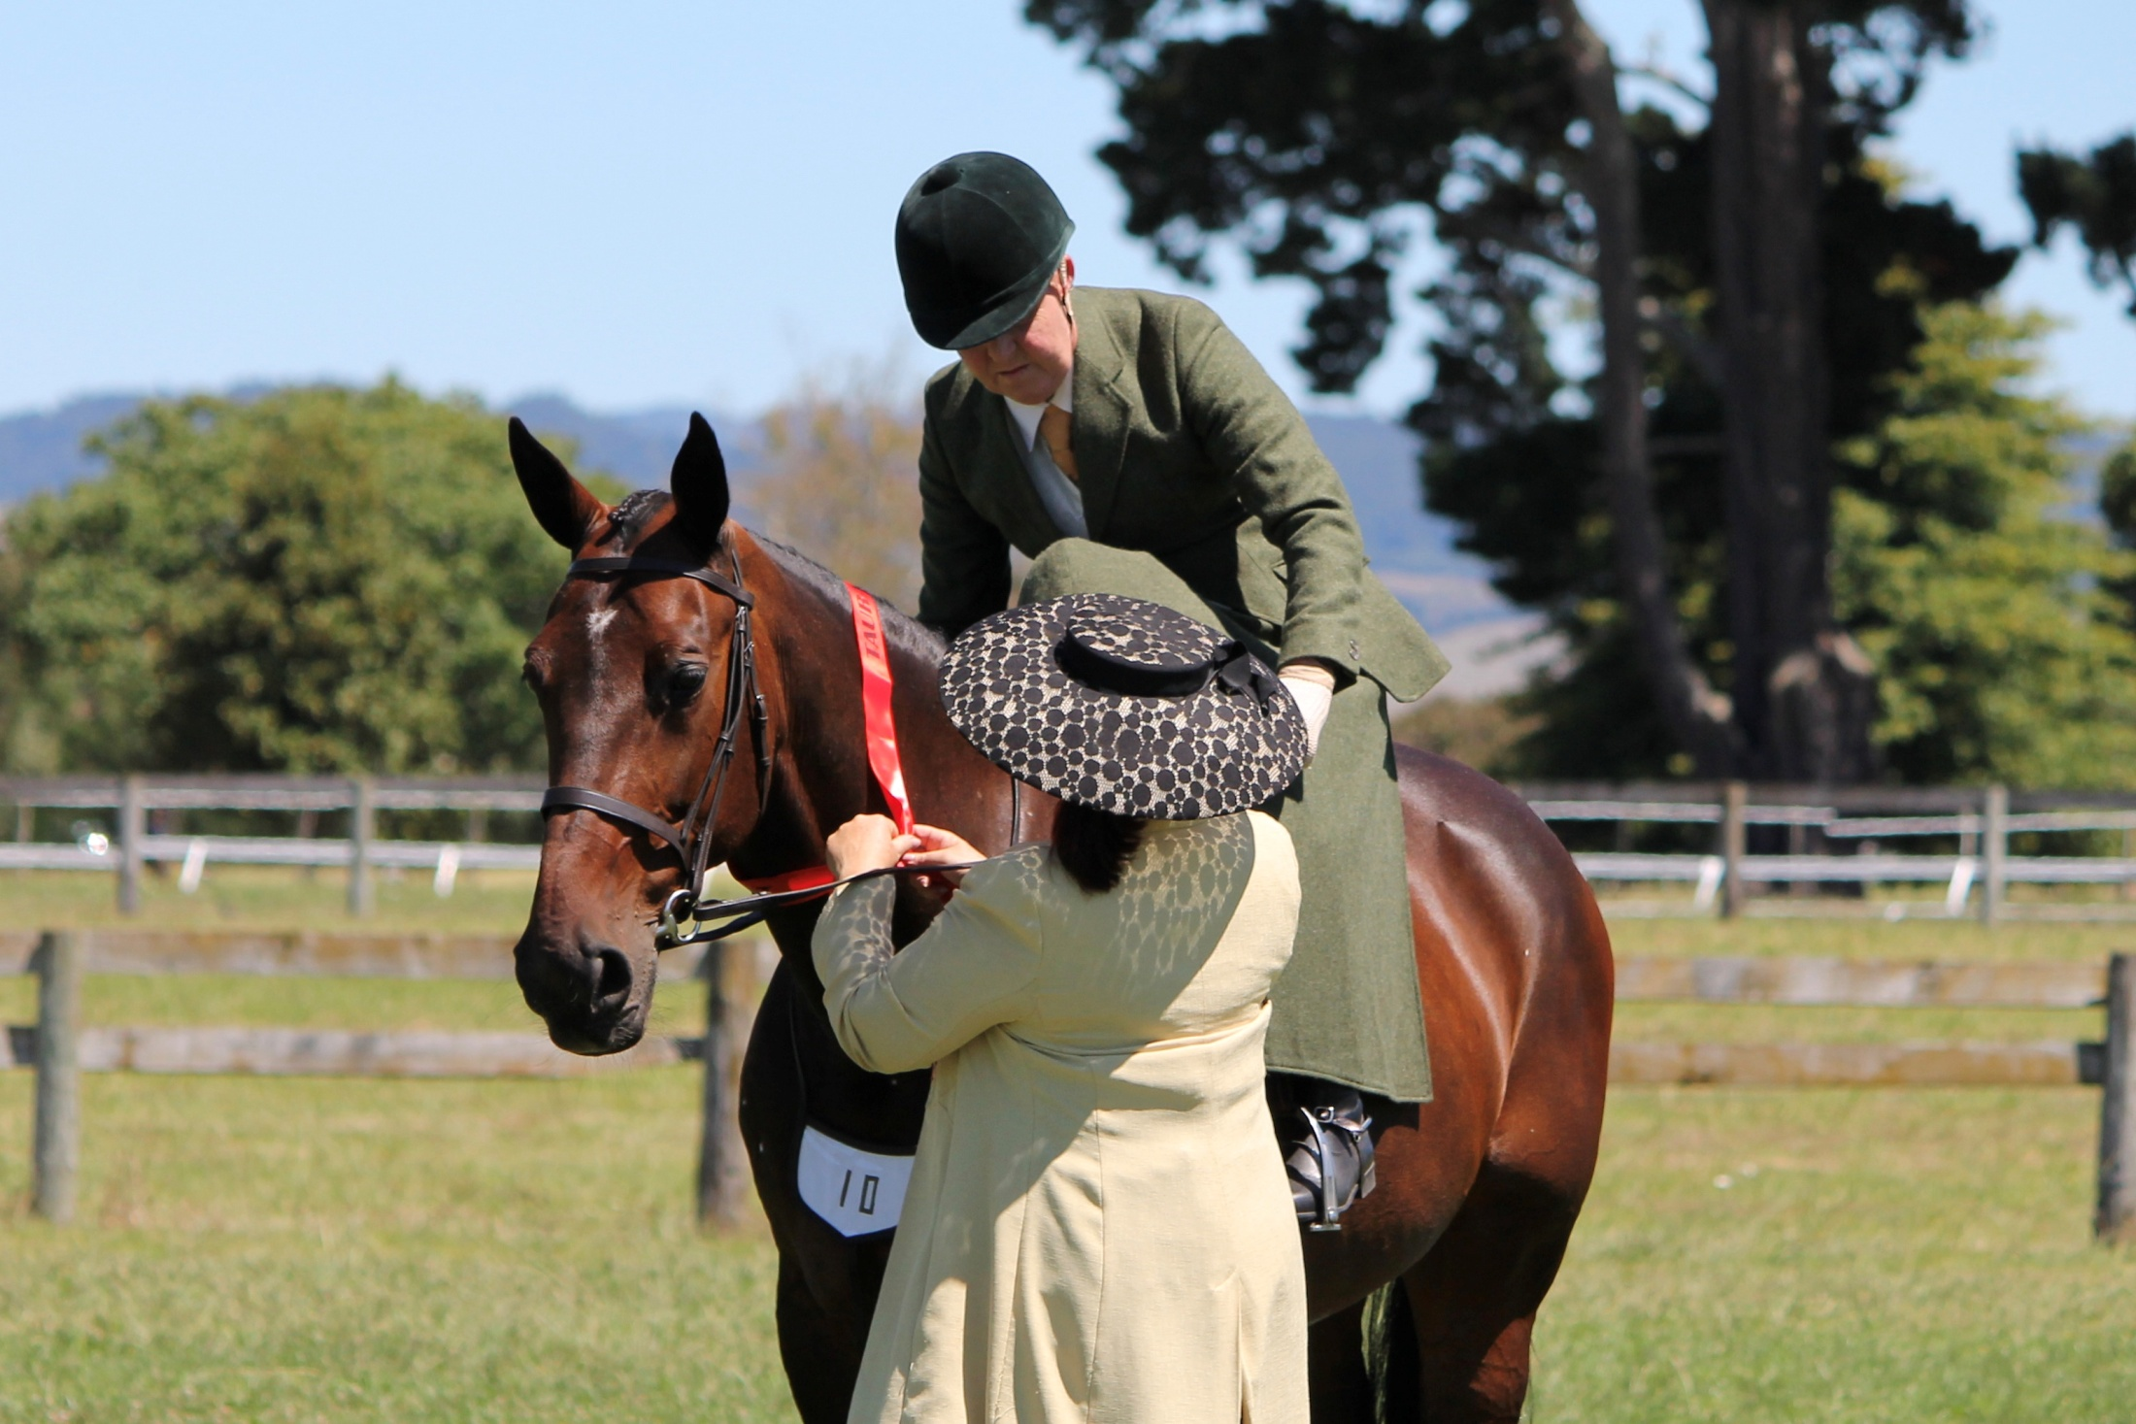
Lasvegasherewecome (Jed)

Slide 4
KEY AREAS OF CONCERN
Definition of Urban. “Urban area – an area used mainly for residential
or commercial purposes. For clarity, urban area means residential, village,
rural residential, heavy industrial, business, and town centre zones in
the Waikato District Plan”
Clause 9.0 Horses – special requirements • Addition of clause 9.1
“A minimum of 2 acres of grazeable land per horse is required for
the keeping of horses in urban areas, excluding Country Living Zones”.
Addition of clause 5.8 “The keeping of lambs of no more than
4 months of age on properties in an urban area is restricted to 1 animal,
for 60 consecutive days at a time, for no more than 60 days total
each year”.

Slide 5
Definition of Urban
I understand that the intention of the proposed bylaw is to legislate
to control possible nuisance in areas where there is a high density
of housing, commercial or industrial premises. Rural Residential
Zoning covers not only small, house only sections but also plots
of land well in excess of that. In my situation I have three conjoined
Titles, the total area being in excess of 10,000 square meters. So not
a one size fits all scenario.
We have been here for nine years now. The reason we purchased the
property was so that I could enjoy the freedom to keep my horses
on the property.
I have successfully kept two or more horses on the property and
harvested supplements as well.

Slide 6
Addition of clause 9.1
There are a number of issues raised by this rationale.
Two acres (I notice reduced from 2 hectares) per horse is excessive.
It is generally accepted that a second, and subsequent horses will not
mean double or equivalent, the amount of land. Whilst horses in turnout
situations do require larger areas, horses that are kept in work for
recreational (and for that matter racing) purposes do not require that.
They are exercised by being ridden or otherwise worked. They require
supplementary feed to balance their diets for the work required. Horses
come in varying sizes. At one point I had an 11.2hh pony as company for
Wolfie. There was no way I could give him a large grazing area. It would
be the same as expecting a child to eat an adult portion every meal.
Very detrimental to their health. Small ponies, and some large horses
are prone to metabolic conditions such as laminitis, Equine metabolic
syndrome and insulin resistence. Wolfie at 17.1hh was in fact such a horse.
These horses need their grass intake monitored very carefully. What does a
property owner with a horse such as this do with the excess grass?
Contribute to green house gases by mowing?

Slide 7
Addition of clause 5.8 “The keeping of lambs of no more than 4 months
of age on properties in an urban area is restricted to 1 animal, for 60
consecutive days at a time, for no more than 60 days total each year”.
Once again I can see the motivation for introducing this clause. However
I am not sure how you can say to a family that only one of their children
can participate in Ag Day. Do they draw straws? It would be a shame for
the traditional Ag Day to disappear and our children to miss out on the
experience of caring for a lamb and participating in this event.
On another note, as an owner of a larger property zoned Rural Residential
I would not be able to keep a couple of sheep to cross graze with my horses,
or for that matter be company for them.

Slide 8
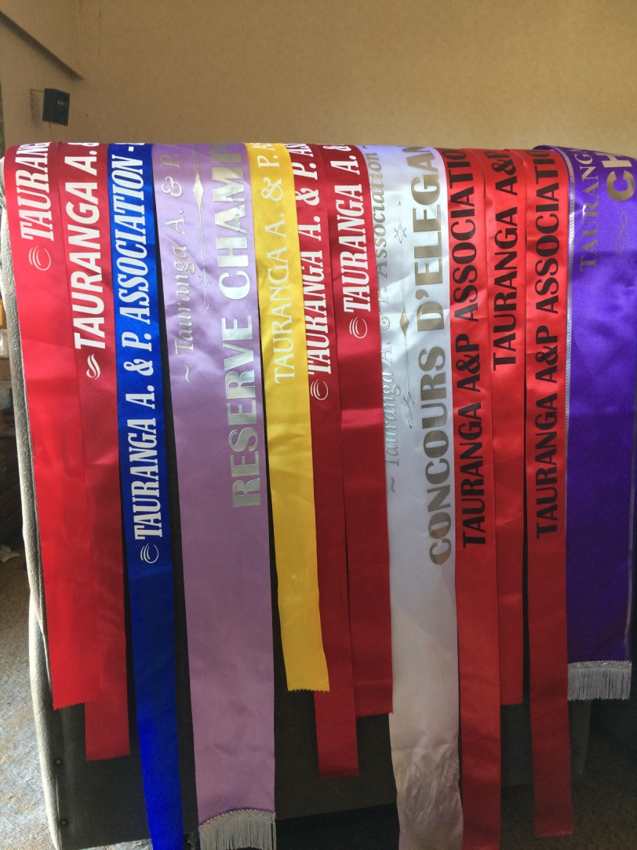
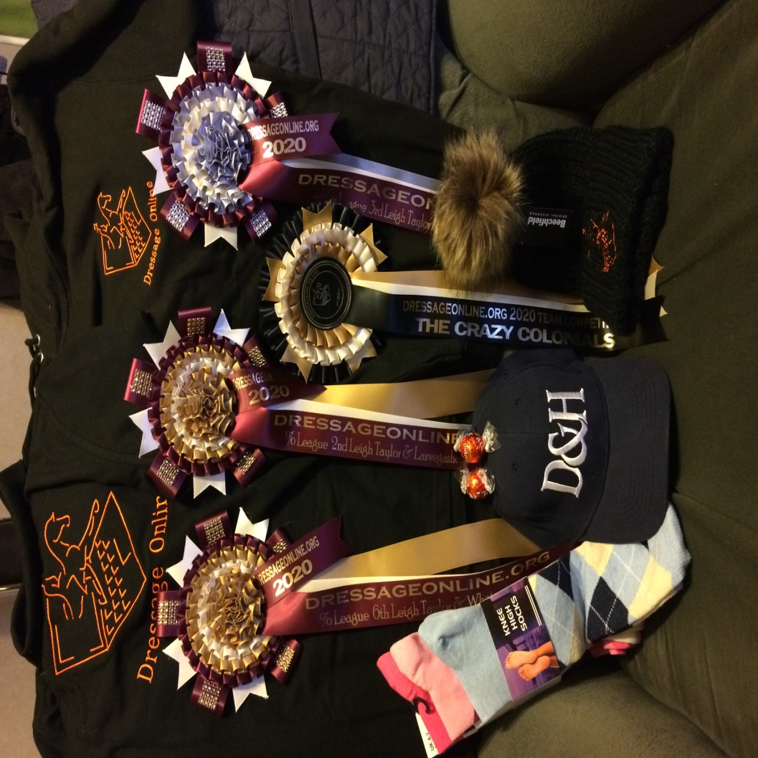

Slide 9
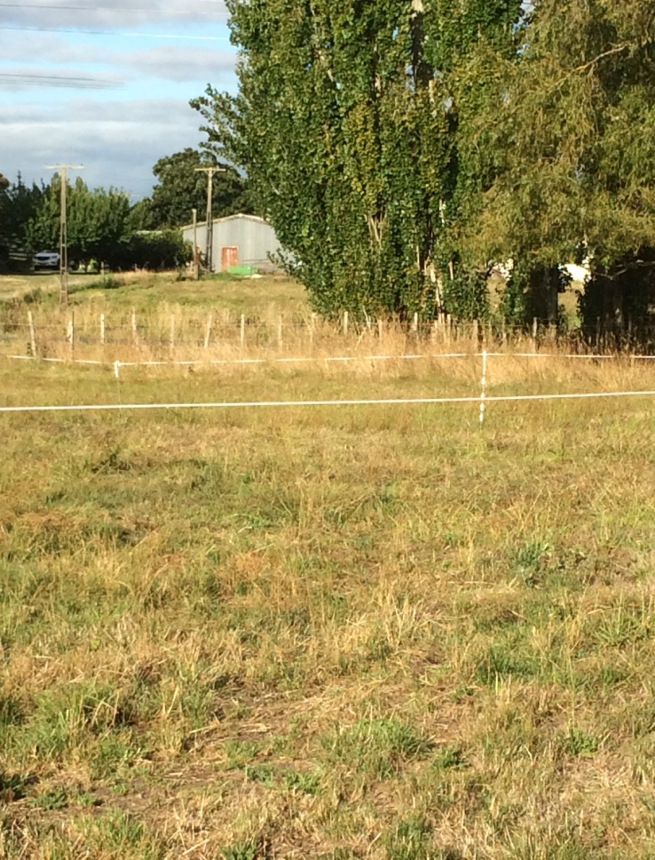
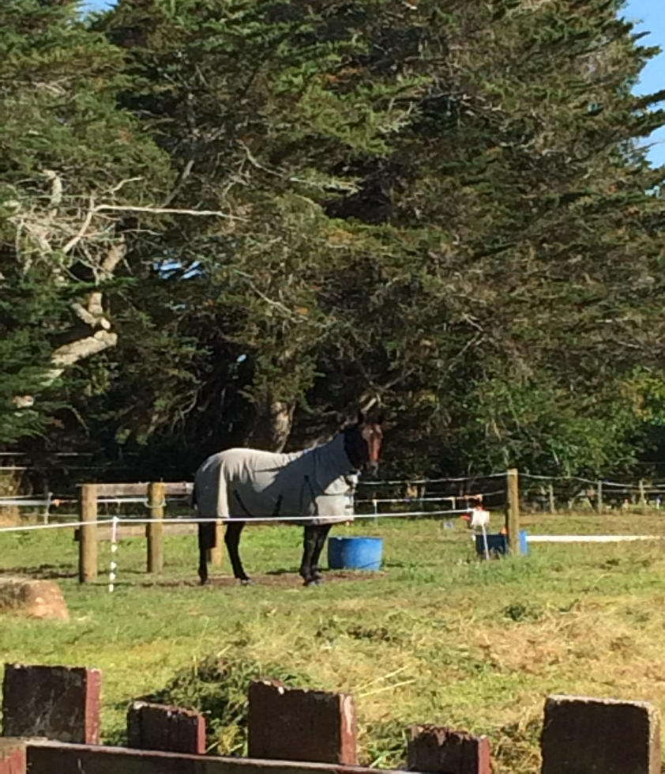

Slide 10

Baling and Wrapping Day 72 bales

Slide 11
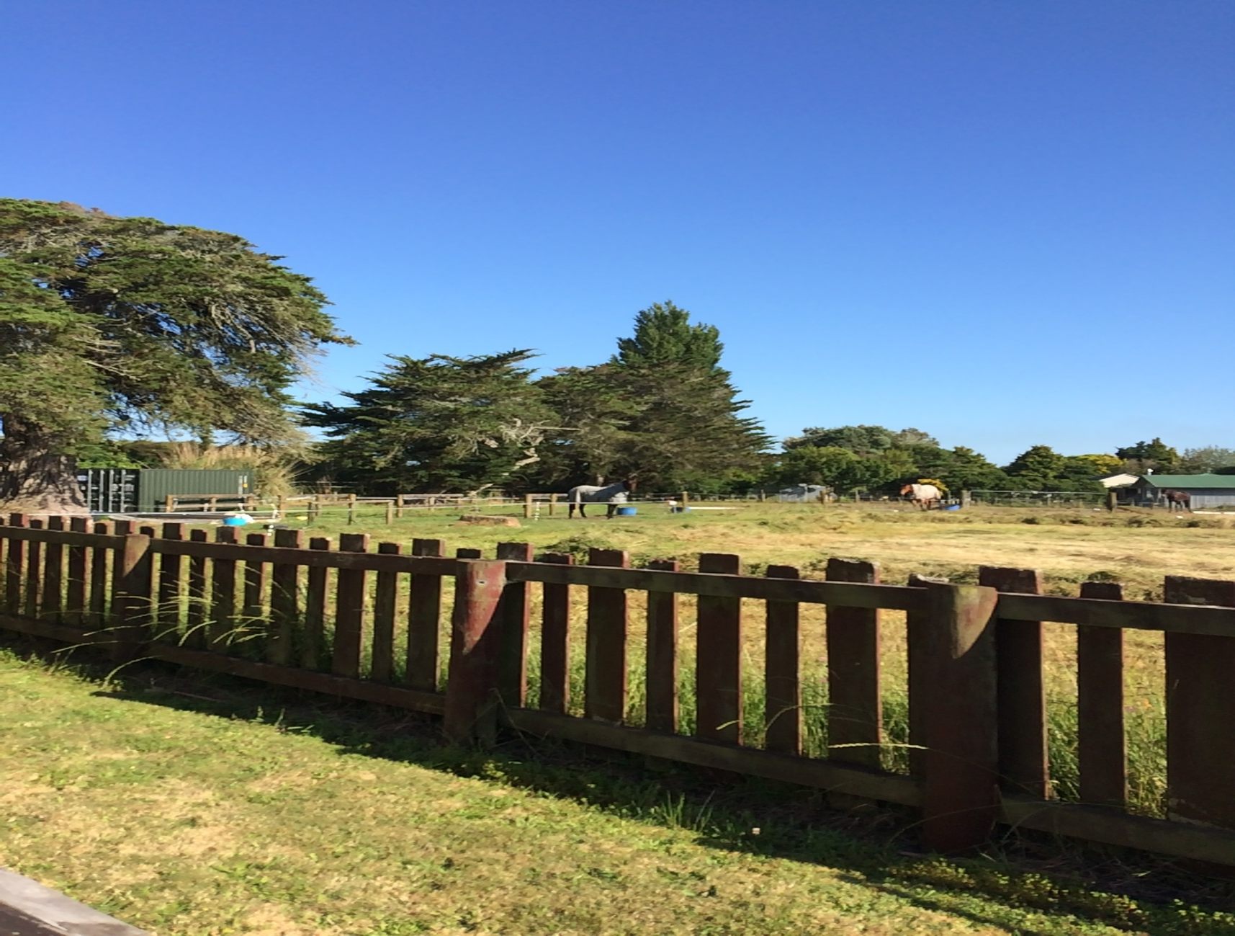

Slide 12
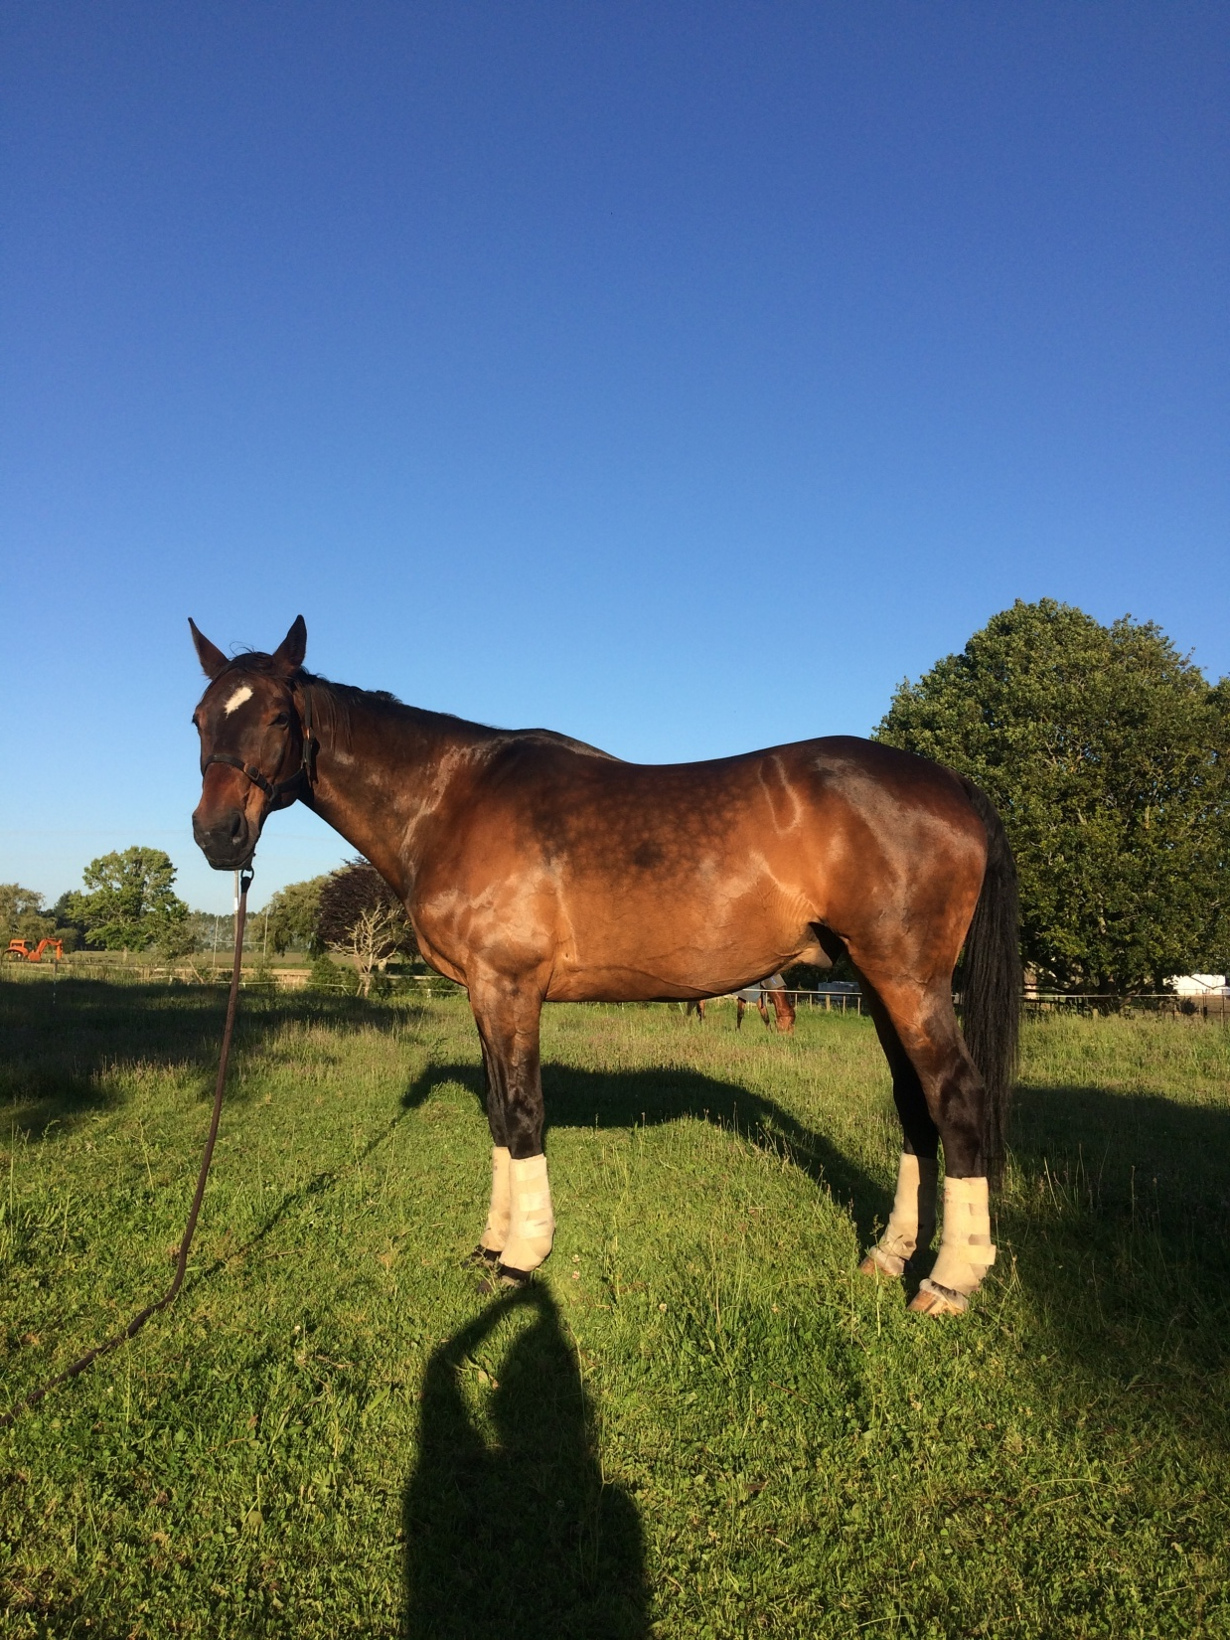
Wolf Whistle (Wolfie) 1996-2021

