Slide 1

Mark Chrisp
Submission on
Proposed Waikato District Plan

Slide 2
Relief Sought:
“Amend Rule 23.4.2(a)(i) to provide for a net site area of at least 3,000m² for subdivision in the Country Living Zone.”

Slide 3
The proposed minimum lot size of 3,000m² will:
Result in a much more efficient utilisation of the finite land resource in accordance with s.7(b) of the RMA compared with the status quo;
Reduce pressure on additional areas of productive Rural Zone land being used for large lot residential purposes in the future;
Be consistent with the objectives and policies relating to the Country Living Zone.

Slide 4
The proposed minimum lot size of 3,000m² will:
Result in little or no adverse effects on infrastructure or the demand for services within the Country Living Zone or elsewhere that cannot be foreseen, planned for, and resolved in a timely manner.
Enable the creation of additional lots mostly in greenfield parts of the Country Living Zone over a period of many years in line with market demand.
Be the most appropriate way to achieve the relevant objectives of the Proposed Waikato District Plan and the purpose and principles of the RMA.

Slide 5
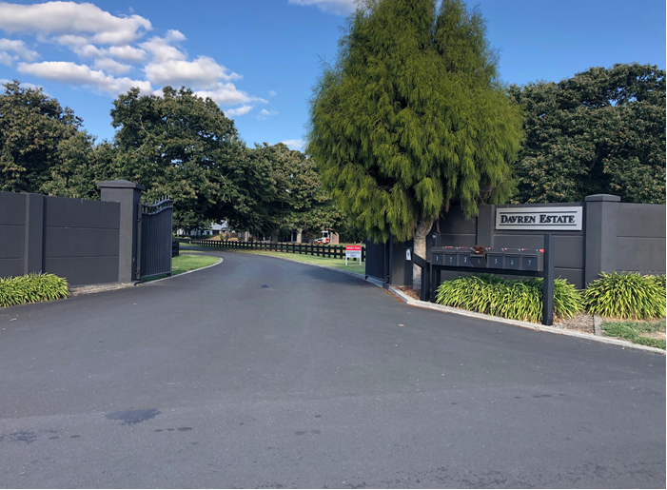
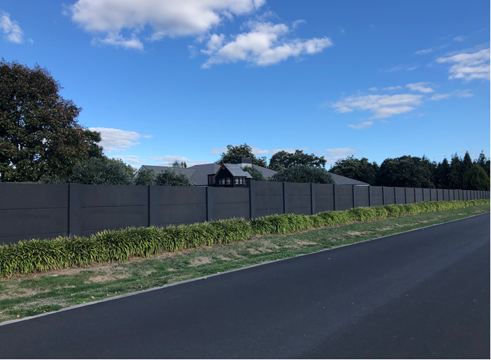
Davren Estate on Redwood Grove

Slide 6
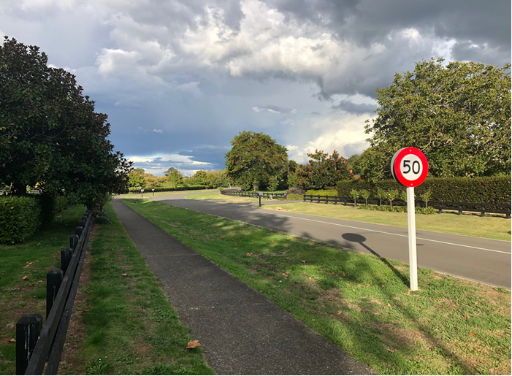
Parklea Drive

Slide 7
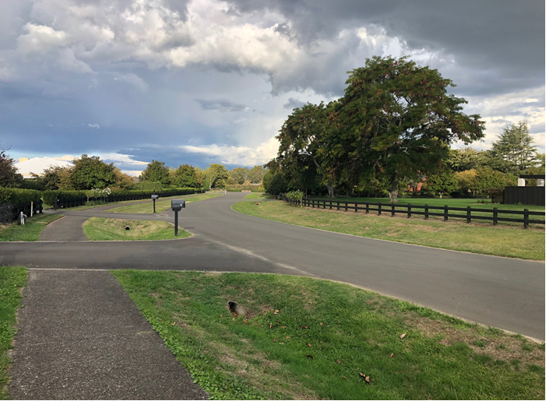
Parklea Drive

Slide 8
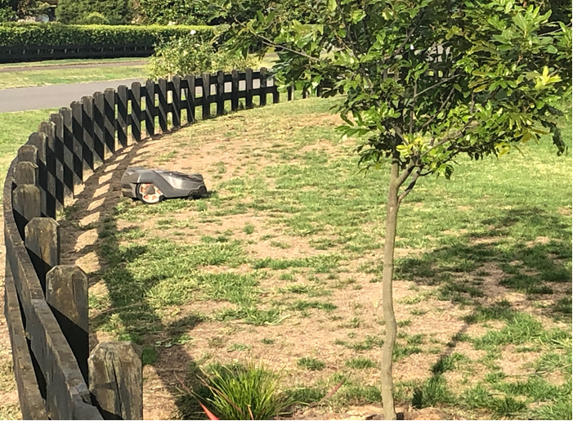
Parklea Drive

Slide 9
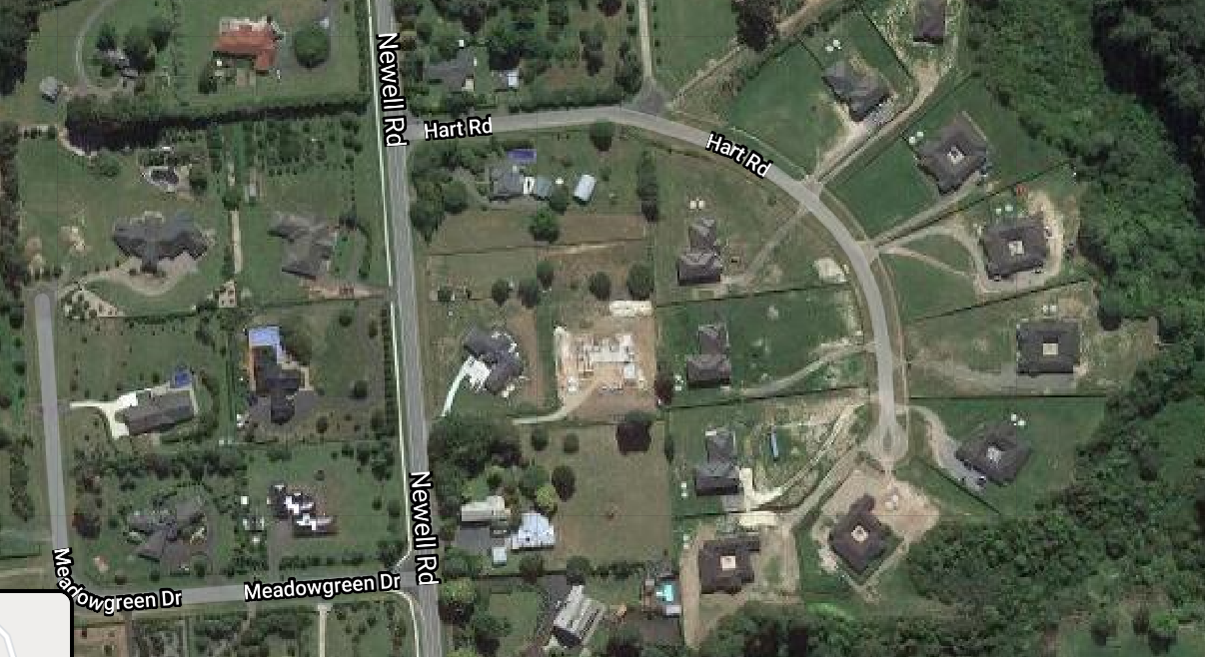

Slide 10
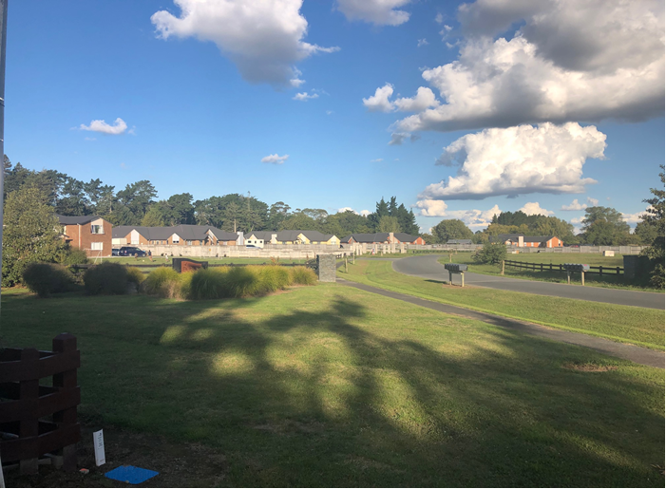
Hart Road

Slide 11
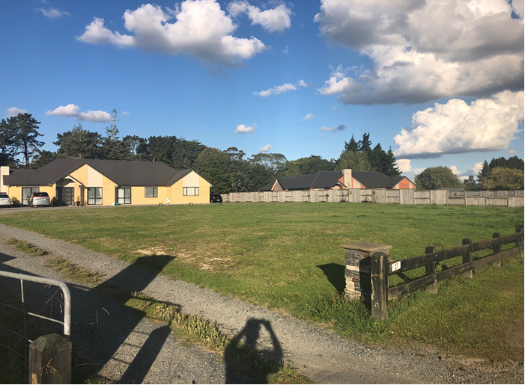
27 Hart Road

Slide 12
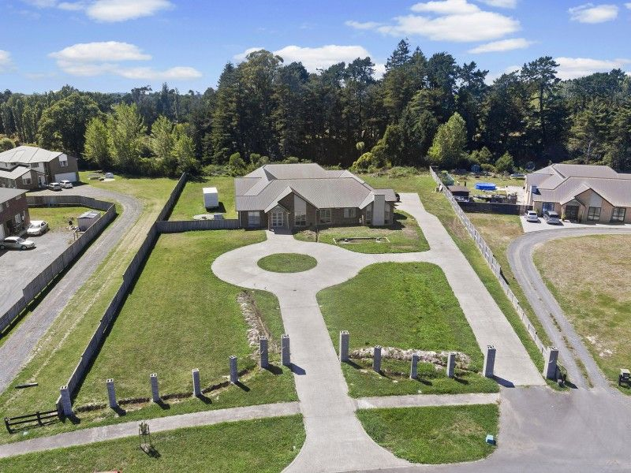
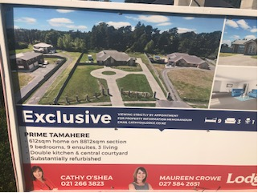
25 Hart Road

Slide 13
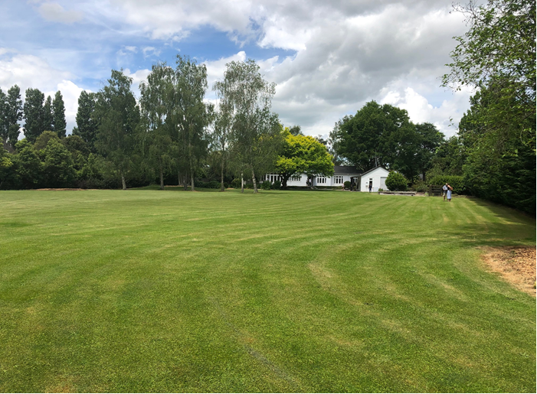
Poplar Lane

Slide 14
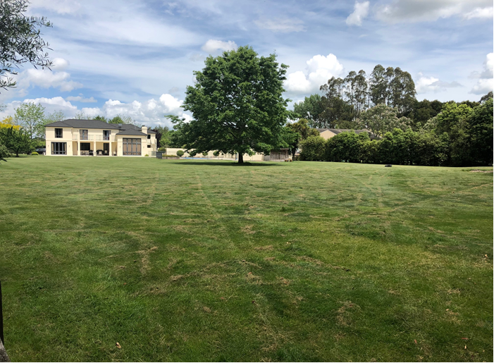
Poplar Lane

Slide 15
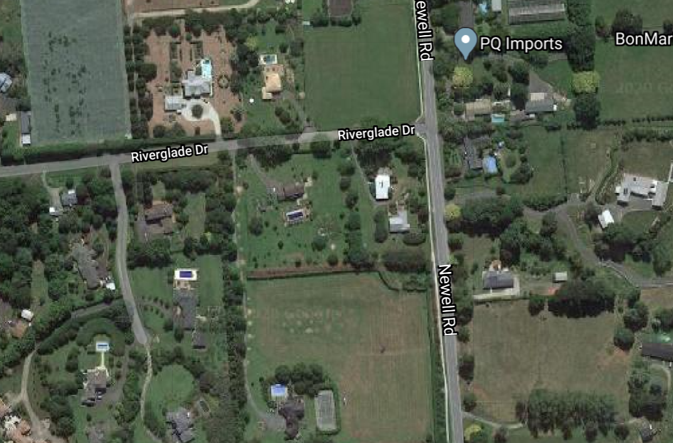

Slide 16
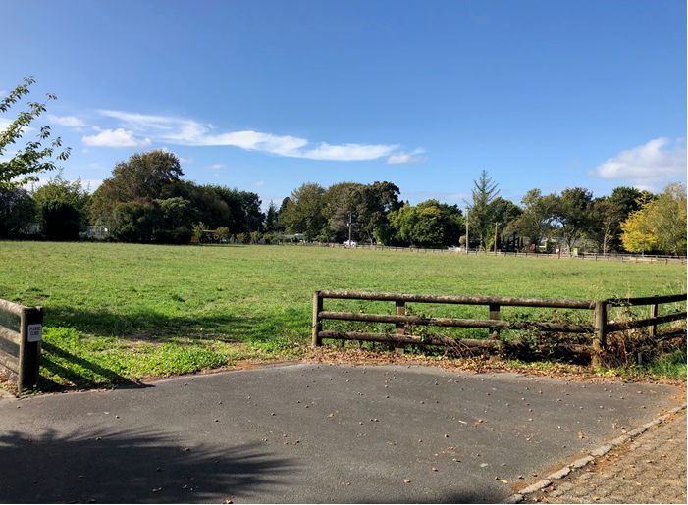
Cnr Newell Road and Riverglade Drive

Slide 17
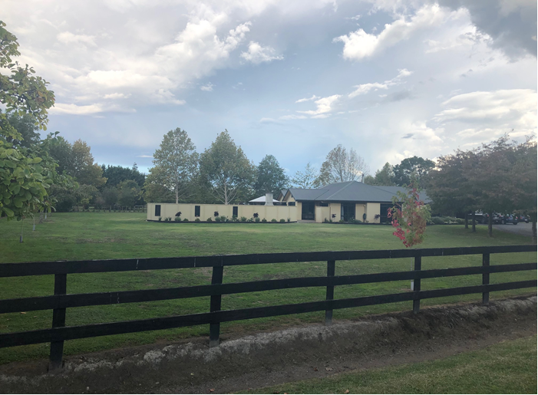
Northern half of submitter’s property – 25A Riverglade Drive

Slide 18
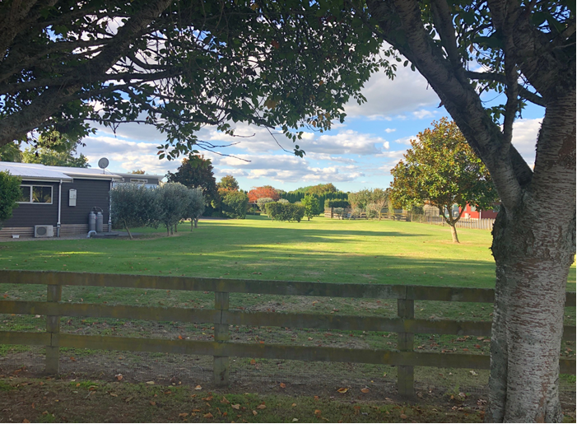
Newell Road

Slide 19
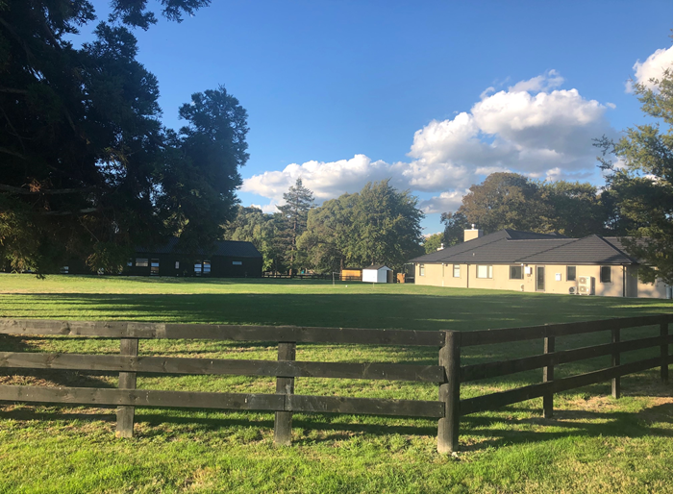
Cnr Birchwood Lane and Newell Road

Slide 20
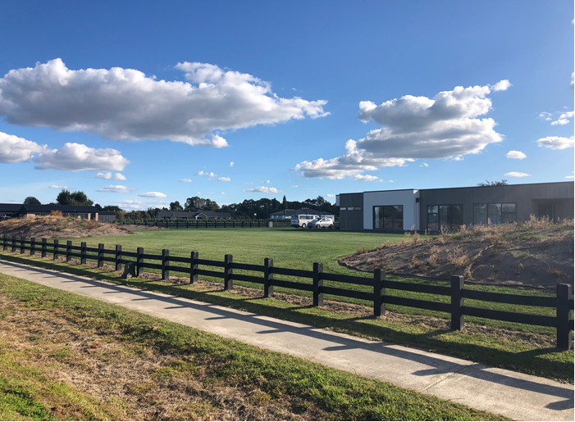
Birchwood Lane

