Slide 1
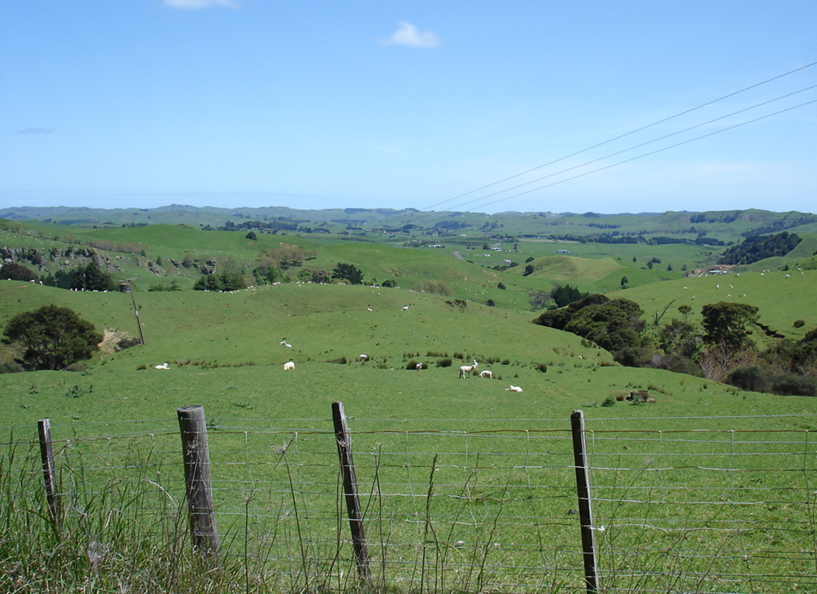
Hearing 18 - Rural Zone
Council Opening Presentation
29 September 2020

Slide 2
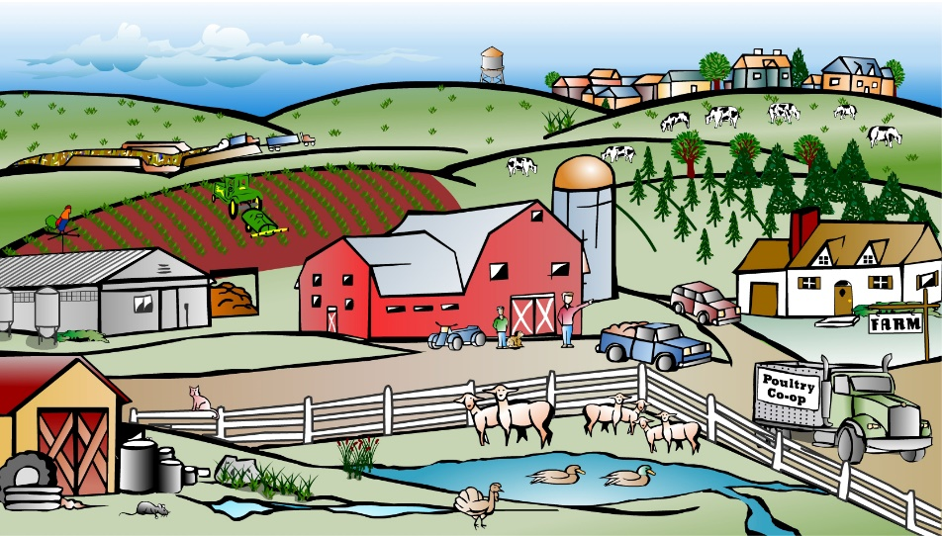
Rural Zone Role & Character
Single zone that covers most of the District
Diverse geography, diverse farming systems, diverse activities
Provisions therefore need to ‘stretch’
More than just farming – reflected in evidence focus

Slide 3
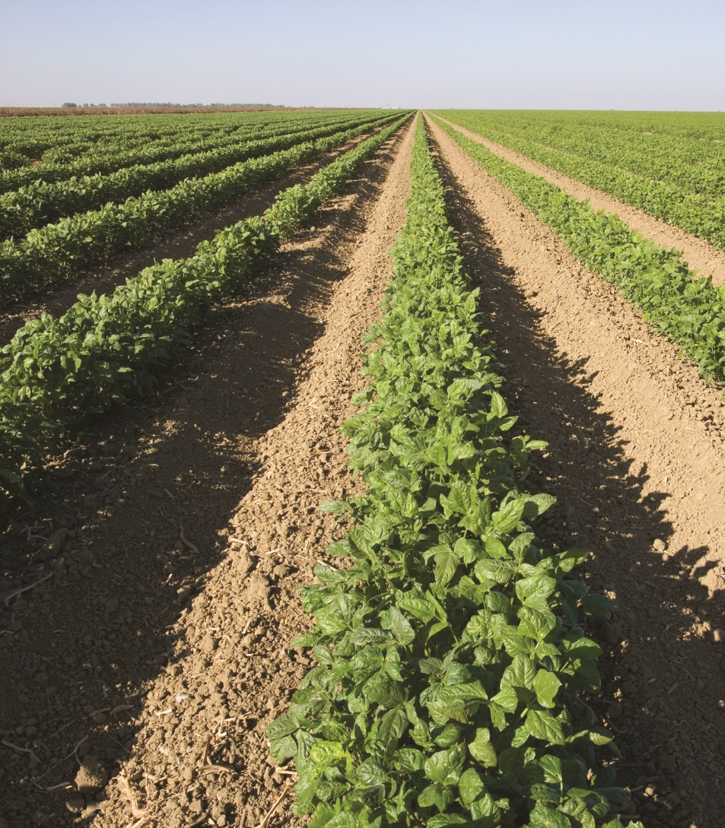
Soils and farms
Soil resource underpins rural production
Farming in all its forms is the predominant activity
Need to maintain the resource to sustain the activity
Detailed rules regarding earthworks, noise, glare, signs, buildings
Definition of ‘Intensive Farming’ – enablement and management

Slide 4
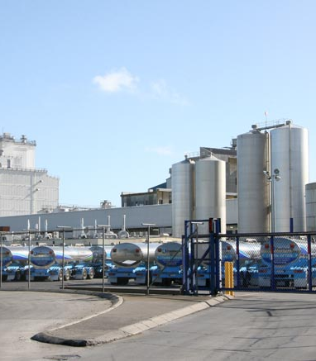
Reverse sensitivity, infrastructure & industry
Rural contains range of infrastructure and industry
Manage effects on-site
Accept some effects may extend beyond sites
Manage new sensitive activities
Setbacks carry potentially significant costs so need to be carefully justified

Slide 5
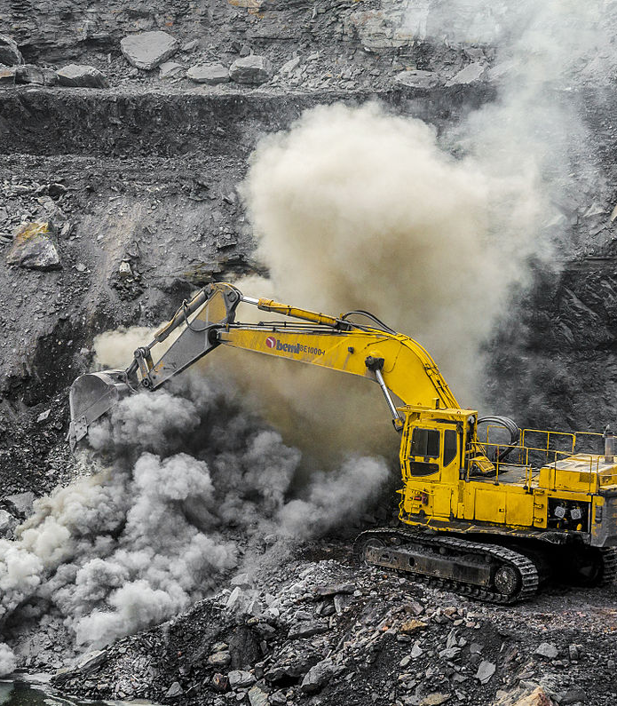
Extractive activities
Coal mining and aggregate/ mineral extraction inherently occur in the rural environment
Identify where such activity is, or is likely to, occur
Set back from these areas
Identification of the resource?

Slide 6
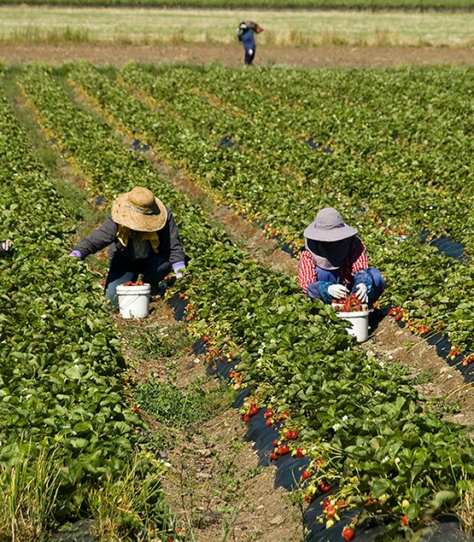
Residential density, worker accommodation & Hamilton UEA
Multiple pathways need to be seen as a package, set within a strategic growth management framework
All pathways provide for worker accommodation
All townships provide for worker accommodation
Hamilton UEA and a consistent approach to Future Urban Zones

Slide 7
Rural Subdivision - Context
16,679 titles in the rural zone (4,734 in Franklin Section, 11,945 in Waikato Section).
80% of titles are smaller than 20ha in size.
2,026 vacant titles (with no dwelling) less than 10ha in size.

Slide 8
Subdivision - Key Issues to address
If subdivision continues as it has always done, there is a risk of irreversible consequences, including:
  loss of productivity;
  further fragmentation of rural land;
  loss of high class soils;
  increased reverse sensitivity effects; and
  degradation of rural character and amenity.

Slide 9
Higher Order Directives - WRPS
Chapter 6A Development Principles
Principles specific to rural-residential development
As well as being subject to the general development principles, new rural-residential development should:
  a) be more strongly controlled where demand is high;
  b) not conflict with foreseeable long-term needs for expansion of existing urban centres;
  c) avoid open landscapes largely free of urban and rural-residential development;
  d) avoid ribbon development and, where practicable, the need for additional access points and upgrades, along significant transport corridors and other arterial routes;
  e) recognise the advantages of reducing fuel consumption by locating near employment centres or near current or likely future public transport routes;
  f) minimise visual effects and effects on rural character such as through locating development within appropriate topography and through landscaping;
  g) be capable of being serviced by onsite water and wastewater services unless services are to be reticulated; and
  h) be recognised as a potential method for protecting sensitive areas such as small water bodies, gully-systems and areas of indigenous biodiversity.

Slide 10
Higher Order Directives - WRPS
Objective 3.26
The value of high class soils for primary production is recognised and high class soils are protected from inappropriate subdivision, use or development.
Policy 14.2
Avoid a decline in the availability of high class soils for primary production due to inappropriate subdivision, use or development.

Slide 11
New National Directives
The National Policy Statement on Highly Productive Land will place more importance on the protection of land defined as Land Use Capability 1, 2 and 3.
While not yet in effect, the NPS is due for release in early 2021.

Slide 12
Rural Subdivision Overview
Five Key Pathways:
General Subdivision
Conservation Lots
Boundary Relocations
Rural Hamlet Subdivisions
Subdivision to create a reserve and incentive lot

Slide 13
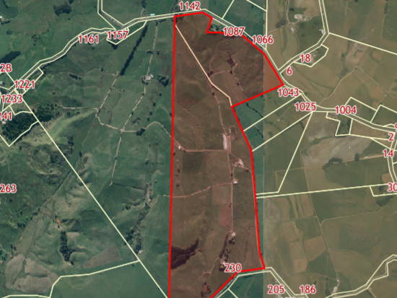
8,000m2 – 1.6ha
General Subdivision
Title Size = 55ha
Title Date = November 1939
Notes:
General Subdivision Example
Property = 55ha
Title Date November 1939
Discuss High Class Soils rule

Slide 14
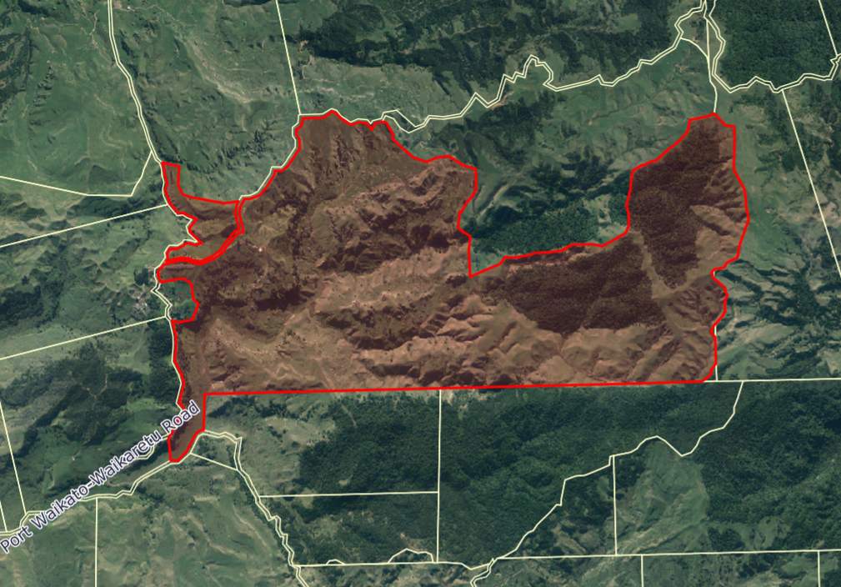
Conservation Lot Subdivision
5ha bush
Lot 1 8,000 – 1.6ha
5ha bush
Lot 2 8,000 – 1.6ha
Lot 3 8,000 – 1.6ha
Notes:
Conservation Lot Subdivision

Slide 15
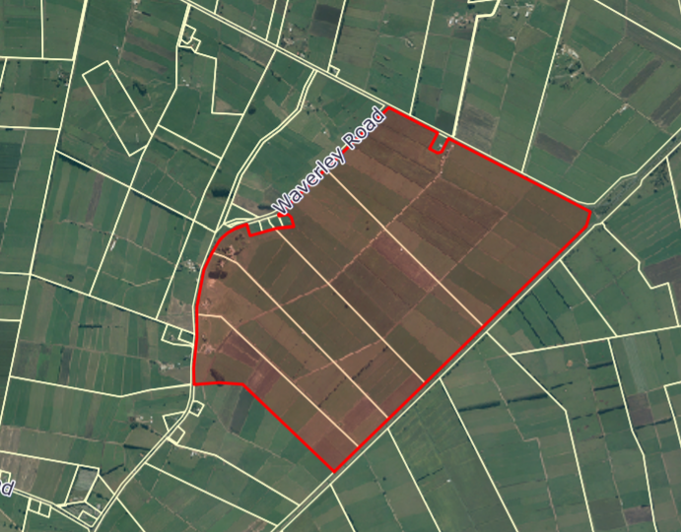
Rural Hamlet Subdivision
Cluster of 3-4 Titles
8,000m2 – 1.6ha
Amalgamation of Balance
Notes:
Rural Hamlet Subdivision

Slide 16
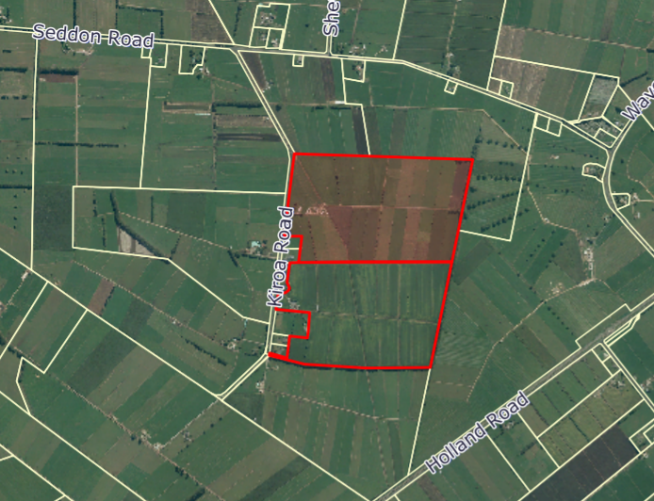
Boundary Relocation Subdivision
8,000m2 minimum
Balance Lot
Notes:
Boundary Relocation

Slide 17
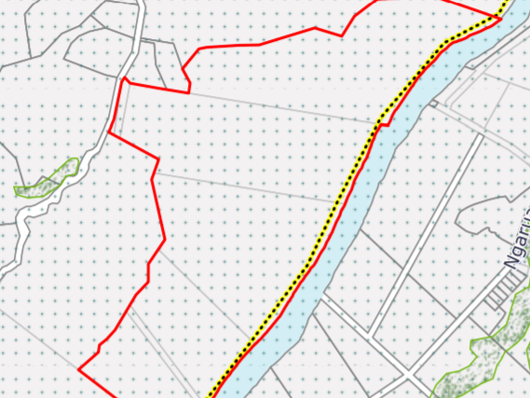
8,000m2 minimum
Subdivision to create a reserve and incentive lot
Notes:
Subdivision to create a reserve and incentive lot
Must be identified in a Waikato District Council Parks Strategy as being required for permanent public access or for reserve purposes

Slide 18
Matters of Contention
Activity status for subdivision within the Urban Expansion Area (UEA) and more lenient boundary relocation provisions.
Amending the prohibited activity status in PR2, PR3 and PR4 to non-complying.
Amending the 40ha parent title size from 20ha.
Rules restricting high class soils in relation to boundary relocations, rural hamlet and conservation lot subdivision.
More enabling provisions using the Conservation lot subdivision pathway.
Amendments to the title boundaries rule (Rule 22.4.3), which also relates to subdivision of land containing heritage items (Rule 22.4.8).
Amendments to subdivision within identified areas (Rule 22.4.5).
Amendments to the esplanade reserves and esplanade strips (Rule 22.4.7) to provide a matter of discretion reflecting s230(3) of the RMA.
The introduction of provisions relating to transferable subdivision.

Slide 19
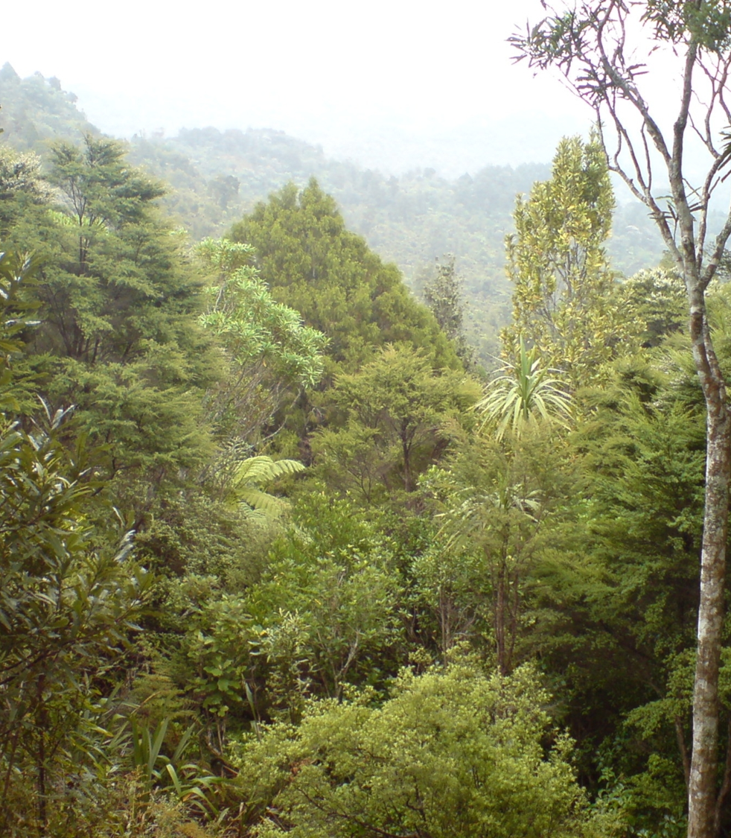
Ecological Aspects of Conservation Lot Subdivision
Benefits of protecting SNA’s within and outside of the Hamilton Ecological Basin Area.
Use of the term “contiguous” in order to qualify for subdivision.
Is there benefit in reducing the minimum size requirement for an SNA to be eligible for subdivision insider the Hamilton Ecological Basin
Merits of the conservation lot rules in terms of restoration and enhancement planting
Is there value in protecting features not identified as Significant Natural Areas?
Is there merit in dropping the size threshold for wetlands?

Slide 20
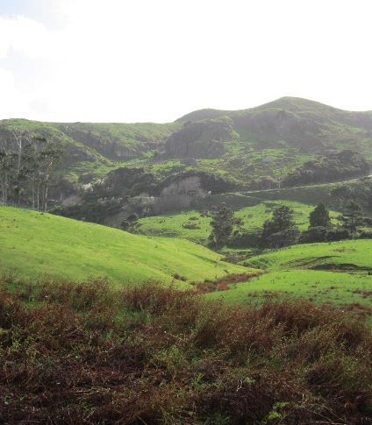
Economic aspects of Rural Subdivision
Rural subdivision is a key matter, affects major share of the Waikato District land resource
Subdivision a core long term influence on land use & ownership → economy and community
Rural subdivision in WDC is predominantly to create small lots for lifestyle living
Major change in Rural zone is replacement of productive primary activity to lifestyle
Productive potential of the Rural zone is critical to the WDC economy and community
Important balance to achieve between enabling lifestyle lots and sustaining WDC economy
Economic Assessment:
What is enabled where (general and conservation routes)
Likely effects on productive land use
Likely effects for rural community
Conclusion – Recommendations version : the balance is about right
Proposed transferable subdivision scheme
some potential benefits, but potential outcomes (scale, location)
and likely effects not identified or assessed

Slide 21
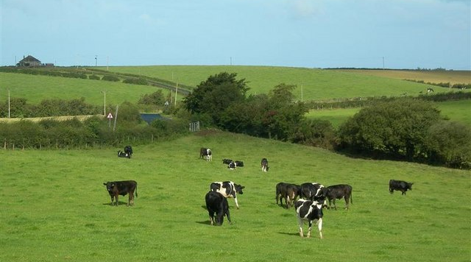
Professor Scrimgeour

Slide 22
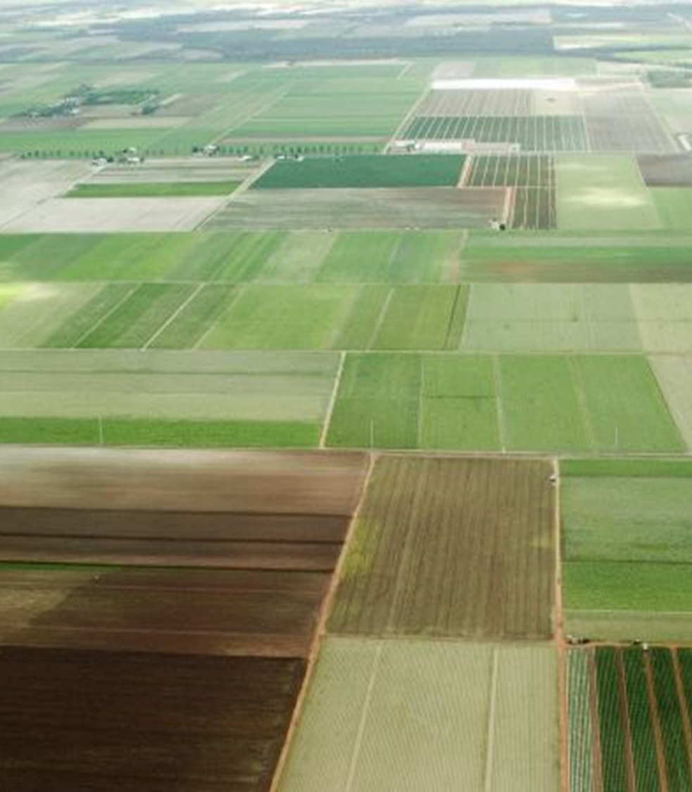
Protection of High Class Soils
High class soil definition aligns with the Waikato Regional Policy Statement and Waipa District Council definition.
Provision important for Rules 22.1.4.2, 22.1.4.4, 22.1.4.5 and 22.1.4.6.
The greatest amount of subdivision in the Waikato region has occurred in the Waikato district, and subdivision has been proportionally greater on LUC Classes 1, 2 and 3.
Key objective is to avoid the loss of high class soil and minimise productive land fragmentation.
Consistent approach across rules is important to avoid cumulative losses.
A property scale site specific Land Use Capability Classification assessment is required to accurately identify high class soil.
Proposed mechanisms:
  Property scale identification of high class soil (Rules 22.1.4.2, 22.1.4.4, 22.1.4.5 and 22.1.4.6).
  40 hectare minimum parent lot size (Rule 22.1.4.2).
  15% high class soil threshold for child lots (Rules 22.1.4.2, 22.1.4.4 and 22.1.4.5).
  Identify high class soil on 4ha titles and lots for boundary relocations (22.1.4.6).

