Slide 1
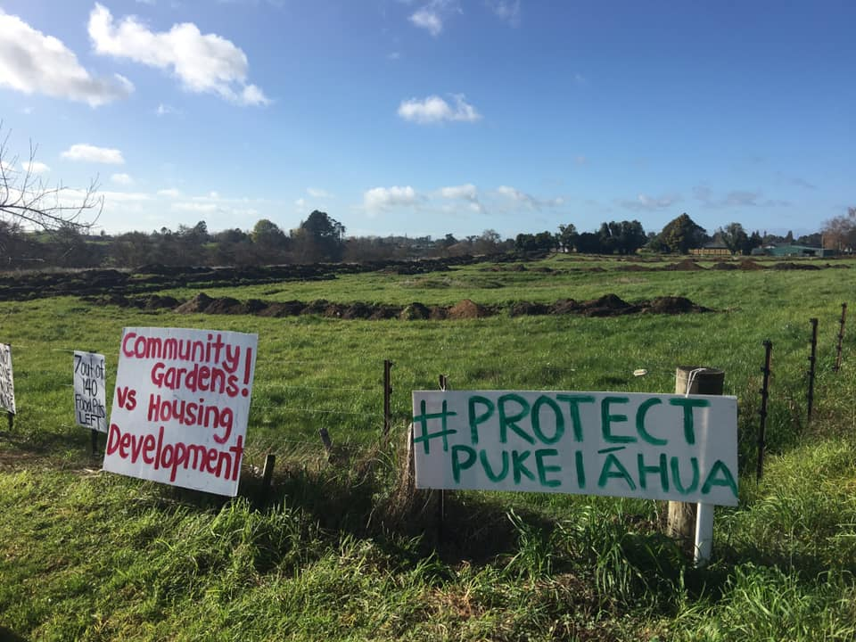
Proposed District Plan
Wāhia Ngā Rua – Putting our hapū footprint in the blueprint
Kimai & I-Jay Huirama, 3 August 2020

Slide 2
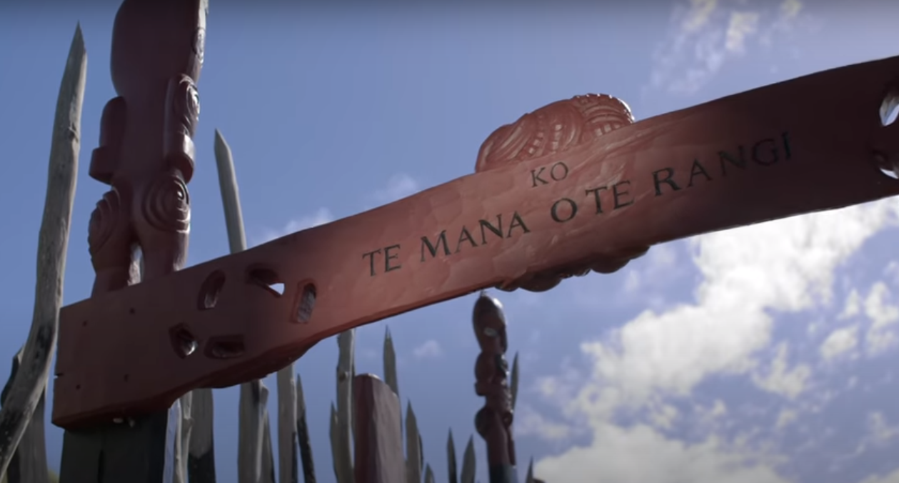
Ngā Uri O Tamainupō
Kōkako = Whaeatāpoko Māhanga = Paratai
Tamainupō = Tūkotuku
Wairere = Hinemoa
Whenu = Hinemotuhia
Keteiwi = Hinemata
Ngaere = Hekeiterangi
Te Mana O Te Rangi
We are 15th generation
Ngāti Tamainupō descendants

Slide 3
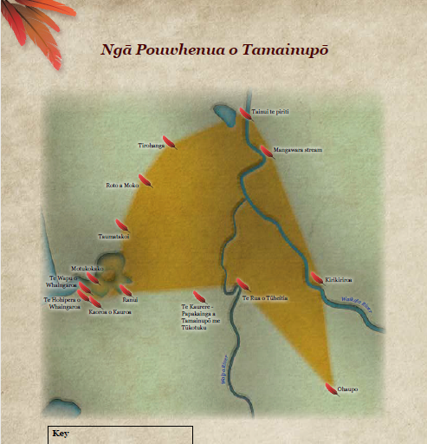
Pou Whenua o Tamainupō
HUNTLY
Whenua
Awa
Moana
Ngahere
Wāhi Tapu
Wāhi Tupuna
Pā
Māra kai (gardens)
NGĀRUAWĀHIA
HAMILTON
WHATAWHATA
RAGLAN
ŌHAUPO

Slide 4
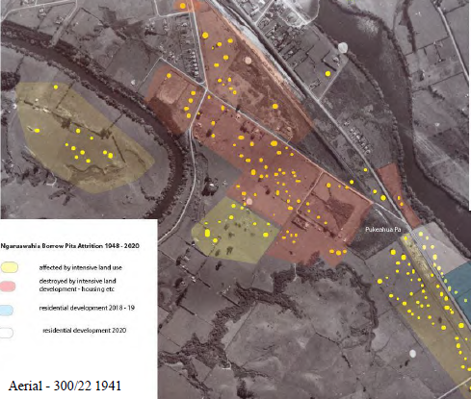
Wāhia Ngā Rua
Open the food pits
Pukeiāhua Pā – Outstanding cultural, archaeological and historical significance
Wāhi Tupuna / Wāhi Tapu
Campaign to save last seven rua of Pukeiāhua Pā
Significance increased due to rarity and proximity to Pā
Narrative carried by every resident and business in Ngāruawāhia

Slide 5
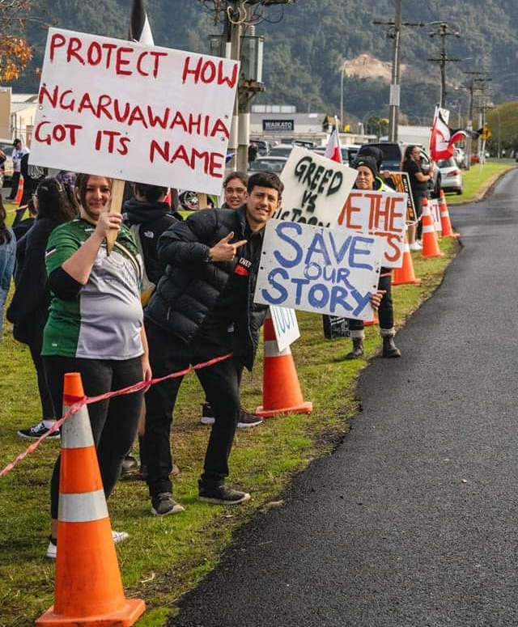
Hapū-led Campaign
89 days straight protest
Over 4,000 sign petition
200+ participate in Hīkoi
80 school children visit during Matariki
Heritage NZ application to upgrade Pukeiāhua listing and include gardens/rua
Community consultation
  75% oppose housing development near Pukeiāhua
  Other ideas include community gardens, educational site and park/reserve.

Slide 6
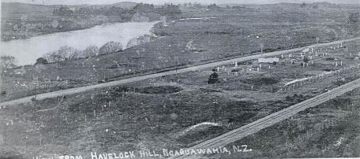
Development vs Protection
Decision to protect significant borrow pits (rua) on 5851 Great South Road, Ngāruawāhia

Slide 7
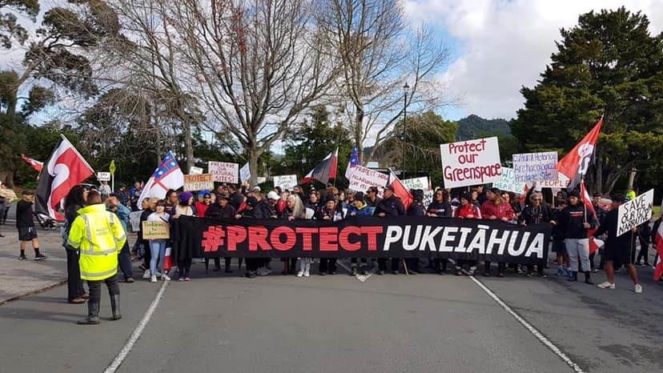
Wāhia Ngā Rua – Putting our footprint in the Blueprint

