Slide 1
APPENDIX 2.
SOUTH AUCKLAND VOLCANIC FIELD GEOHERITAGE

Slide 2
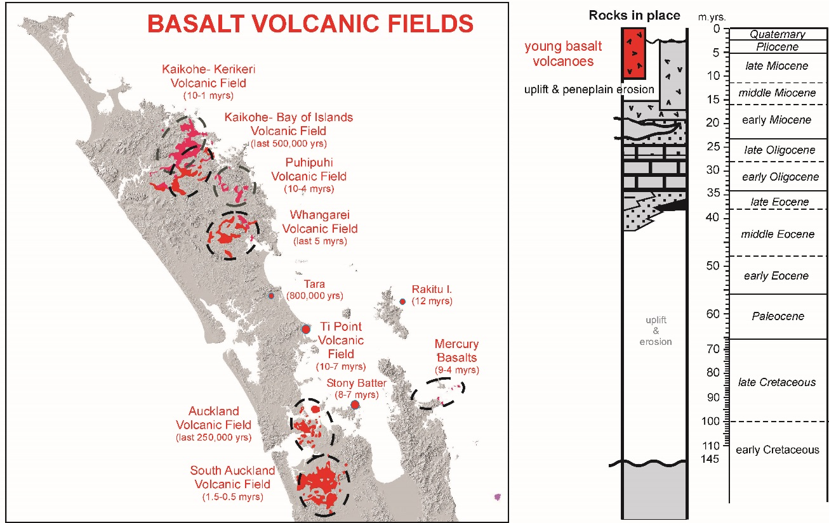

Slide 3
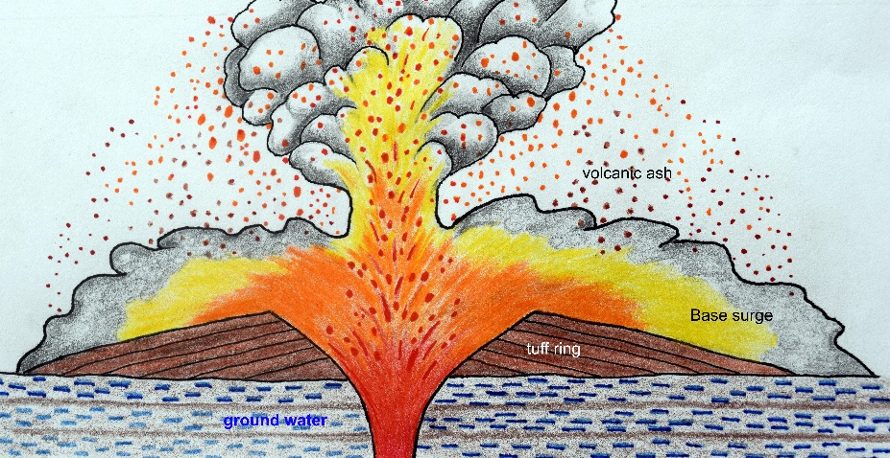

Slide 4
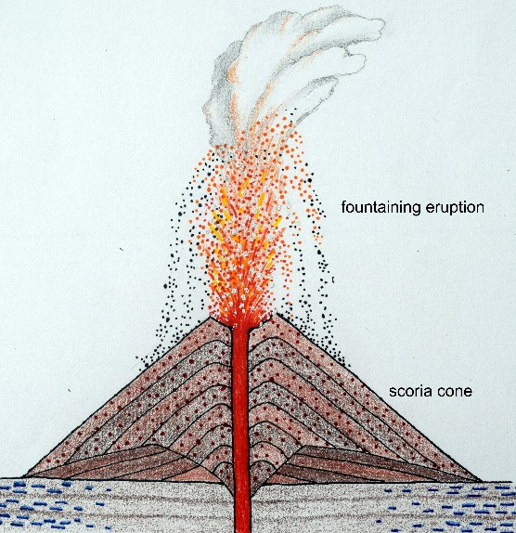

Slide 5
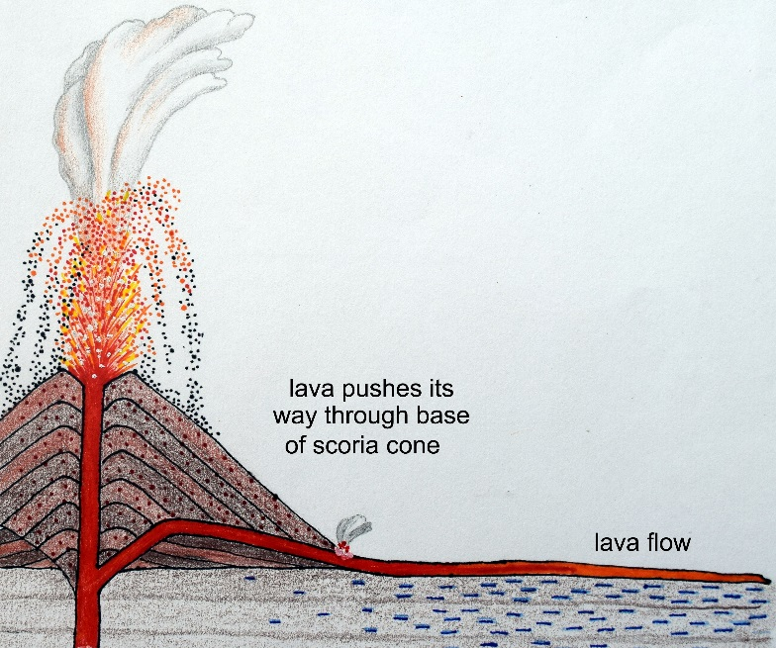

Slide 6
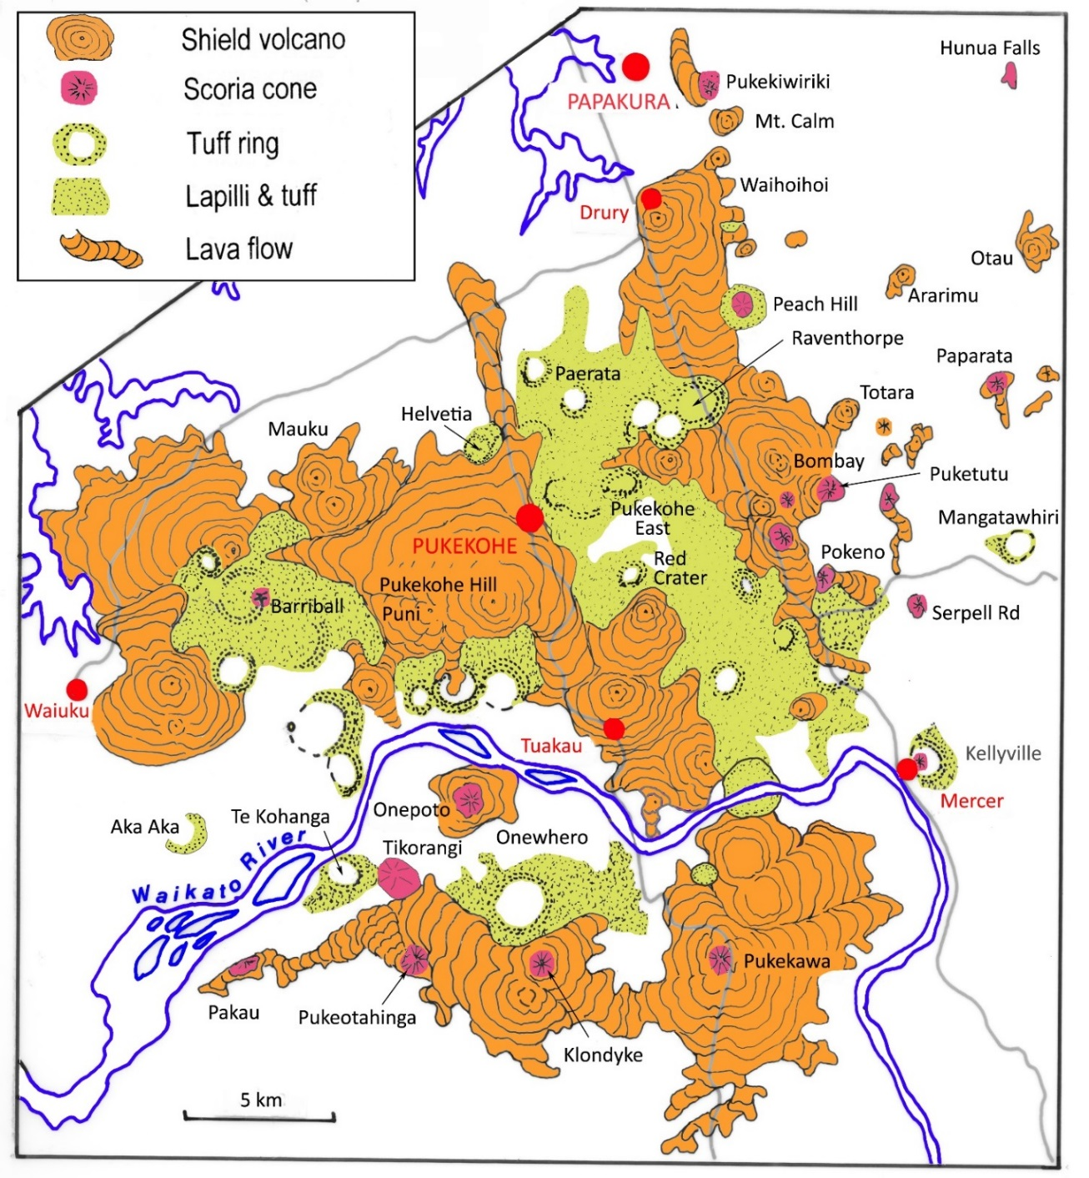

Slide 7
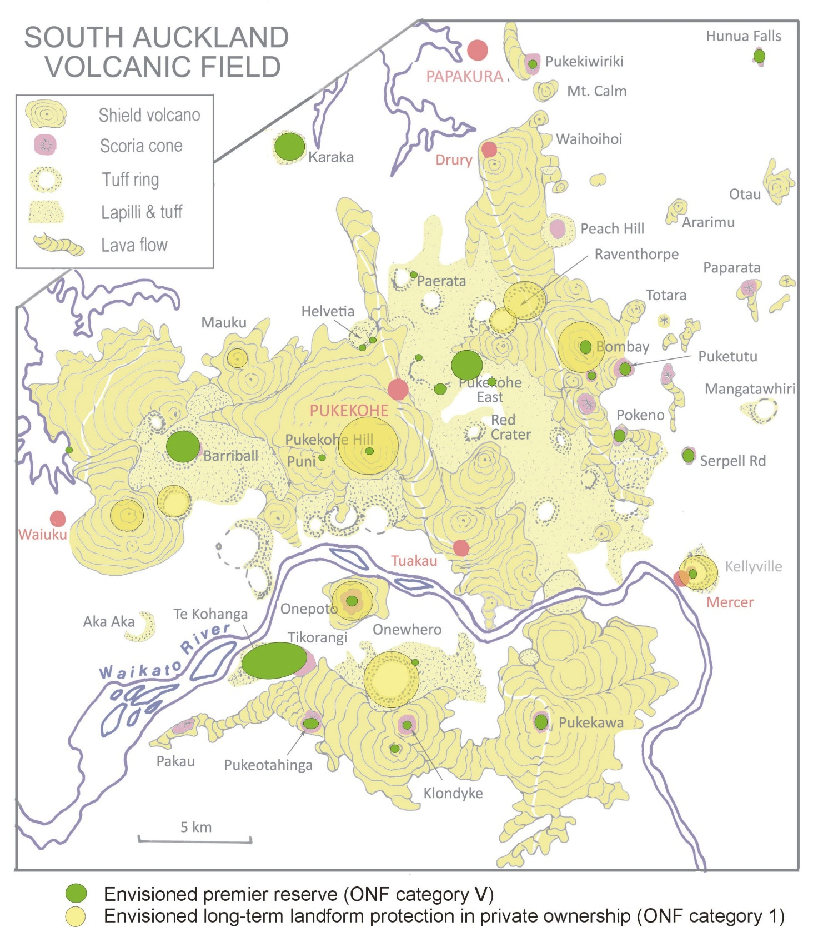
A 30-50-year vision for the
South Auckland
Volcanic Field

Slide 8
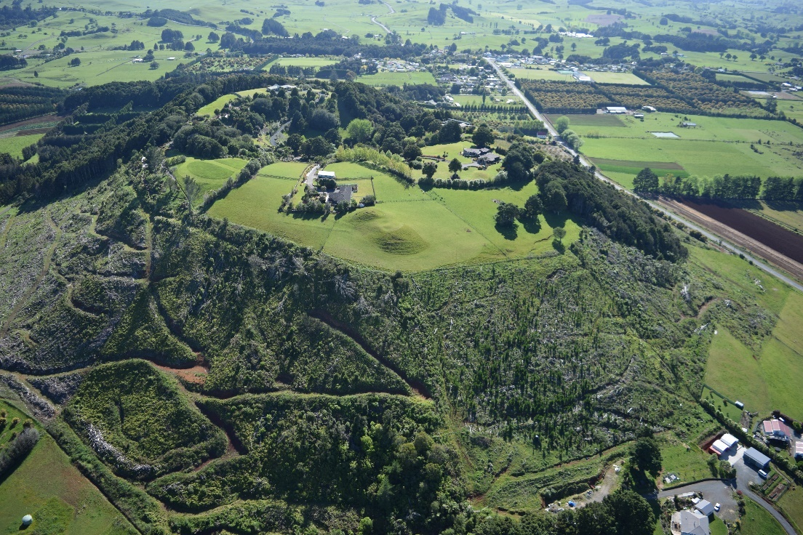
Maungakaramea

Slide 9
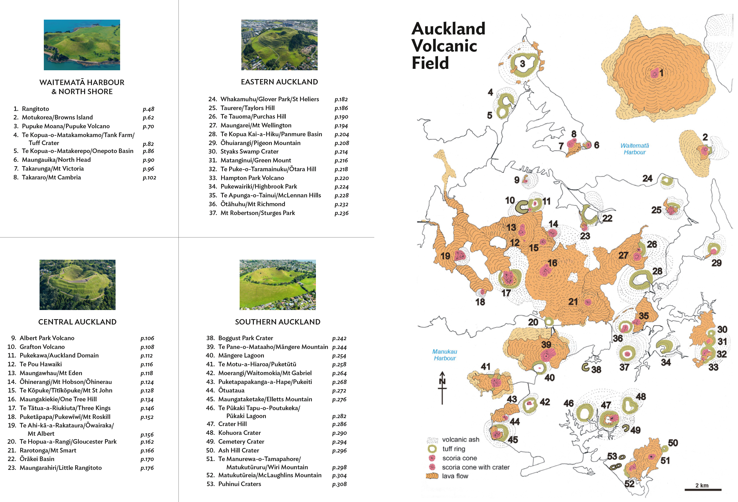
Volcanoes of Auckland: A field guide, Bruce Hayward, 2019, Auckland University Press

Slide 10
Existing or proposed
protected status of the
best-preserved volcanic
heritage of the South
Auckland Volcanic Field,
2020

Slide 12
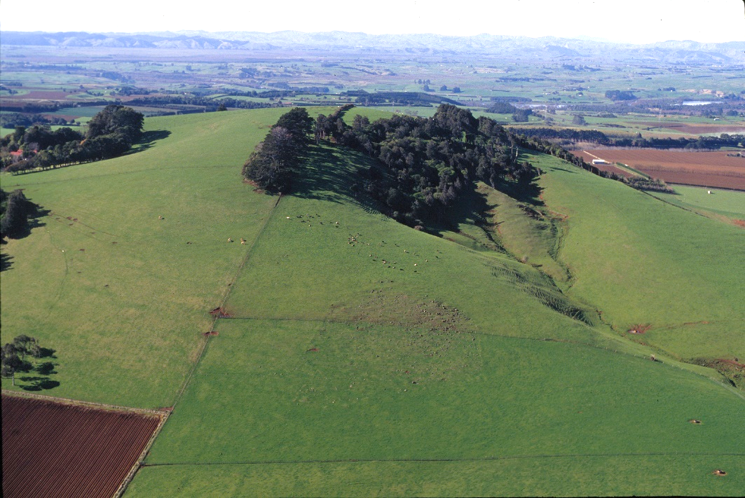
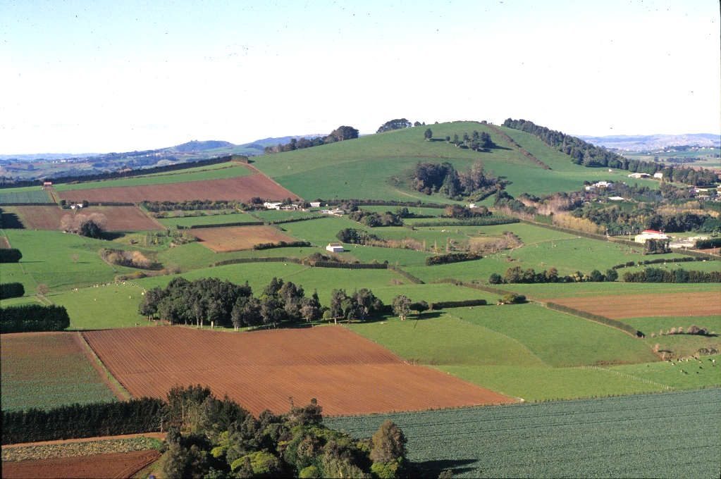
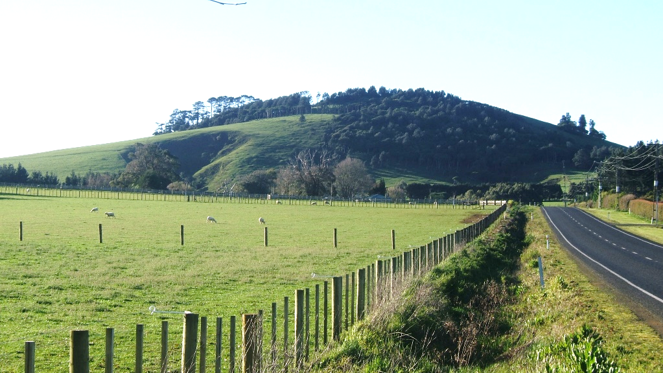
EXISTING ONF 9.
Pukekawa I Scoria Cone.

Slide 13
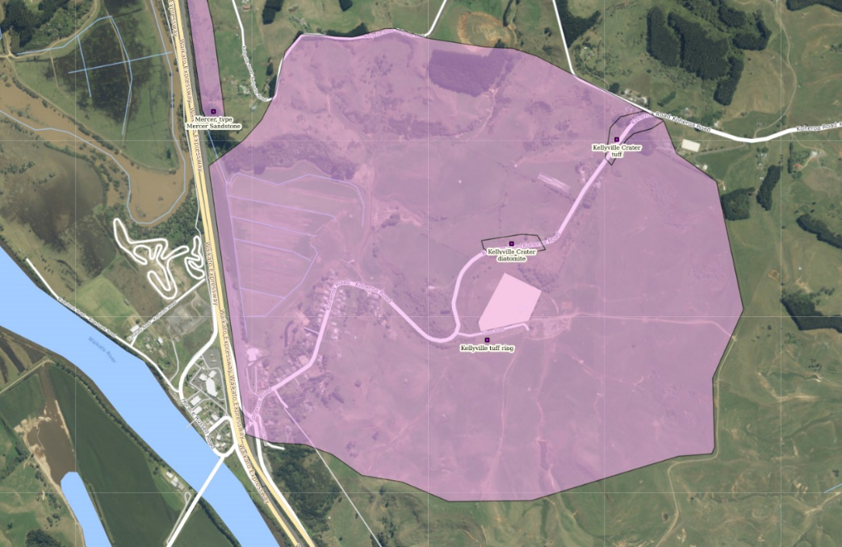
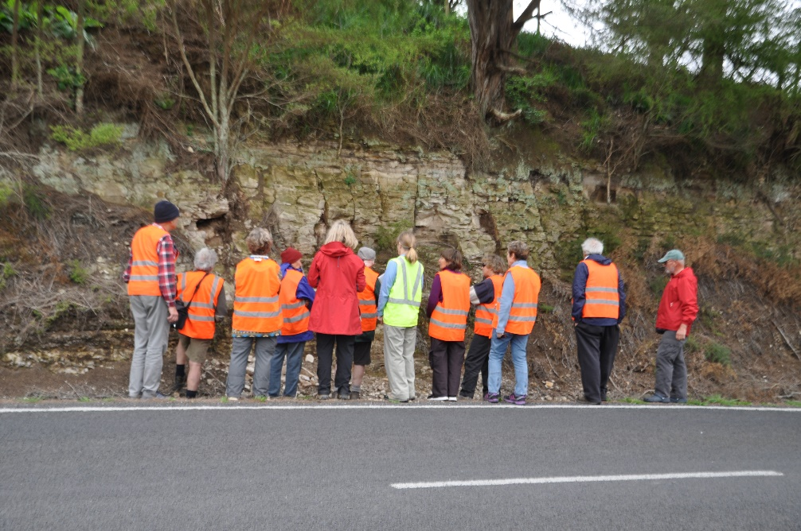
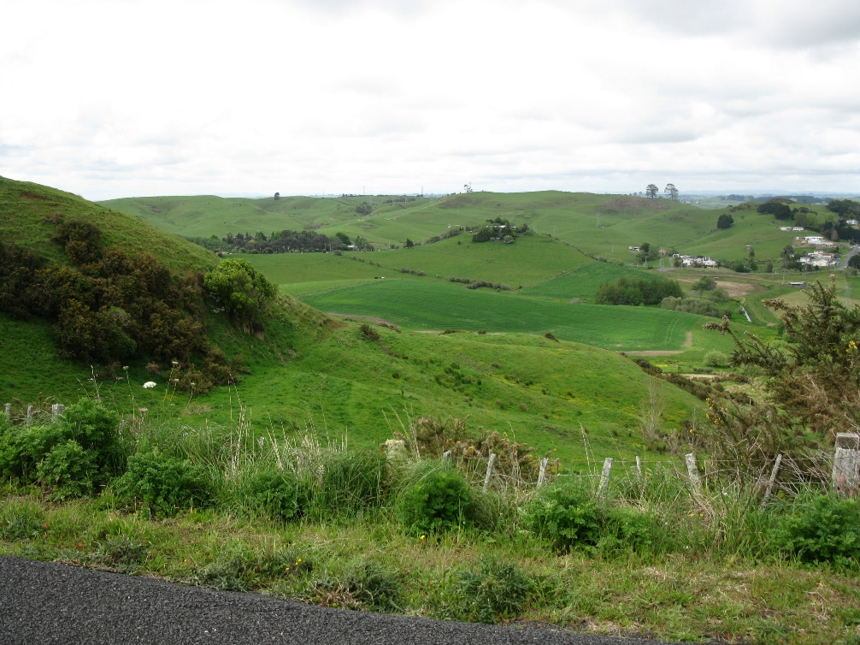
EXISTING ONF 4.
Kellyville Tuff Ring.

Slide 14
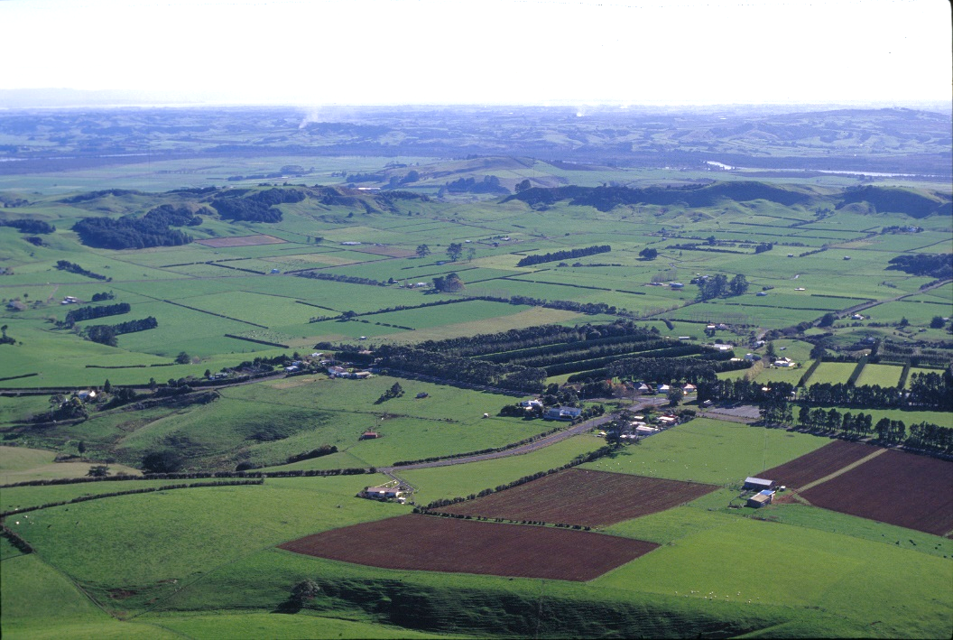
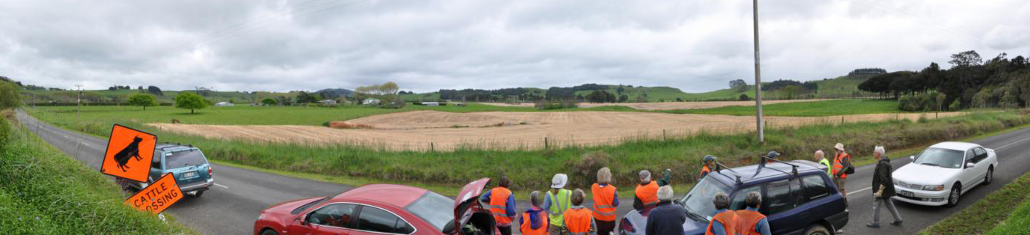
EXISTING ONF 6. Onewhero Tuff Ring.

Slide 15
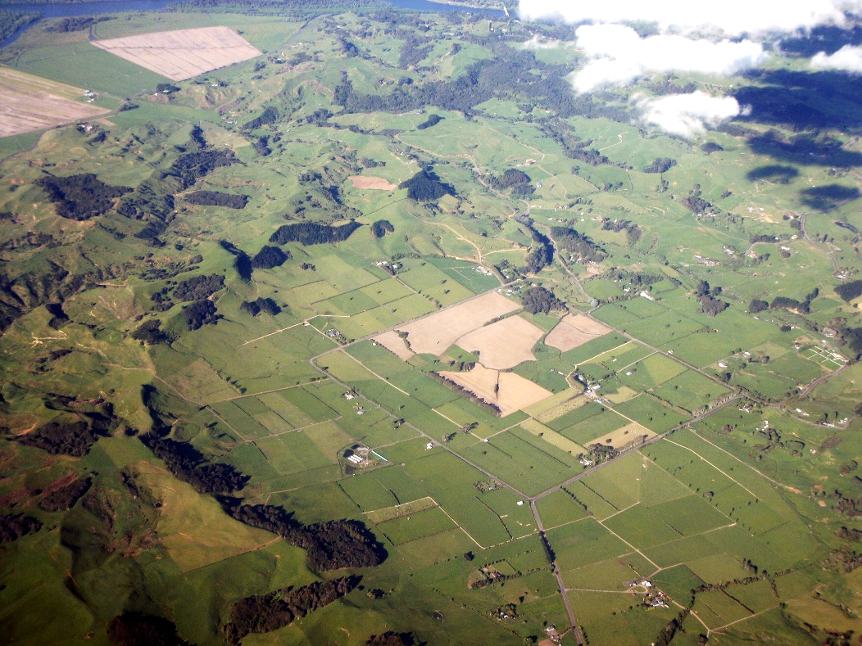

Slide 16
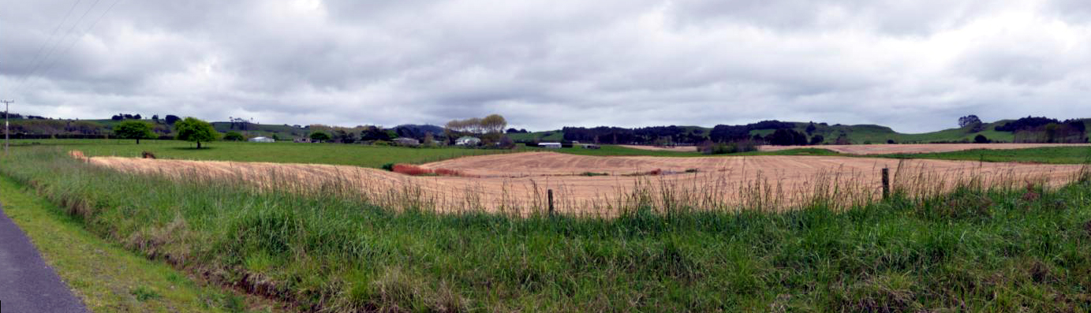
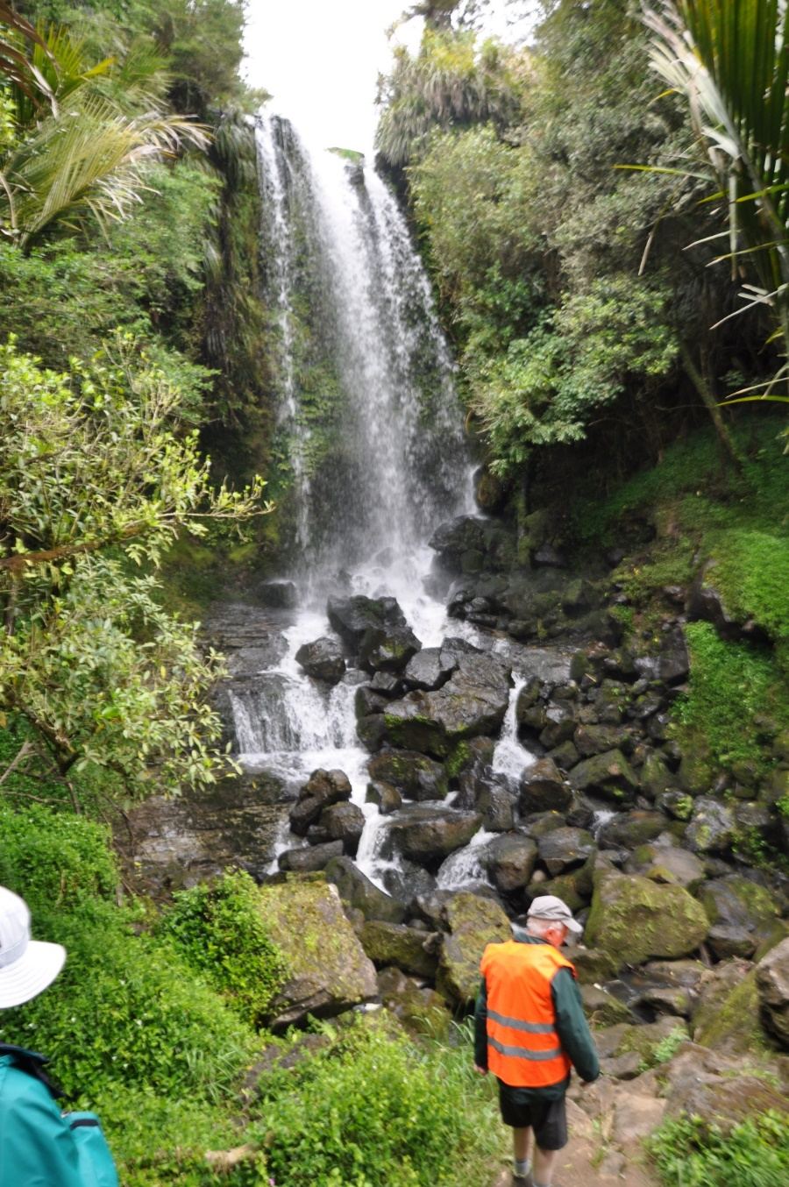

Slide 17
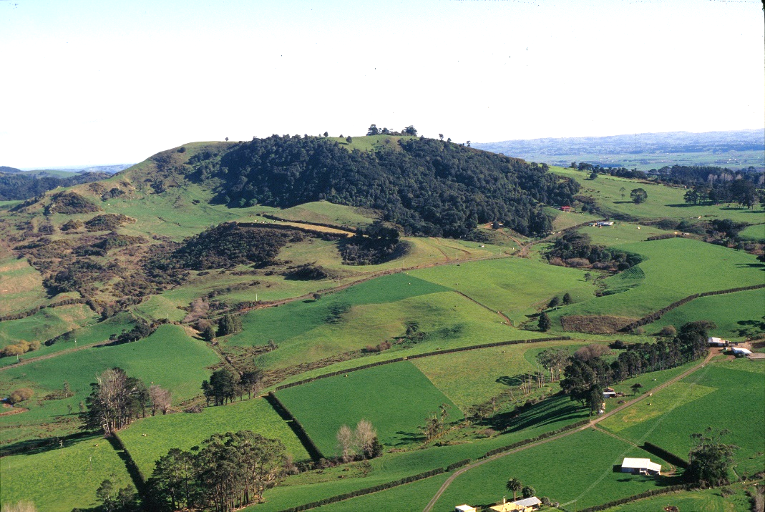
Pukeotahinga Scoria Cone

Slide 19
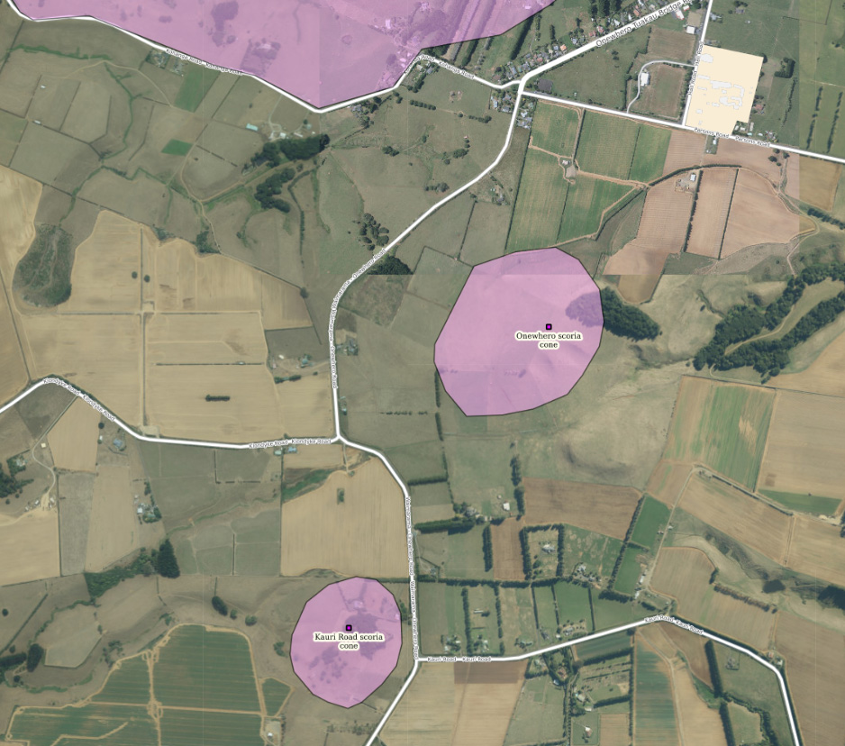
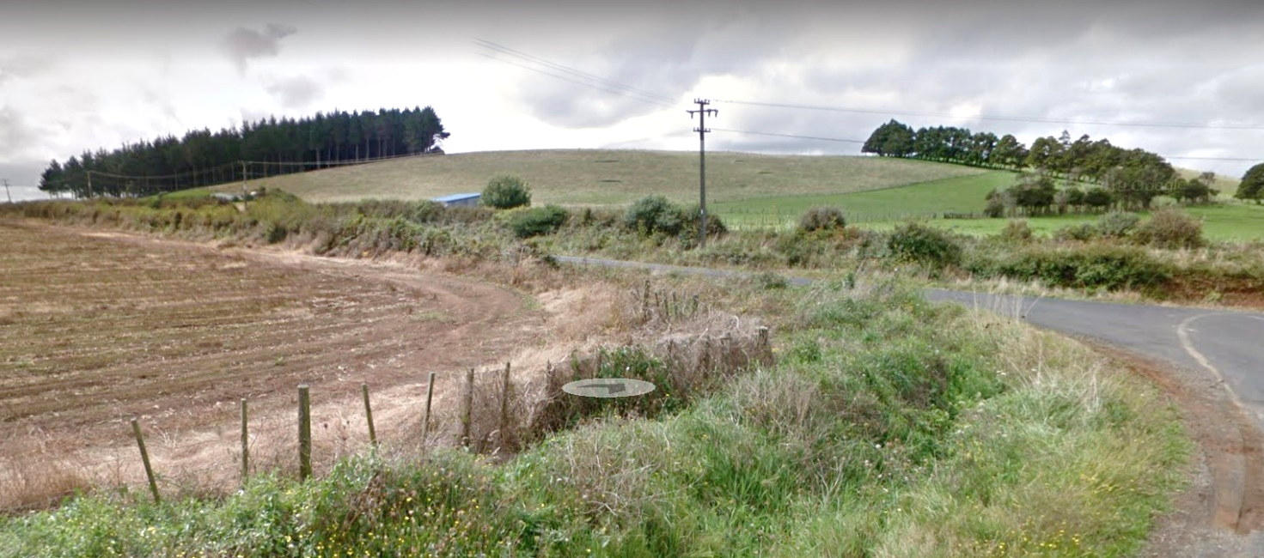
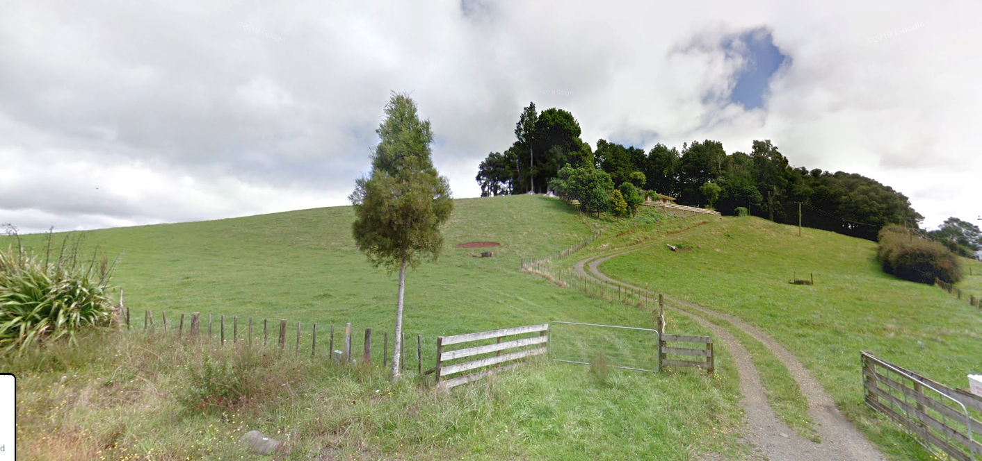
Onewhero scoria cone
Onewhero scoria cone

Slide 20
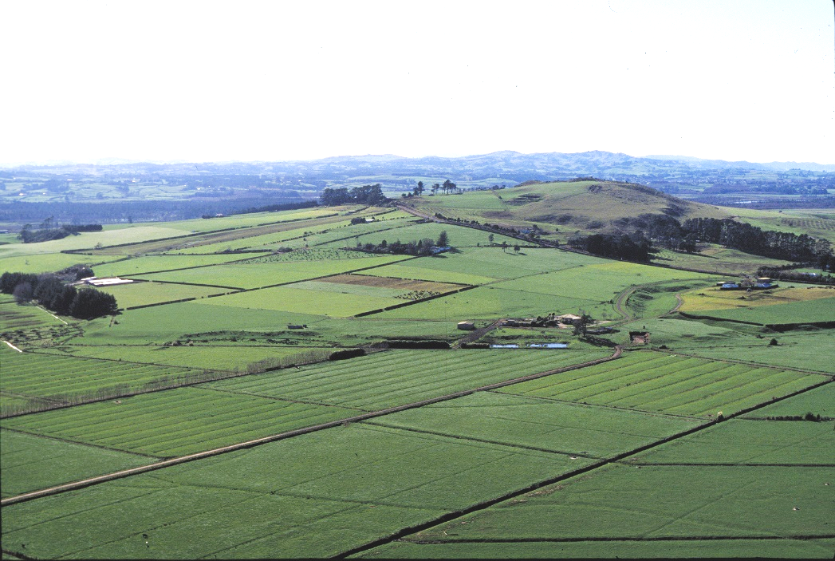
Onepoto volcanic cone

Slide 21
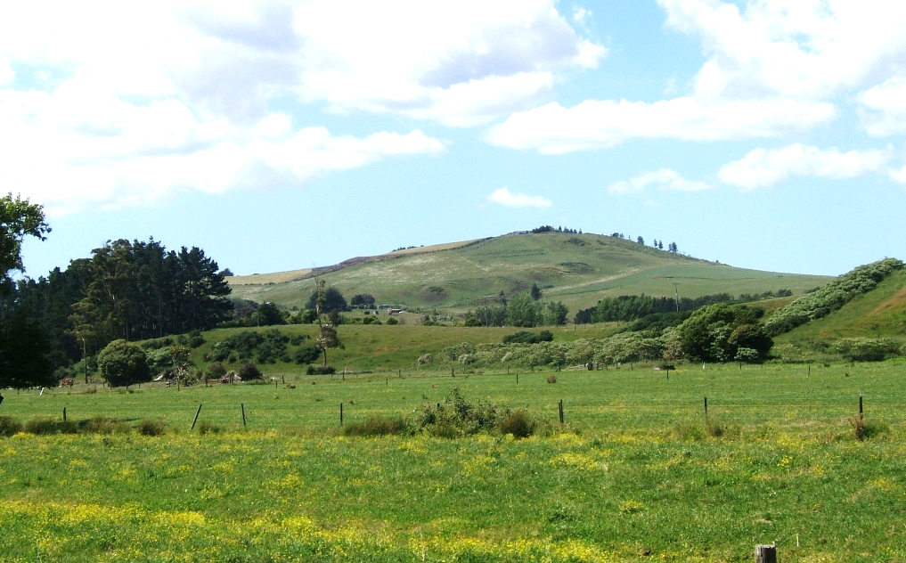
Onepoto volcanic cone

Slide 23
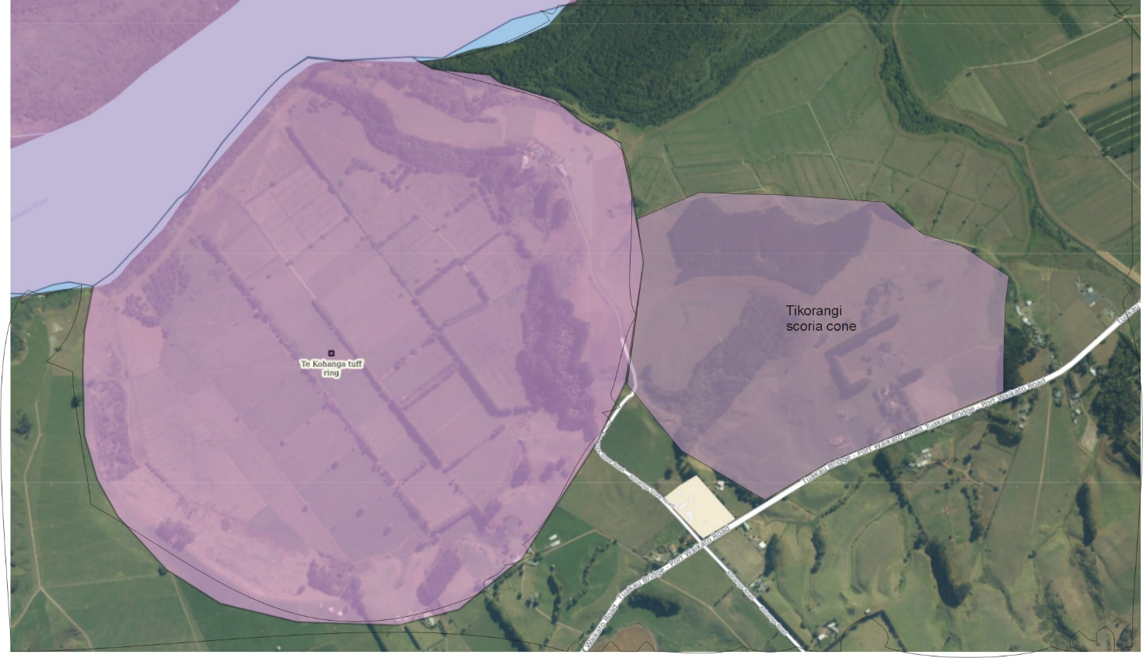

Slide 24
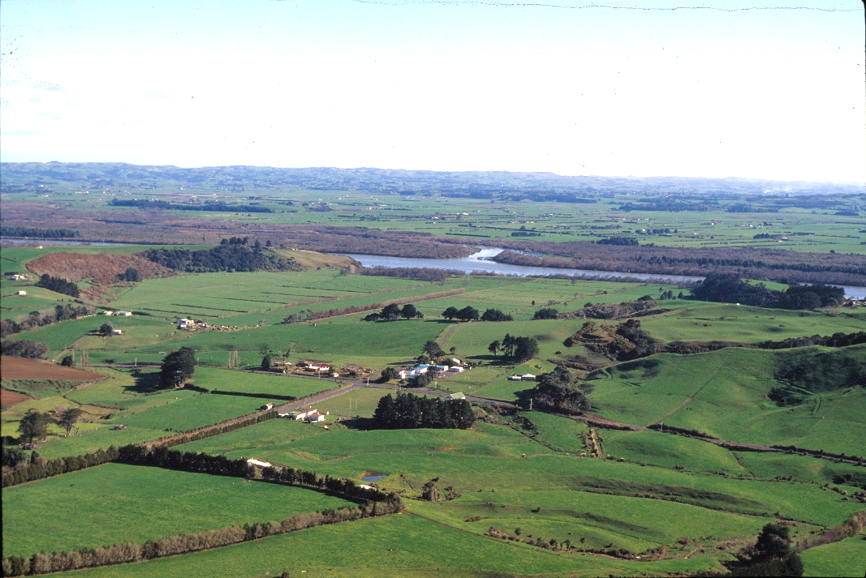
Te Kohanga Tuff Ring

Slide 25
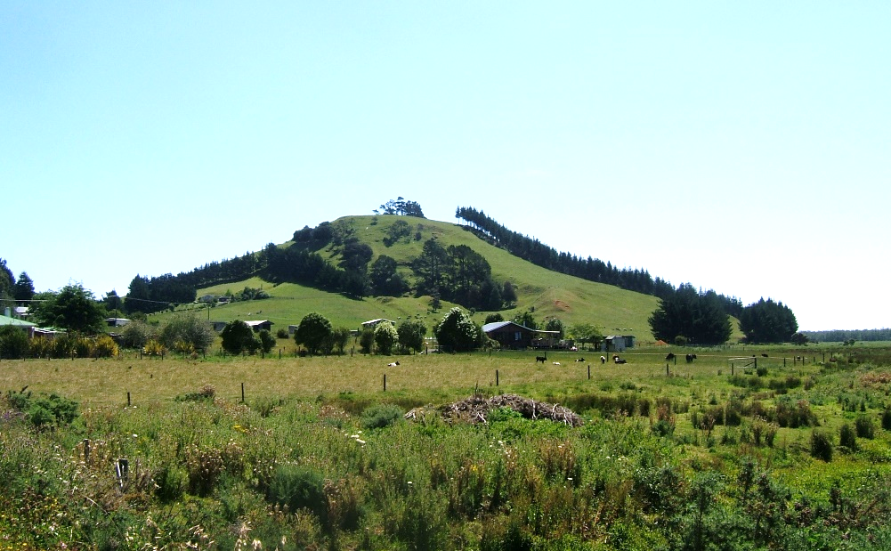
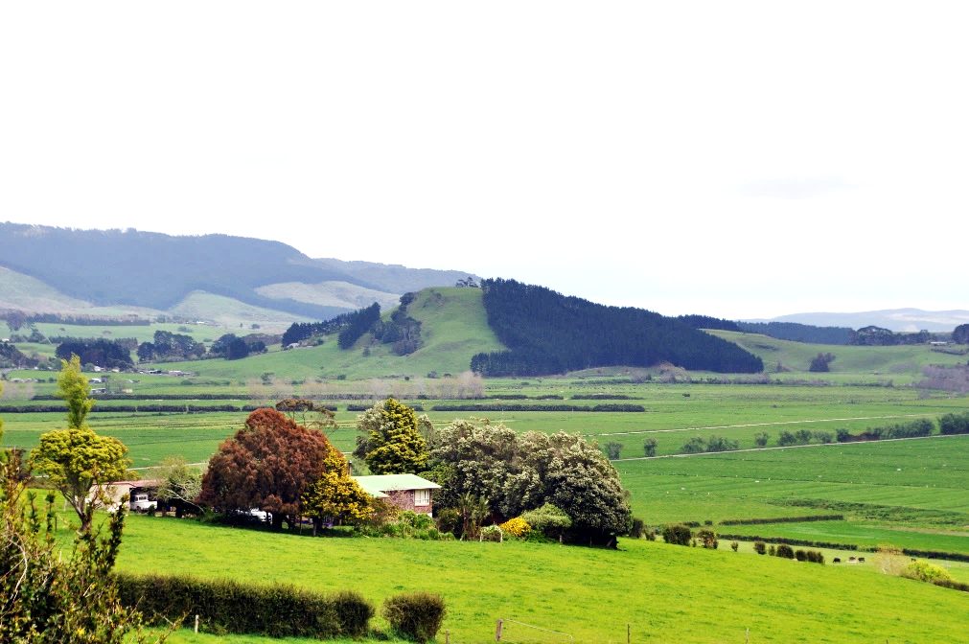
Tikorangi scoria cone

Slide 27
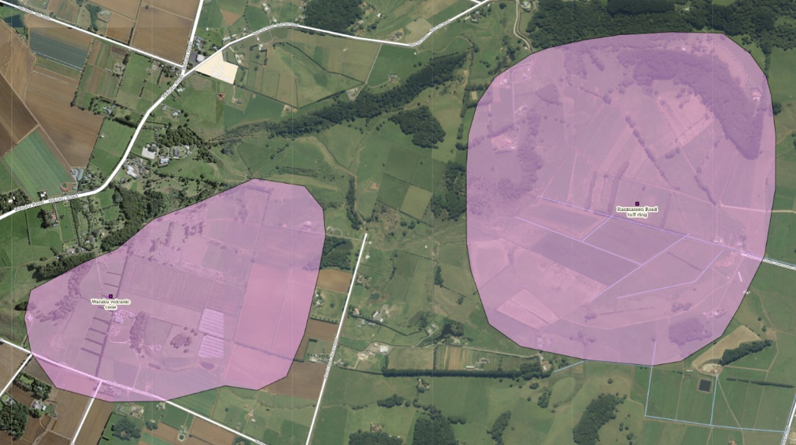
Waiuku Volcanic Cone
Rasmussen Rd Tuff Ring

Slide 28
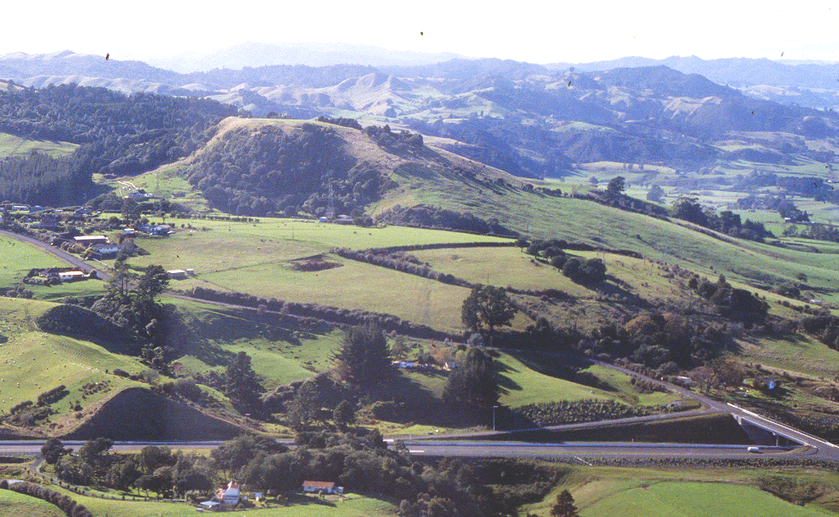
Pokeno Scoria Cone

Slide 30
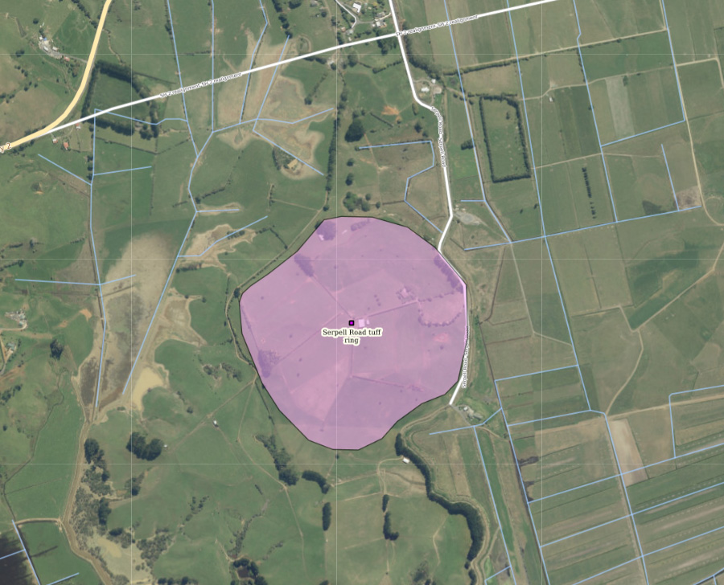

Slide 31
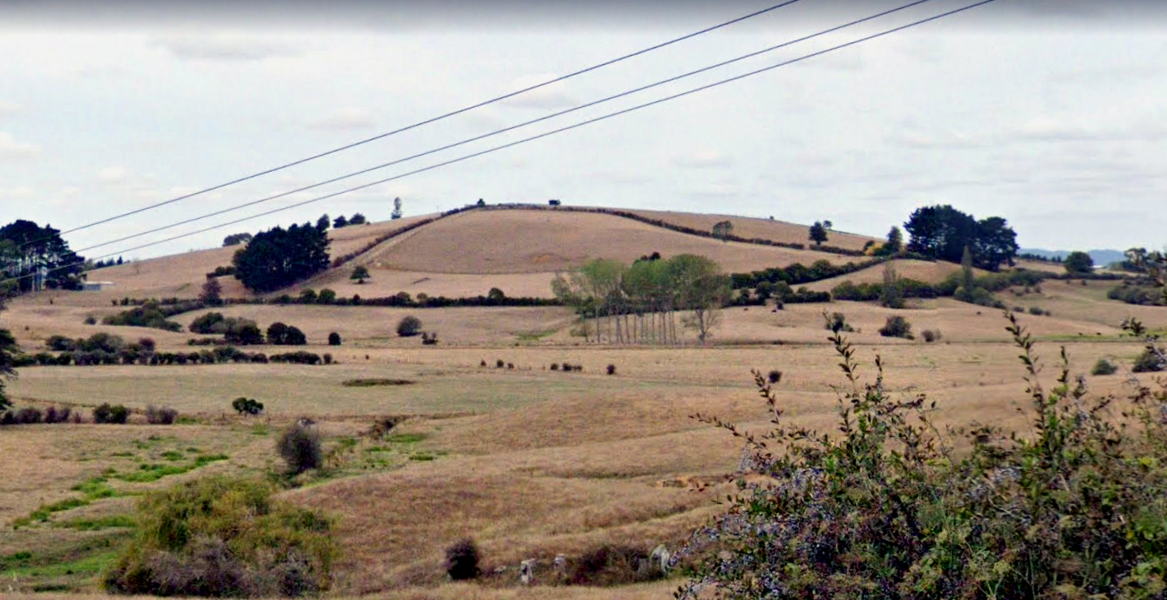
Serpell Rd Tuff Ring and cone

Slide 33
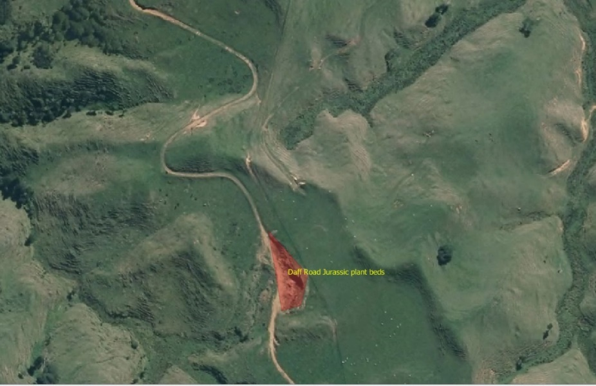
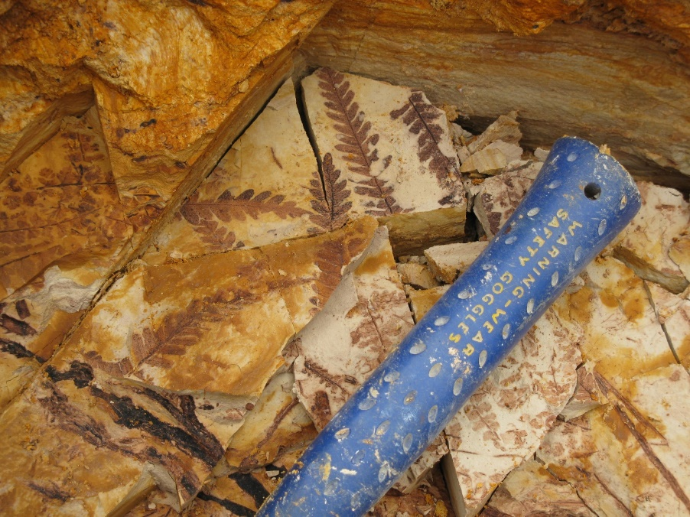
EXISTING ONF 2. Daff Road Jurassic Plant Beds

Slide 34
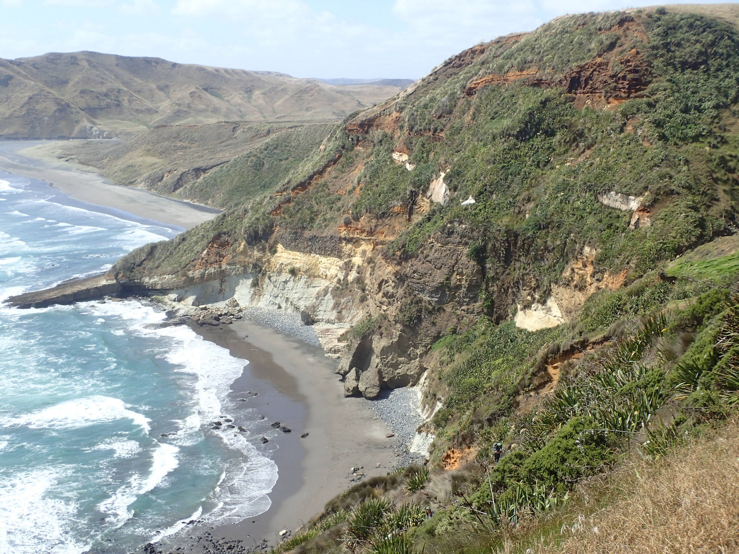
EXISTING ONF 3. Kaawa Creek - Ngatutura Bay Section.

Slide 35
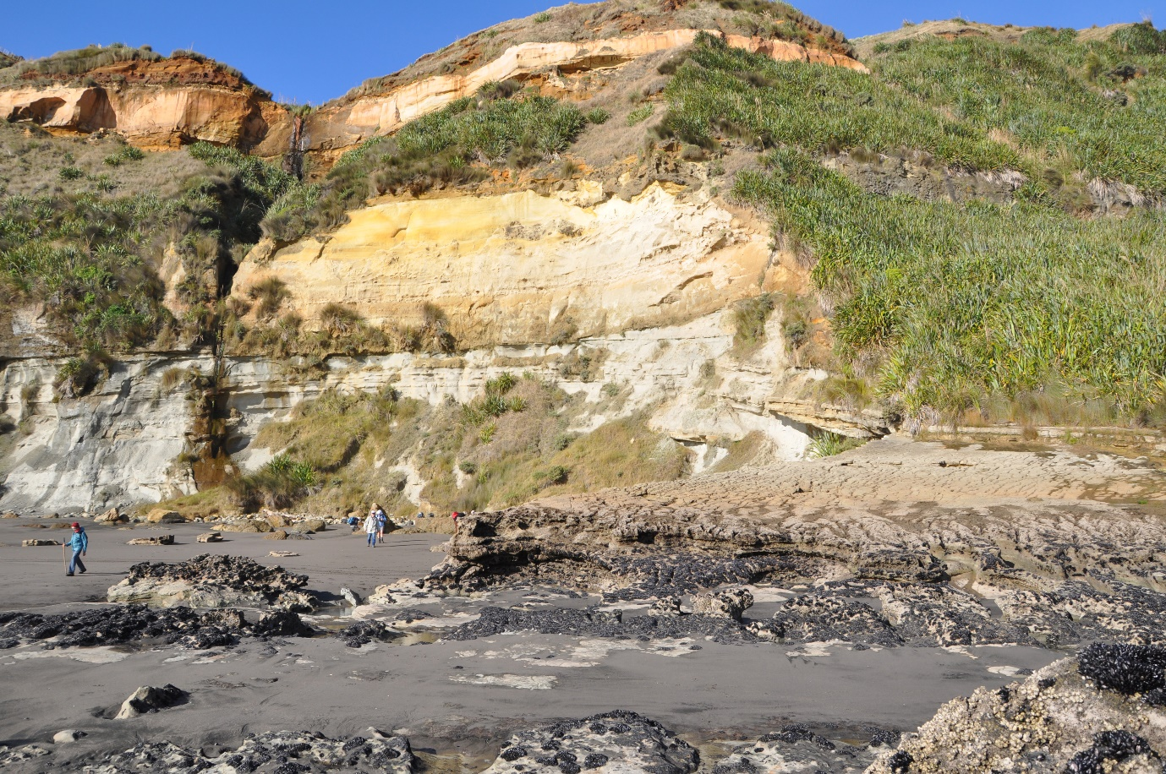

Slide 36
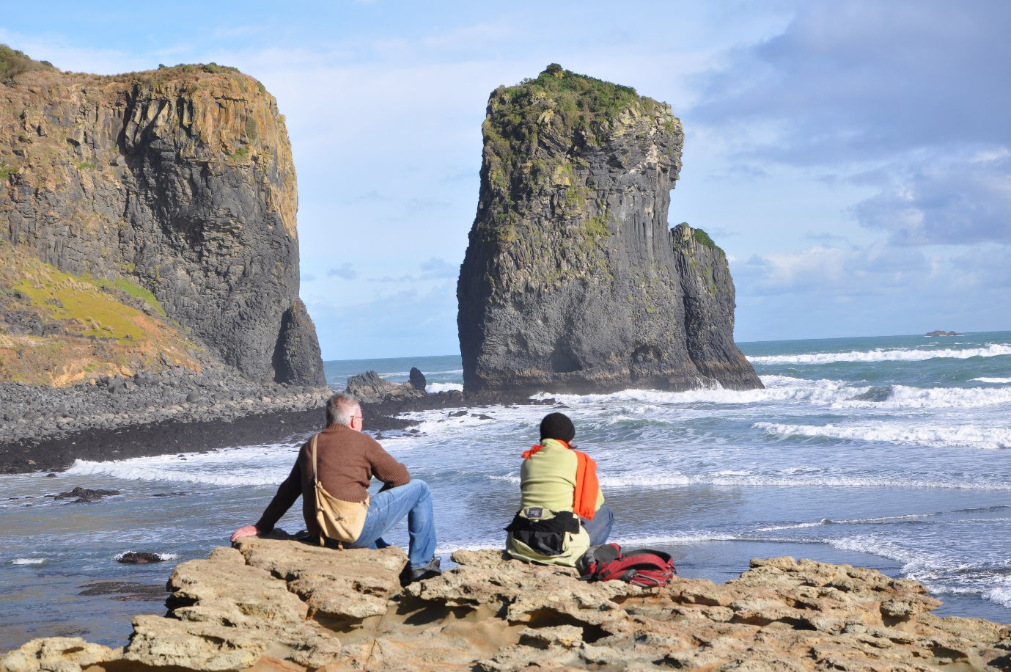

Slide 37
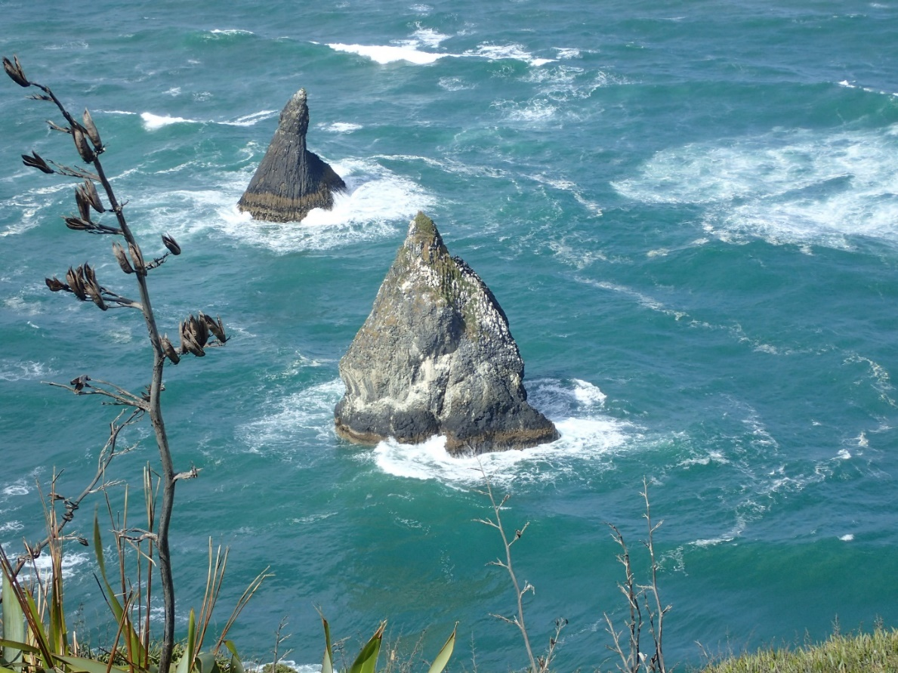

Slide 38
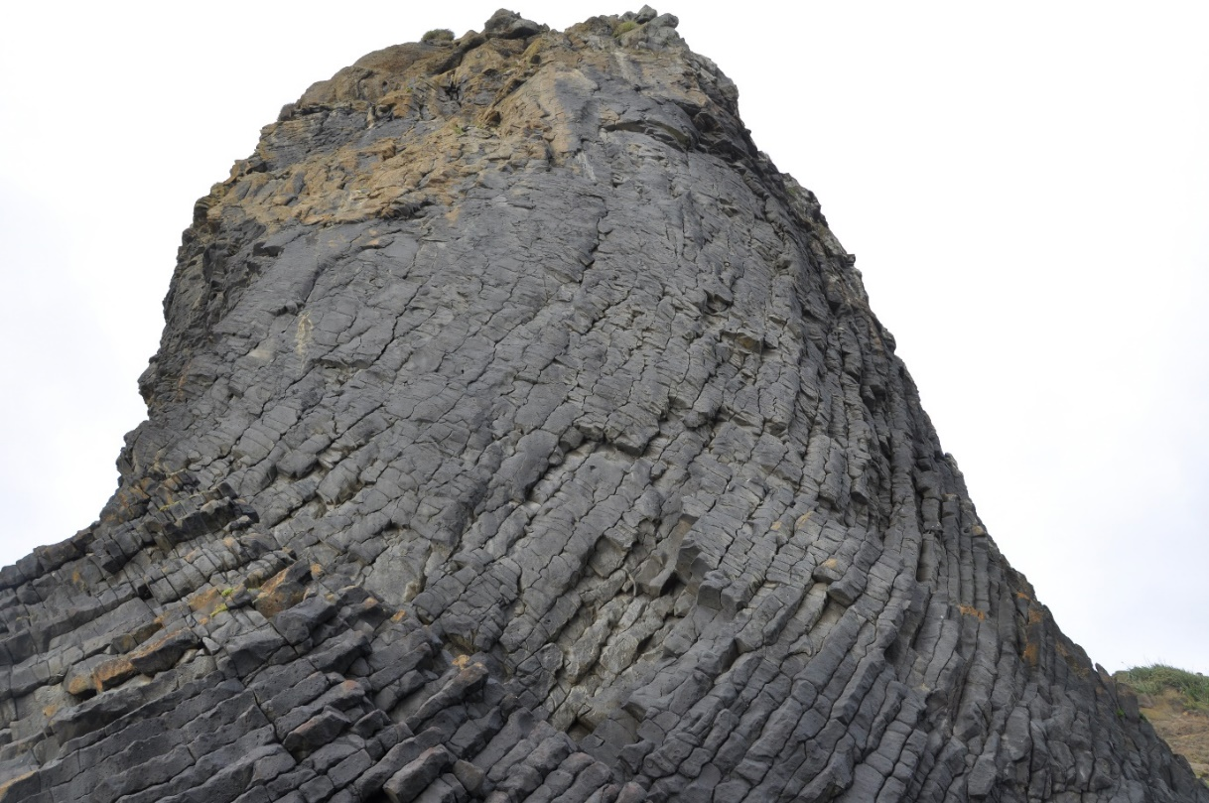

Slide 39
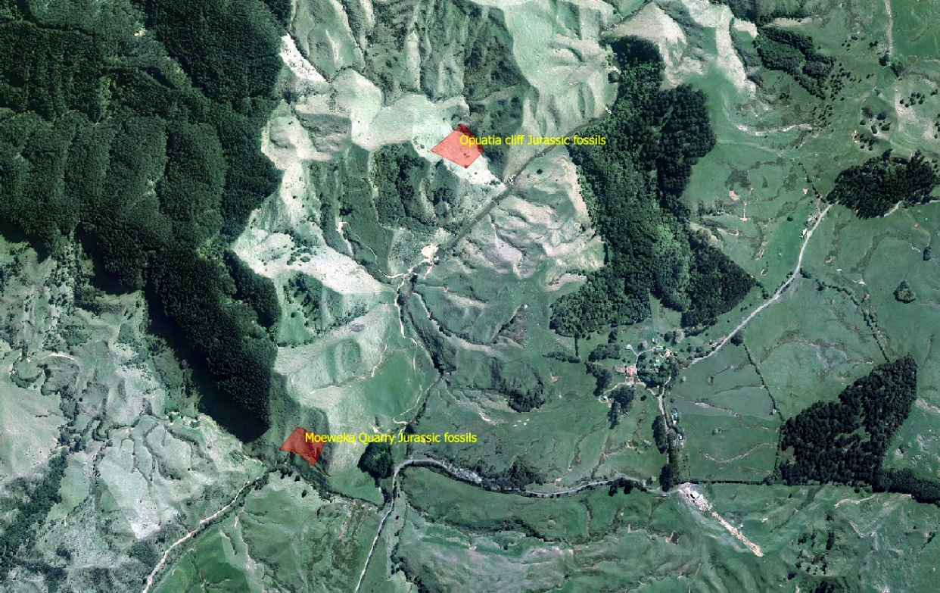
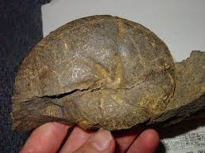
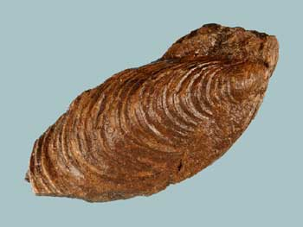
EXISTING ONF 7. Opuatia Cliff Jurassic Fauna.
EXISTING ONF 5. Moeweka Quarry Jurassic Fauna.

Slide 40
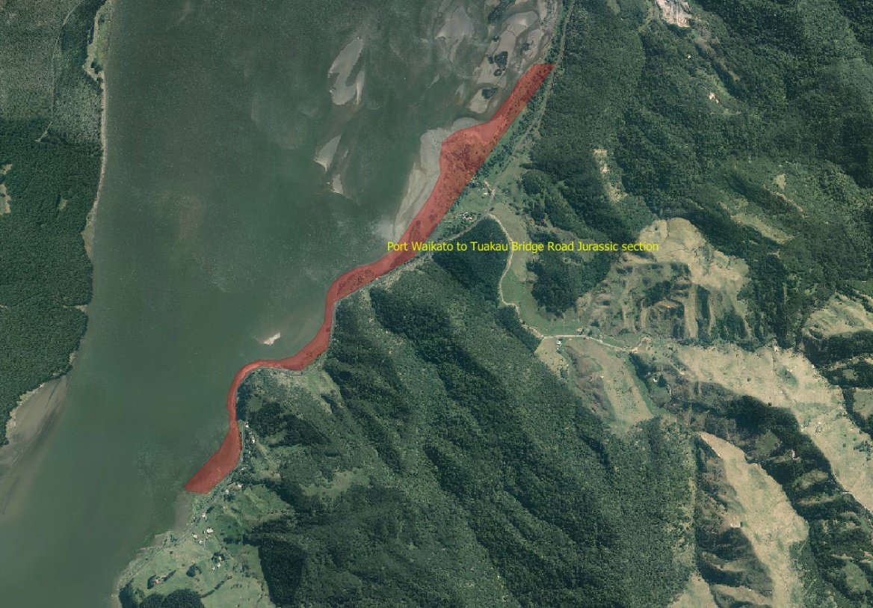
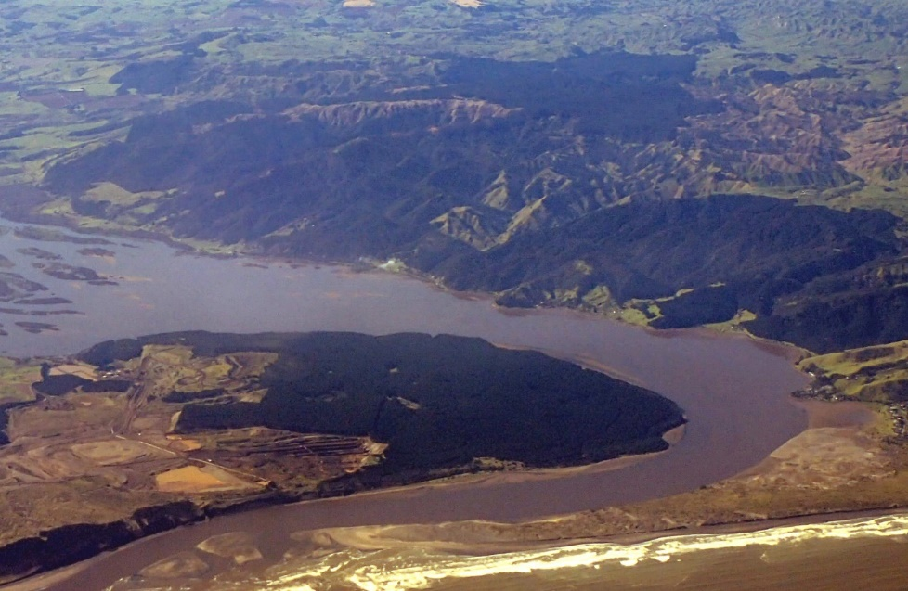
EXISTING ONF 8. Port Waikato To Tuakau Bridge Road Jurassic Section

Slide 41
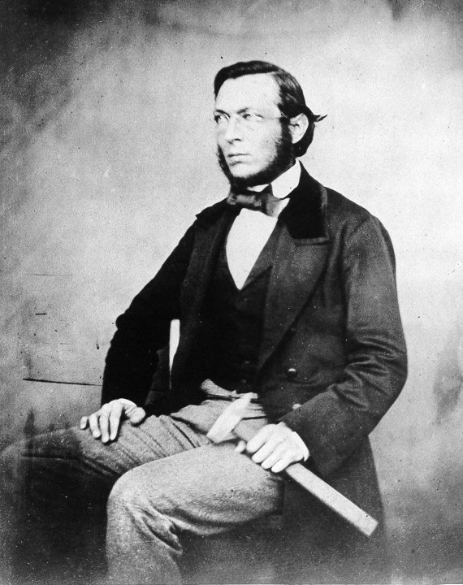
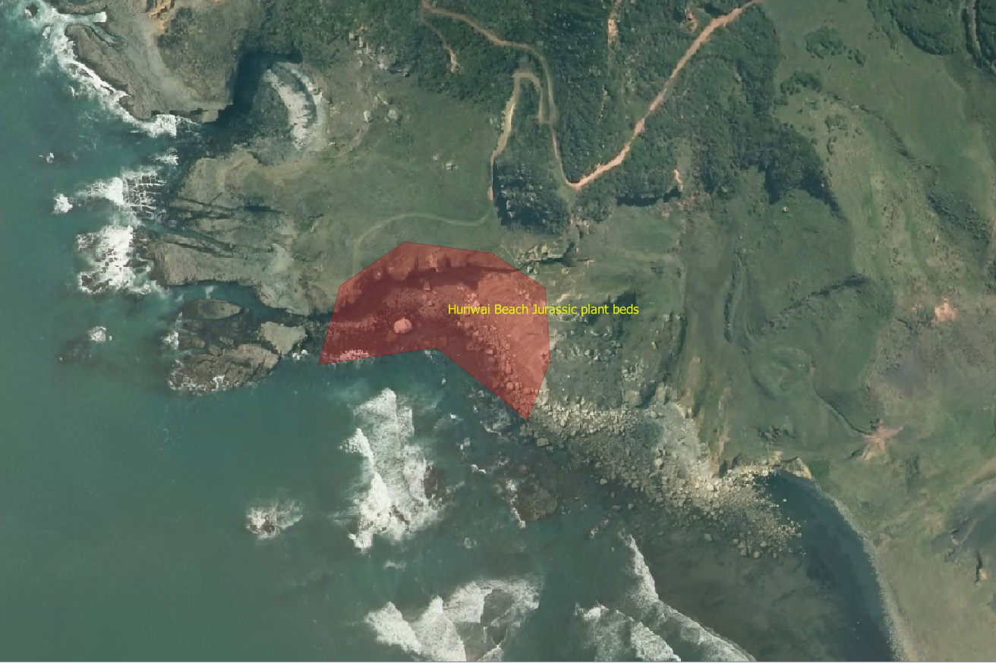
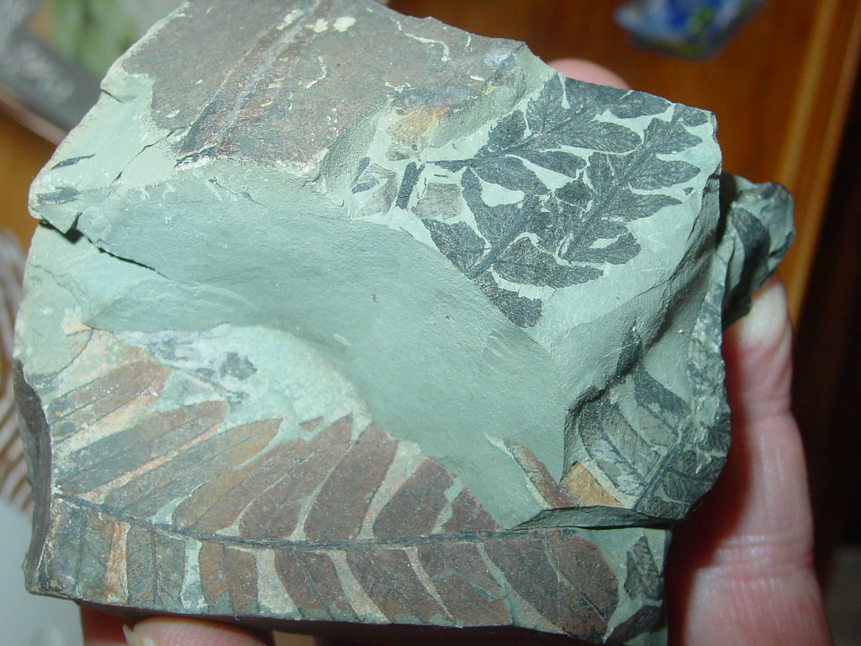
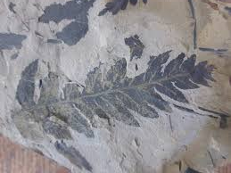
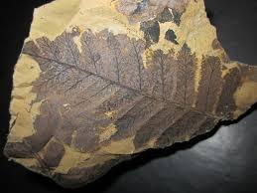
EXISTING ONF 10. Huriwai Beach Jurassic Plant Beds

Slide 42
ADDITIONAL ONFs SUGGESTED TO BE ADDED TO PWDP

Slide 43

1. Port Waikato sandspit

Slide 44

2. Ngapuriri natural arch and surrounding Waikawau Valley karst

Slide 45


Slide 46


Slide 47


Slide 48


Slide 49


Slide 50


Slide 51


Slide 52



Slide 53

3. Huriwai-Waikawau coastal section

Slide 54


Waiwiri Beach unconformity and basal Waitemata group

Slide 55



Puketoka conglomerate

Slide 56


Slide 57


Gibsons Beach unconformity and fossil karst

Slide 58

Taupiri Gorge

Slide 59


Dunphail Bluffs Oligocene sandstone

Slide 60



Carters Beach shore platforms

Slide 61


Raglan coastal karst

Slide 62


Slide 63



Slide 64


Te Toto Gorge lava and pyroclastic sequence

Slide 65


Mt Karioi

Slide 66

Papanui Pt volcanics

Slide 67

Bridal Veil Falls columnar jointed basalt

Slide 68


Slide 69

26. Lake Disappear blind valley
27. Lake Disappear karst

Slide 70



Slide 71


28. Taranaki Pt karst
29. Taranaki Pt volcanics

Slide 72

30. Aotea dune field

Slide 73




31. Helectite Hole karst = Old Mountain Rd karst

Slide 74

Nikau Cave and karst

Slide 75



