Slide 1

Waikato District Plan Review
Infrastructure Chapter (Hearing 22)
Evidence of Hywel Edwards on behalf of Firstgas Ltd
20 October 2020

Slide 2
Summary of Evidence
Quick recap on reverse sensitivity for context (Rural Chapter)
Infrastructure Evidence
  Large measure of agreement with Infrastructure Officer Report Recommendations, but some amendments sought:

Slide 3
Summary of Evidence
1. Gas Transmission Network:
“A network for the purpose of conveying high pressure gas and liquid petroleum including pipelines and above-ground infrastructure”
2. Planning Maps – illustration of above-ground gas stations (x10)

Slide 4
Summary of Evidence
Relief sought - part of a suite of measures (Rural Chapter evidence)
Required to address reverse sensitivity effects on the wider gas transmission network beyond solely the gas transmission pipeline (e.g. Objective 6.1.6)
Gas Stations
Nature of activities different (e.g. venting with noise and odour emissions)
Different risk profile (no land covering)
Maintenance activities occur at gas stations

Slide 5
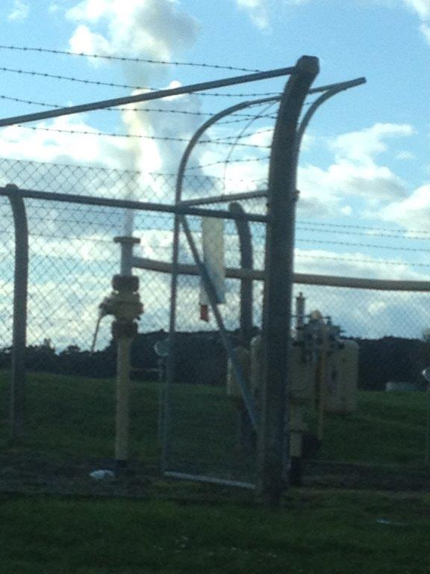
Above-ground Gas Stations
Secure compound
Can be a site to house infrastructure for changing high pressure into low pressure
‘Venting’ activities (temporary noise and odour emissions)

Slide 6
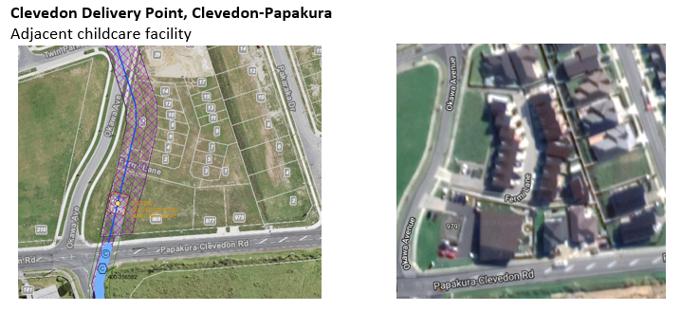
‘Gas Station’ built-out (subdivision and land use)

