Slide 1

Waikato-Tainui
Waikato District Council Proposed District Plan Hearing 25 – Rezoning
Hopuhopu

Slide 2

Presentation today
Gavin Donald – Context and background to submission
Shane Solomon - History of site
Development of Hopuhopu - video
Susan Henderson – Proposed planning provisions
BBO project team planner and engineers available for questions

Slide 3
Context and background to submission – Gavin Donald
Submission point 286.2 seeks to retain residential.
Submission point 286.3 seeks to retain business zone.
Submission point 286.17 seeks a specific Hopuhopu Zone, removing confusion and providing clarity around future uses and aspirations for the site.
Submission point 26.17 seeks a joint partnership approach with Council in developing a way forward.
The minute and directions from the Hearings panel for Hearing 4 (Tangata Whenua chapter) stated that the unique nature and zoning of the land at Hopuhopu mean that it could well be amenable to a zoning approach.

Slide 4
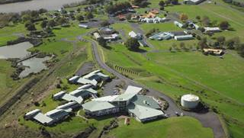
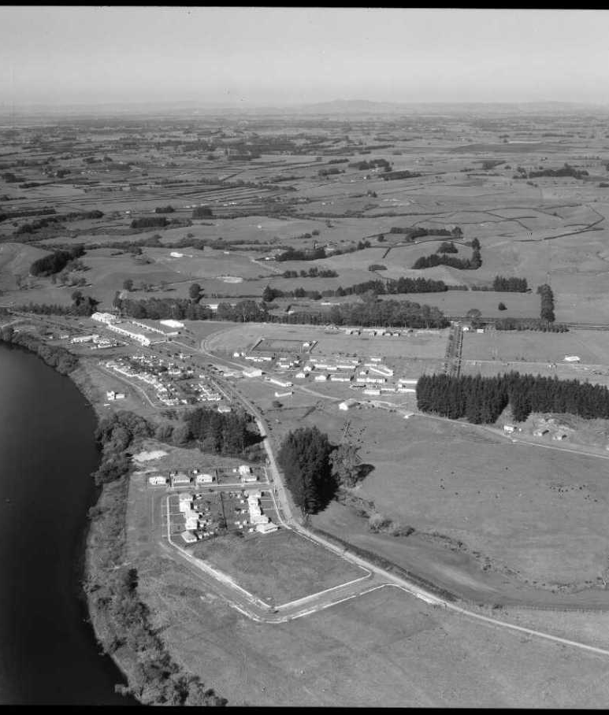
Background to the Hopuhopu site –
Shane Solomon

Slide 5
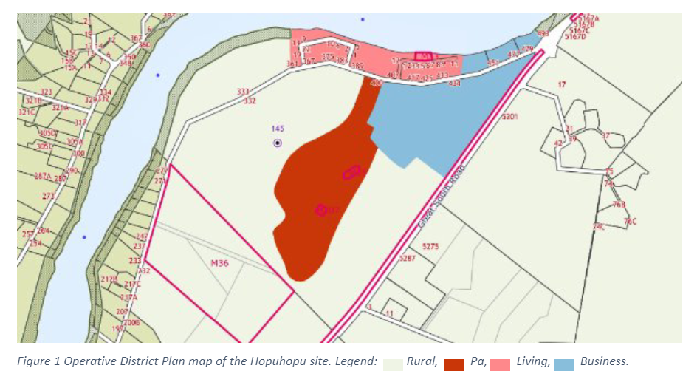
Planning provisions – Susan Henderson
The site contains four zones in the Operative District Plan – Rural, Pa, Living and Business.

Slide 6
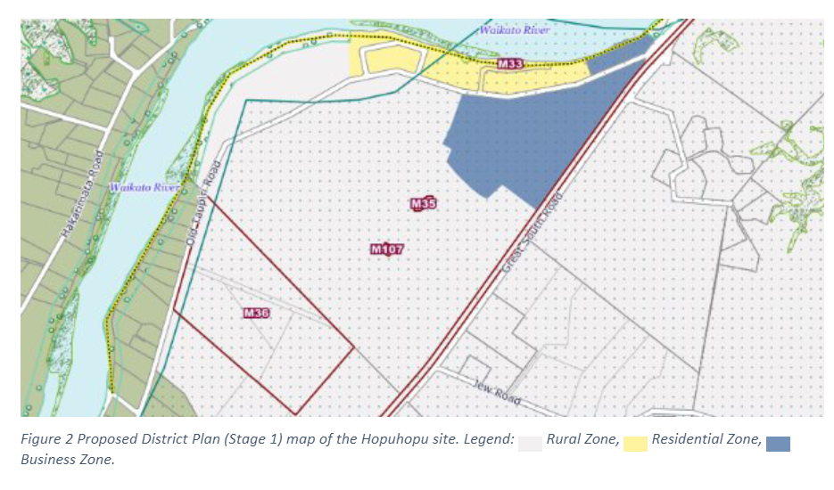
Planning provisions – Susan Henderson
Under the notified version of the Proposed Waikato District Plan, the open space and Endowed College area were rezoned to Rural zone. The existing residential and business areas remained in the Residential and Business zones respectively.

Slide 7
Planning provisions – Susan Henderson
It is proposed to insert a new zone into the PDP for the Hopuhopu site known as the ‘Special Purpose Zone – Hopuhopu’ (SPZ-H).
The SPZ includes five specific precincts.
  PREC 1 – Hopuhopu Residential Precinct;
  PREC 2 – Hopuhopu Education and Conference Precinct;
  PREC 3 – Hopuhopu Business Precinct;
  PREC 4 – Hopuhopu Open Space Precinct;
  PREC 5 – Hopuhopu Mixed Use Precinct
The boundaries of the precincts have been developed to take into account existing and future development and site features.
Consequential amendments are required to Chapter 14 and 29 to ensure that there are provisions specific to the Hopuhopu zone.

Slide 8
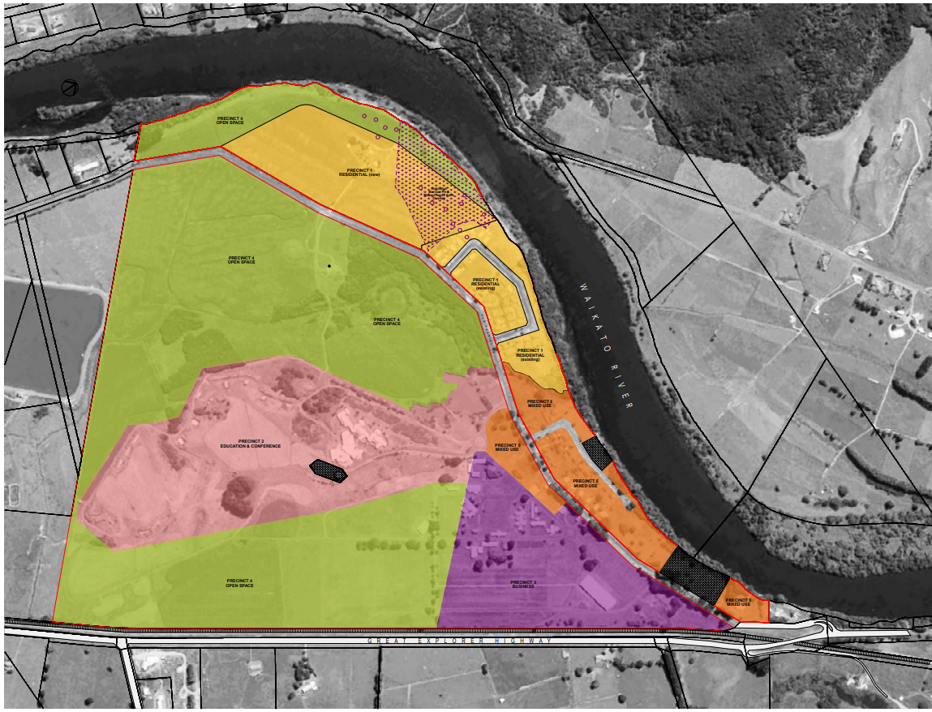
Proposed Special Purpose Zone - Hopuhopu

Slide 9
Proposed Planning Provisions – PREC 1 – Residential
The Residential Precinct largely reflects the existing provisions in the operative Residential and proposed Living zones.
The density of residential development is limited to a yield equivalent to an average of one residential unit per 450m² – equivalent to the operative and proposed district plan provisions.
Around half of the existing residentially-zoned land will become part of the Mixed Use Precinct, with an area to the west which is currently zoned rural becoming part of the Residential Precinct to take its place.
The total area of PREC1 will be 16.4 ha.

Slide 10
Proposed Planning Provisions – PREC 2 – Education and Conference
The provisions in the Operative Pa zone are to be reinstated to some extent but with a smaller, more specific range of activities to reflect the existing and proposed use of that part of the area as the Endowed College.
The boundaries of the precinct will primarily match that of the Operative Pa Zone, with a slight reconfiguration so that it follows physical features on the ground such as the existing accessway and lake on site.

Slide 11
Proposed Planning Provisions – PREC 3 - Business
The operative and proposed district plans both allow for a wide range of activities in the Business zone. The proposed Business Precinct retains many of these activities but has a more tailored list of permitted activities.
The Operative District Plan provided for around 23.7 ha of business-zoned land on this site.
The proposed PREC3 would be around 15.1 ha in area.

Slide 12
Proposed Planning Provisions – PREC 4 – Open Space
Some changes are proposed to more clearly provide for the existing uses on the site which are partly rural in nature and partly related to the existing sports fields and other events that occur in that part of the site.
Additionally, specific activities which are envisioned for this part of the site, including a wholesale plant nursery, carvers’ workshop and environmental education facility, are provided for.

Slide 13
Proposed Planning Provisions – PREC 5 – Mixed Use
This precinct will be the heart of the Hopuhopu area and is to provide for a mix of residential (primarily kaumaatua housing), cultural (Whare Taonga/museum), and administrative uses (Waikato-Tainui headquarters and offices), along with potential for a small convenience retail and café.
Part of this precinct was zoned Living/Residential and part was zoned Business under the operative and proposed district plans.
The total area proposed for PREC5 is approximately 8.5ha.
The combined areas of the Business and Mixed Use precincts is approximately 23.6 ha, slightly smaller than the Operative Business zone area.

Slide 14
Site servicing and suitability
Transport: Effects are expected to be moderate and able to be managed and mitigated to an acceptable level.
Three waters: Sufficient capacity to service the site. Wastewater pipe replacements will be required.
Geotechnical: Suitable foundations will be required with detailed design at building consent/earthworks consent stage.
Archaeological: A series of probable and possible borrow pits identified. Advice note to be added.
Ecological: Impacts can be avoided, remedied, mitigated or offset. To support consent applications, further detailed survey work is recommended, including bioacoustic surveys for bats.
Contamination: A range of HAIL activities are known/likely to have been undertaken, at some locations within the site. Likely consent required under NES and Waikato Regional Plan.
Alligator weed: Size of infestation area is small in relation to the size of the restricted place. Process is underway to remove the restricted place as a result of recent monitoring. Advice note to be added.

Slide 15
Questions

