Slide 1
Zone Extents: Rest of District
Evidence Highlights
Bevan Houlbrooke for
Diamond Creek Farm Ltd

Slide 2
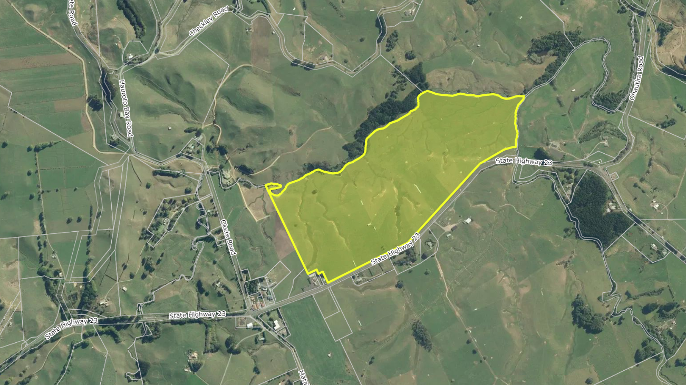

Slide 3
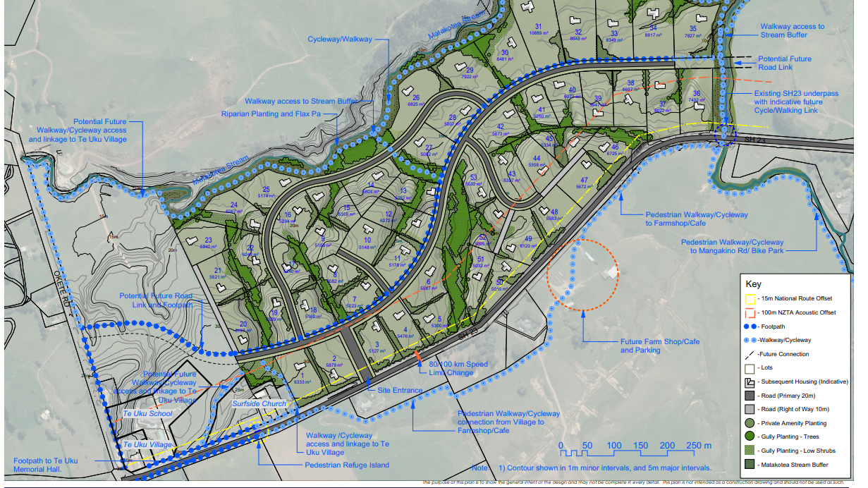

Slide 4
Summary of proposal
Rezone 43 ha from Rural to Country Living Zone (CLZ).
Site is east of Te Uku village containing a school, community hall, general store, coffee shop and church.
Structure Plan, Geotechnical, Transportation, Agricultural and Landscape Assessments completed.
54 rural residential lots (>5000m²).
Road connection with SH23. Cycleway/walkways within site and links to village.
Steam margin and gully enhancement opportunities.

Slide 5
Village Limits
Future Proof does not identify urban or village limits for Te Uku, or any other village outside of the Hamilton Periphery.
s42A asserts that the intention of Future Proof is for growth to only be directed to areas with urban and village limits, either wholly within or at the periphery.
I disagree in respect of villages. Village limits were only identified on the Hamilton periphery where a more stringent framework for managing growth was required.
It is not the intention of Future Proof to strictly limit the growth of rural villages and nodes outside of the Hamilton periphery. For example, all of the rural villages in the Waipa District do not have village limits identified in Future Proof yet they have been enabled for growth (Plan Change 5).
Furthermore, Section 7.5 of Future Proof sets out the maps representing the settlement pattern only provide a general indication of extent of urban areas.

Slide 6
High class soil and fragmentation
DCF site contains both versatile (37%) and non-versatile soils (63%).
Agricultural impact report concludes that modest changes to farming practices could see the net loss of animals brought down to approximately 60 animals as a result of rezoning proposal.
Policy 14.2 of the WRPS seeks to avoid a decline in the availability of high class soils for primary production due to inappropriate subdivision, use or development.
It is not the intention of Policy 14.2 to prevent all urban development on high class soil, however it is expected that in order to ensure development is appropriate, it would be subject to a comprehensive planning process such as district plan review, structure plan or growth strategy prior to re-zoning.
Information provided with the submission has been comprehensive and concludes the loss of high-quality soil is not significant. Te Uku being an existing settlement is an appropriate location for CLZ.

Slide 7
Availability of services
s42A states that the Framework Report (and the WRPS and NPS-UD) set out a preference for urban growth to be accommodated in locations where it is possible to ne serviced by council-held reticulated networks.
The WPDP has appropriately responded by largely directing urban growth to towns and villages. This does not mean that there is not a legitimate role for the CLZ in appropriate locations. There is demand for rural-residential living and it is the role of the WPDP to manage this and ensure it occurs at an appropriate scale and at appropriate locations.

Slide 8
WRPS Schedule 6
General development principles in contention:
Te Uku is not expected to have a village limit as it is not located in the Hamilton Periphery.
The objectives, policies and rules will ensure a clear delineation between the rural zone and the Country Living Zone. The anticipated outcomes are very different.
The WPDP provides opportunities for urban intensification and development. It is not the intention to foreclose all greenfield development in lieu of enabling those infill opportunities exclusively.
DCF site will promote a compact form, albeit at a density consistent with the CLZ. Structure plan shows well planned community with walkways, cycleways and can utilise public bus service.

Slide 9
WRPS Schedule 6 cont.
Rural residential principles in contention:
e) DCF will connect with existing infrastructure, including SH23 and public bus services. Can also utilise existing social infrastructure at Te Uku, including school, store, community hall, church etc.
c) and f) Referring to the evidence from Mr Mansergh, the zone change will enable development which would have no effect to moderate effect on the key attributes of the surrounding landscape. Consolidation and intensifying existing nodes assist with avoiding uncontrolled/inappropriate subdivision.

