Slide 1
Greig Metcalfe
Hearing 6 – Village Zone
Evidence Highlights
Bevan Houlbrooke
Key: Amendments in s42A report
Amendments in rebuttal evidence
Amendments sought by submitter

Slide 2
Airport Obstacle Limitation Surface
Mr. Metcalfe has an interest in a property at Te Kowhai which is subject to the Airport Obstacle Limitation Surface (OLS).
The rebuttal evidence from Mr. Cattermole recommends provisions relating to OLS be addressed as part of the Te Kowhai Airpark hearing.
This approach is supported by Mr. Metcalfe.

Slide 3
Te Kowhai - Subdivision
The submission from Mr. Metcalfe supported the notified provisions that allowed for the creation of unserviced 3000m² lots in Te Kowhai as a restricted discretionary activity.
In response to other submissions, Mr. Clease has recommended that a 20ha minimum lot size should apply in the Te Kowhai “Village Future Urban Density Precinct”. Failure to comply requires discretionary activity consent.
Subdivision creating lots >800m² becomes a restricted discretionary activity when services are provided and a Structure Plan is approved (by plan change or through a subdivision consent).
Mr. Metcalfe wishes to retain the ability to develop a portion of his site with unserviced 3000m² lots after first completing a structure plan process to identify appropriate locations (i.e. steeper topography and away from existing village boundary where services are more likely to be available in the future). The following amendments are therefore sought:

Slide 4
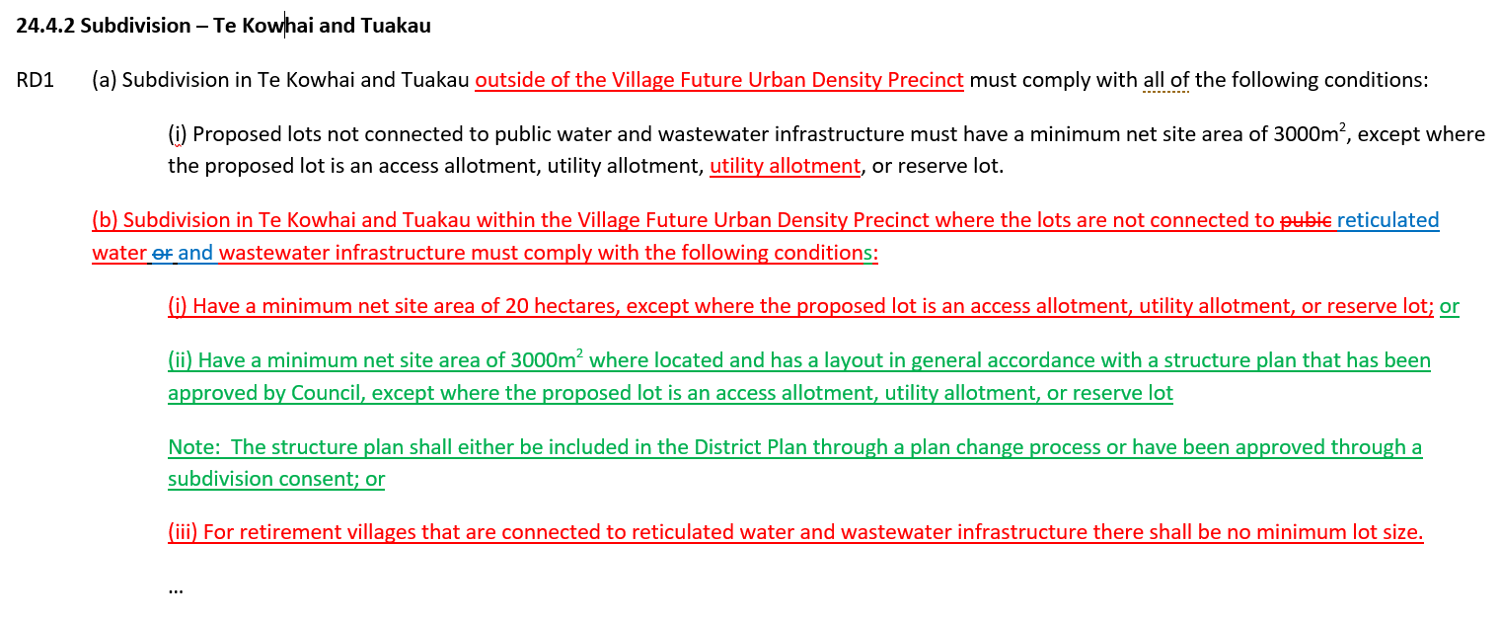
Te Kowhai - Subdivision (cont.)

Slide 5
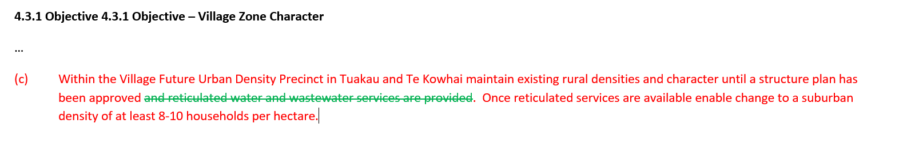
Te Kowhai - Subdivision (cont.)

Slide 6
Public vs Reticulated Services
The submission from Mr. Metcalfe requested that minimum lot sizes and building coverage be linked to the provision of “reticulated” water and wastewater infrastructure. This differs from what was notified which refers to provision of “public” water and wastewater infrastructure.
The reason for seeking this change is to not foreclose stand-alone engineering solutions capable of providing reticulated services to discrete blocks of land.

Slide 7
Public vs Reticulated Services (cont.)
The rebuttal evidence from Mr. Clease in respect of minimum lot size accepts that the reference to “public” infrastructure should be amended to “reticulated” infrastructure. In doing so this aligns with the proposed policy framework which also refers simply to “reticulation”.
The rebuttal evidence from Mr. Cattermole in respect of building coverage recommends consistency with what ever is decided for minimum lot size in relation to Mr Clease’s evidence.
Mr. Metcalfe supports these recommendations.

Slide 8
Retirement Villages
Retirement Villages were not specifically provided for in the Village Zone and therefore would default to a non-complying activity.
The submission from Mr. Metcalfe requested a permitted activity status which had been rejected by the S42A report.
The rebuttal evidence from Mr. Cattermole has now recommended a restricted discretionary activity for retirement villages in Tuakau, Pokeno and Te Kowhai, and has proposed two new policies (4.3.16 & 4.3.17) to support that.
This recommendation is supported by Mr. Metcalfe, although it is suggested:
the policy refers specifically to Tuakau, Pokeno and Te Kowhai; and
reference to public services is replaced with reticulated services.

Slide 9
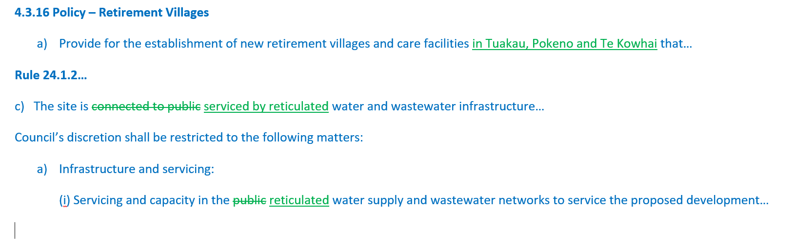
Retirement Villages (cont.)

Slide 10
Real Estate Signs
The submission from Mr. Metcalfe sought amendments to Rule 24.2.7.1 P3 to enable a better framework for managing real estate signs as a permitted activity in the Village Zone.
The recommendation in the s42A is an improvement on what was notified, but some further refinements are suggested including:
Remove the requirement for the sign to relate to the site on which it is located (e.g. property down a ROW, low volume road etc.)
Limit the number of signs to one per agency per road frontage
Allow signs to be up to 2.16m² (largest sign typically used for auction/tender sales)

Slide 11
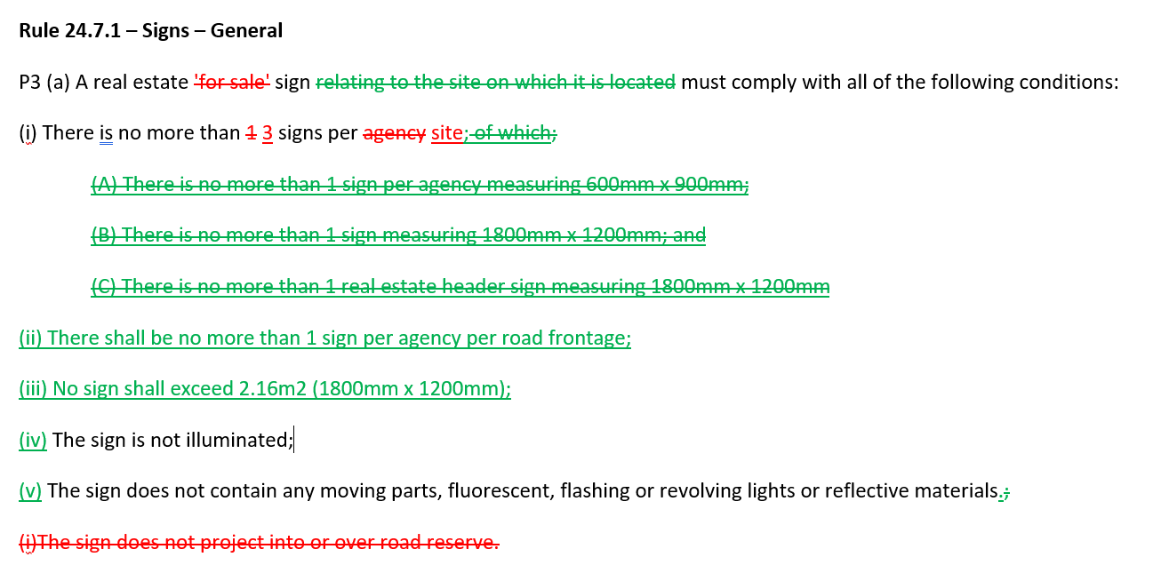
Real Estate Signs (cont.)

